Slide 1
Principles of Multimedia Learning

Slide 2
Mayer’s Principle of Multimedia Learning
Coherence Principle
Signaling Principle
Redundancy Principle
Spatial Contiguity Principle
Temporal Contiguity Principle
Segmenting Principle
Pre-training Principle
Modality Principle
Multimedia Principle
Personalization Principle
Voice Principle
Image Principle
Notes:
Richard E. Mayer (born 1947) is an American educational psychologist who has made significant contributions to theories of cognition and learning, especially as they relate to problem solving and the design of educational multimedia.
Mayer's best known contribution to the field of educational psychology is multimedia learning theory, which posits that optimal learning occurs when visual and verbal materials are presented together simultaneously.

Slide 3
Coherence Principle
Take away:
If something doesn’t add to the learning, it distracts from it
Keep it simple
Examples:
Talking head
Decorative pictures
Fancy backgrounds
Background music
Notes:
People learn better when extraneous words, pictures and sounds are excluded rather than included.

Slide 4
Signaling Principle
Take away:
Provide cues to highlight essential information
Examples:
Bold key words
Use arrows, circles, etc.
Use lists
Provide learning organizers (e.g. Module overview)
Notes:
People learn better when cues that highlight the organization of the essential material are added.

Slide 5
Redundancy Principle
Take away:
Avoid narrating text that is on-screen
Examples:
- Use text and images that support learning rather than duplicating the lecture
Notes:
People learn better from graphics and narration than from graphics, narration and on-screen text.

Slide 6
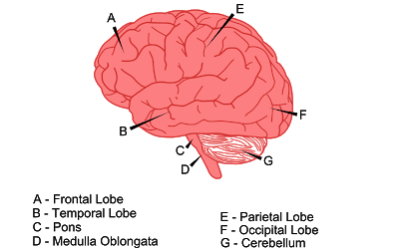
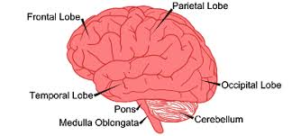
Contiguity Principles
Spatial Contiguity
Temporal Contiguity
Integrate labels with diagrams
Display labels and diagrams at the same time
“Contiguity Principle“ is property of Northern State University. Copyright.
Notes:
Spatial Contiguity Principle – People learn better when corresponding words and pictures are presented near rather than far from each other on the page or screen.
Temporal Contiguity Principle – People learn better when corresponding words and pictures are presented simultaneously rather than successively.

Slide 7
Segmenting Principle
Take away:
Enable greater learner control
Examples:
Provide information in small chunks
Enable learners to stop, pause, replay, rewind, etc.
Computer are omni-patient
Notes:
People learn better from a multimedia lesson is presented in user-paced segments rather than as a continuous unit.

Slide 8
Pre-training Principle
Take away:
Examples:
Diagnostic assessments w/ feedback
Module overviews
Glossary of Terms
Topic Introductions
Notes:
People learn better from a multimedia lesson when they know the names and characteristics of the main concepts.

Slide 9




Modality Principle
Graphics & Narration
Animation & Text
“Microphone" by OpenClipart-Vectors is licensed under CC by 1.0
“Text" by FastText.org is licensed under CC by 1.0
“Graph" by ShareIcon.net is licensed under CC by 1.0
“Runner" by Manuel Strehl is licensed under CC by 1.0
Notes:
People learn better from graphics and narrations than from animation and on-screen text.
https://piktochart.com/
https://www.canva.com/
https://venngage.com/
https://www.easel.ly/
https://www.visme.co/

Slide 10
Multimedia Principle
Words & Pictures
Words Only
“Graph" by ShareIcon.net is licensed under CC by 1.0
“Text" by FastText.org is licensed under CC by 1.0
Notes:
People learn better from words and pictures than from words alone.

Slide 11

Personalization Principle
“Let’s Talk" by Ron Mader is licensed under CC by 2.0
Notes:
People learn better from multimedia lessons when words are in conversational style rather than formal style

Slide 12

Voice Principle
Humans = Good
Robots = Bad
“Robot" by Freepik is licensed under CC by 3.0
Notes:
People learn better when the narration in multimedia lessons is spoken in a friendly human voice rather than a machine voice.
Robot - https://commons.wikimedia.org/wiki/File:Robot.svg

Slide 13

Image Principle
See Coherence Principle
“Lecture" by nist6dh is licensed under CC by 2.0
Notes:
People do not necessarily learn better from a multimedia lesson when the speaker’s image is added to the screen.

Slide 14
References
Clark, R. C., & Mayer, R. E. (2003). e-Learning and the science of instruction. San Francisco, CA: Pfieffer
Mayer, R. E. (2008). Research-based principles for learning with animation. In R. Lower & W. Schnotz (Eds.), Learning with animations: Research and implications for design. (pp. 30-48). New York, NY: Cambridge University Press.
Walsh, K. (2017, June 20). Mayer’s 12 Principles of Multimedia Learning are a Powerful Design Resource [Blog Post]. Retrieved from https://www.emergingedtech.com/2017/06/mayers-12-principles-of-multimedia-learning-are-a-powerful-design-resource/

