Slide 1
Foundations of UDL
Resource Package
Darla Benton Kearney
Teaching & Learning Consultant – UDL
Centre for Teaching & Learning

Slide 2
Why UDL?
Universal Design for Learning (UDL) is a curriculum design, development, and delivery framework used to create inclusive, equitable and accessible learning environments.
Mohawk College is committed to UDL implementation to support our Equity, Diversity and Inclusion (EDI) targets and institutional accessibility goals.

Slide 3
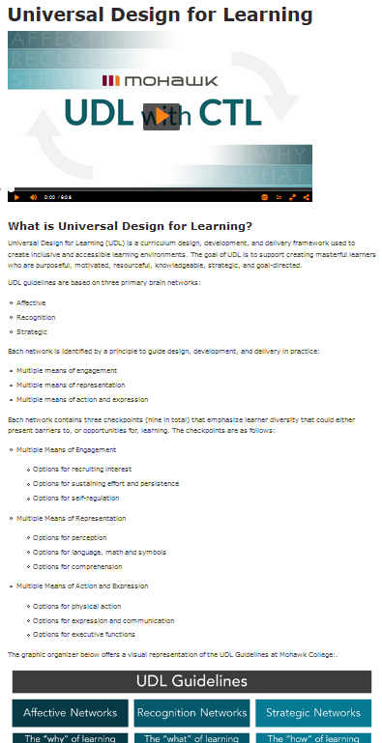
Purpose
The information in this resource package will:
  Provide you with foundational UDL information for a higher education context.
  Offer you examples of UDL at Mohawk College.
  Provide you with resources to learn more about UDL when are able.

Slide 4
Overview of UDL

Slide 5
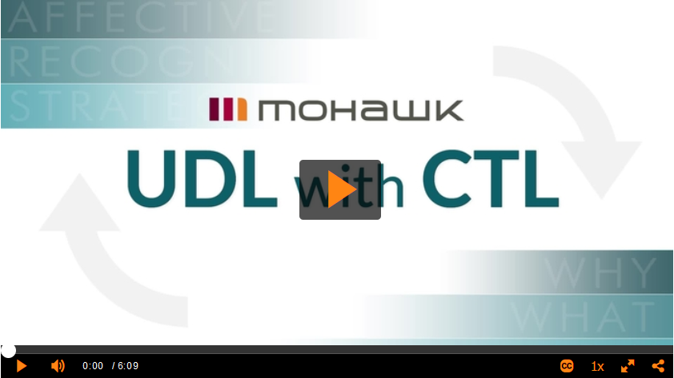
UDL with CTL
The UDL with CTL video can be found on Mohawk College’s UDL landing page.
Using the link provided, watch the video to learn about the UDL Guidelines and how they apply at Mohawk College [6:09].

Slide 6
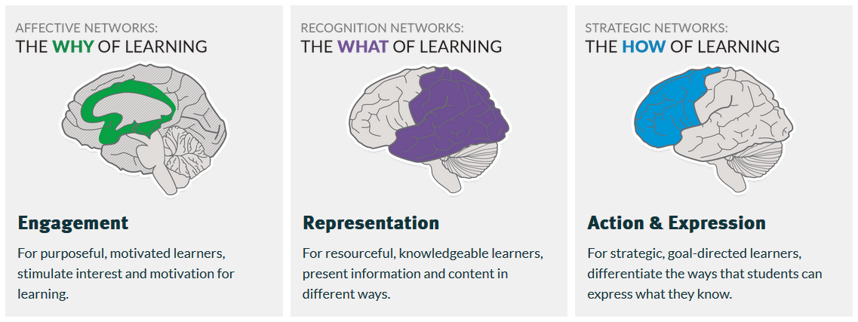
Overview of UDL | Goal
The goal of UDL is to develop masterful learners who are purposeful, motivated, resourceful, knowledgeable, strategic, and goal-directed.
  Each network is focused on supporting the development of expert learning.
The next slides offer a text explanation of the UDL Guidelines, as well as a graphic of the UDL Guidelines used at Mohawk College.

Slide 7
Overview of UDL | Guidelines
UDL guidelines are based on three primary brain networks:
  Affective
  Recognition
  Strategic
Each network is identified by a principle to guide curriculum design, development, and delivery:
  Multiple means of engagement – the “why” of learning
  Multiple means of representation – the “what” of learning
  Multiple means of action and expression – the “how” of learning

Slide 8
Overview of UDL | Guidelines
Multiple means of engagement
  Options for self-regulation
  Options for sustaining effort and persistence
  Options for recruiting interest
Multiple means of representation
  Options for comprehension
  Options for language, math and symbols
  Options for perception
Multiple means of action and expression
  Options for executive functions
  Options for expression and communication
  Options for physical action
Each network is supported by checkpoints to encourage the development of teaching and learning options.

Slide 9
UDL Guidelines
Affective Networks
The “why” of learning
Strategic Networks
The “how” of learning
Recognition Networks
The “what” of learning
Multiple Means of Engagement
Multiple Means of Representation
Multiple Means of Action and Expression
Provide options for recruiting interest
Provide options for sustaining effort and persistence
Provide options for self regulation
Provide options for perception
Provide options for language and symbols
Provide options for comprehend-sion
Provide options for physical action
Provide options for expression and communica-tion
Provide options for executive functions

Slide 10
UDL at Mohawk College

Slide 11
UDL in Action
If UDL is new to you, it can be difficult to visualize what it might look like in your context. The following slide provides a number of practical examples of UDL in higher education.
When thinking about UDL, please keep in mind that adding UDL to your curriculum does not need to be a massive undertaking or involve time consuming elements.
  For implementation ideas, review Mohawk College’s UDL Implementation webpage.

Slide 12
UDL Examples
Multiple Means of Engagement
Explicitly state learning goals and/or expectations.
Provide note taking support.
Give opportunities to collaborate.
Offer opportunities for reflection.
Multiple Means of Representation
Provide content in multiple ways.
Employ interactive learning activities.
Use multimedia resources to deliver content.
Link new information to previously learned content or experiences.
Multiple Means of Action and Expression
Develop an agenda or learning plan and follow it.
Provide access to resources to deepen learning.
Include a variety of communication options.
Offer opportunities to review content or practice skills.

Slide 13
UDL at Mohawk College
Mohawk College has many excellent UDL implementers. To learn more about how your colleagues are leveraging UDL to improve their teaching and learning, review these short videos.
  UDL at Mohawk College – Lisa Pender [2:54]
  UDL at Mohawk College – Ryan Iles [2:56]
  UDL at Mohawk College – Melodie Spencer [3:19]
  UDL at Mohawk College – Peggy Daniel [3:03]
  UDL at Mohawk College – Tara Dinyer [3:13]

Slide 14
Next Steps

Slide 15
Next Steps | Reflection
Reflect
How are you already implementing UDL in your curriculum?
What elements of your course(s) are not going as well as you would like? Could UDL help improve those aspects of your curriculum?
What barriers do you anticipate with your UDL implementation?

Slide 16
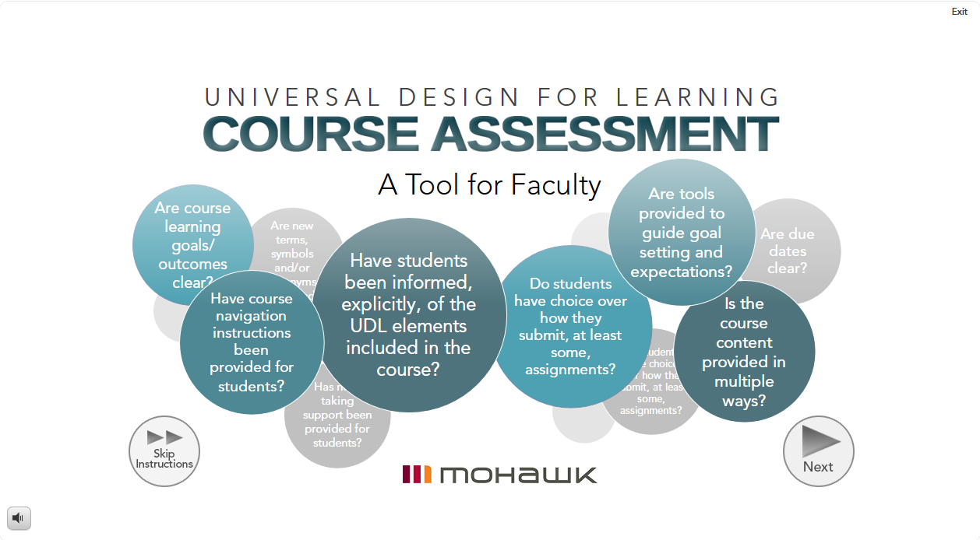
Next Steps | UDL Course Assessment
Now that you have foundational UDL information, complete Mohawk College’s UDL Course Assessment.
The UDL Course Assessment is a tool for educators that will:
  Show you what UDL elements you have already included in your curriculum.
  Give you ideas and targeted resources to implement other aspects of UDL that work well in higher education learning environments.

Slide 17

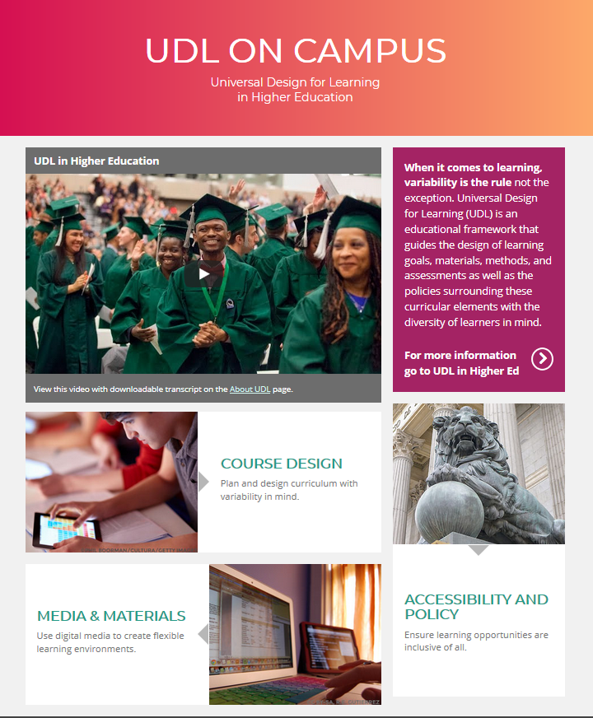
Next Steps | Resources
The following websites have a variety of higher education focused resources to support your UDL implementation journey:
  CAST – About Universal Design for Learning webpage
  UDL on Campus - UDL in Higher Ed
  Mohawk College - UDL webpages
You are also welcome to connect with Darla Benton Kearney, Teaching & Learning Consultant – UDL at darla.benton@mohawkcollege.ca or extension 3688.

Slide 18
References
Learning Designed. (2022). CAST logo. [Image]. Retrieved June 16, 2022 from https://www.learningdesigned.org/about
Meyer, A., Rose, D. H., and Gordon, D. (2014). Universal design for learning: Theory and practice. CAST Professional Publishing. Wakefield, MA.
Mohawk College. (2021). UDL Guidelines. [Image]. Retrieved April 14, 2022 from https://www.mohawkcollege.ca/employees/centre-for-teaching-learning/universal-design-for-learning
Ohio University Instructional Innovation. (2022). What is UDL? [Image]. Retrieved April 19, 2022 from https://www.ohio.edu/instructional-innovation/stories/showcase/universal-design-learning
UDL on Campus. (n.d.). UDL on Campus homepage. [Image]. Retrieved April 13, 2022 from http://udloncampus.cast.org/home
UDL with CTL. (2020), November). Mohawk College. [Video]. Retrieved April 20, 2022 from https://www.mohawkcollege.ca/employees/centre-for-teaching-learning/universal-design-for-learning
Universal Design for Learning. (2021). Mohawk College. [Image]. Retrieved April 14, 2022 from http://www.mohawkcollege.ca/employees/centre-for-teaching-learning/universal-design-for-learning

