Slide 1
UDL Intro Package
Fall 2019
Darla Benton Kearney, MA
Universal Design for Learning Curriculum Consultant
Centre for Teaching & Learning

Slide 2
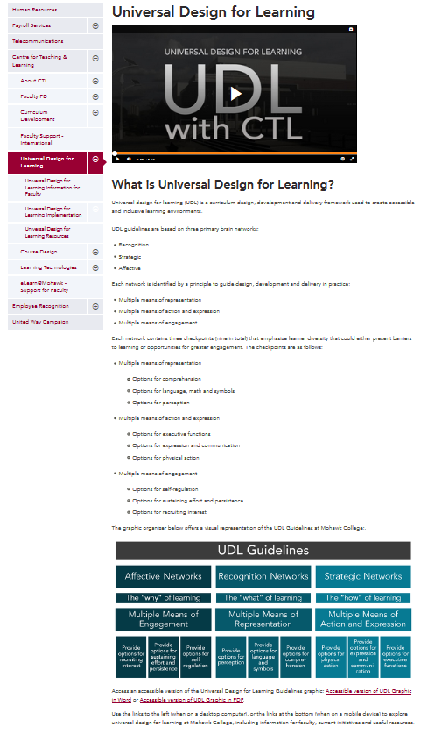
Purpose
The information here will:
  Give you a brief overview of Universal Design for Learning (UDL).
  Offer recommendations to watch, review, and do to learn more about UDL.

Slide 3
Overview of UDL

Slide 4
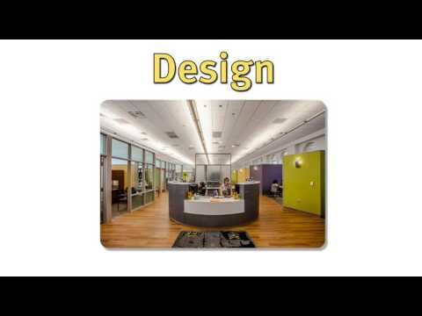
Overview of UDL
UDL at a Glance offers an overview of UDL in higher education.

Slide 5
Overview of UDL | Guidelines
UDL guidelines are based on three primary brain networks:
  Affective
  Recognition
  Strategic
Each network is identified by a principle to guide curriculum design, development, and delivery:
  Multiple means of engagement
  Multiple means of representation
  Multiple means of action and expression

Slide 6
Overview of UDL | Guidelines
Multiple means of engagement
  Options for self-regulation
  Options for sustaining effort and persistence
  Options for recruiting interest
Multiple means of representation
  Options for comprehension
  Options for language, math and symbols
  Options for perception
Multiple means of action and expression
  Options for executive functions
  Options for expression and communication
  Options for physical action
Each network contains checkpoints to support the development of options for learners.

Slide 8
Recommendations to
Watch, Review, and Do

Slide 9
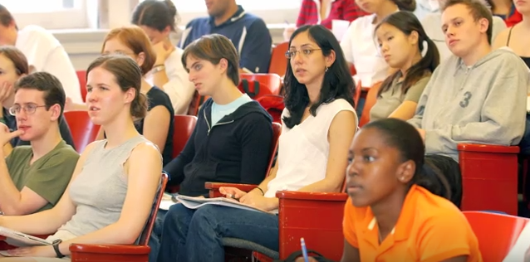

To Watch
UDL in Higher Education
  UDL on Campus
Getting Started with UDL
  UDL on Campus
Innovation at the Margins
  UDL on Campus
The Myth of Average
  Todd Rose at TEDx Sonoma County
UDL with CTL
  Mohawk College

Slide 10
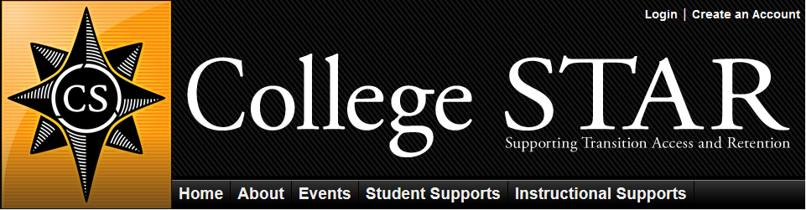
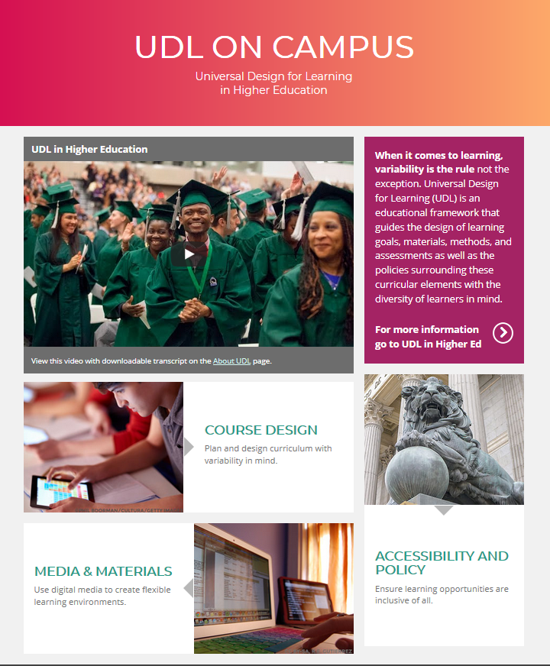
To Review
UDL on Campus
  UDL in Higher Ed
College STAR
  Instructional Supports webpages
Mohawk College UDL webpages
  Information for Faculty
  Implementation
  Resources

Slide 11
To Do
Familiarize yourself with UDL using the resources provided here.
Review your learning plans, course materials and learning activities to determine where and/or when you can apply UDL.
Bring your UDL questions to Darla Benton Kearney:
  darla.benton@mohawkcollege.ca
  905-575-1212 extension 3688

Slide 12
References
College STAR. (2016, December 13). UDL at a Glance [Video]. Retrieved from https://www.youtube.com/watch?v=YhuvG0iwiao
College STAR. (n.d.). Webpage banner [Image]. Retrieved from https://www.collegestar.org/universal-design-for-learning
Meyer, A., Rose, D. H., and Gordon, D. (2014). Universal design for learning: Theory and practice. CAST Professional Publishing.
Wakefield, MA.
Mohawk College. (2016). Universal Design for Learning webpage [Image]. Retrieved from
http://www.mohawkcollege.ca/employees/centre-for-teaching-learning/universal-design-for-learning
UDL on Campus. (2015, October 6). Innovation at the Margins video [Image]. Retrieved from
https://www.youtube.com/watch?v=4yUYQgcWGGA
UDL on Campus. (n.d.). UDL on Campus webpage [Image]. Retrieved from http://udloncampus.cast.org/home
UDL on Campus. (2016, December 13). UDL in Higher Education video [Image]. Retrieved from
http://udloncampus.cast.org/page/udl_about#.WFAIn31SHAE

