Slide 1
Encryption

Slide 2
Learning Outcomes for this Module
Gain an understanding of what encryption is.
Know the difference of symmetric and asymmetric encryption methods.
What is used to protect data stored long-term.
The importance of encryption on the Internet.
Best practices for protecting your data.

Slide 3
Introduction

Slide 4
What is Encryption?
Cryptography is a practice of secure communication between technologies.
Encryption is the scrambling of data, referred to as plain text, into an unreadable format as a form
of cryptography.
The data remains protected in this way until it is delivered to its intended recipient with a security key.
  With the security key the data translates back into its original state through decryption.

Slide 5
Why Do We Need Encryption?
We encrypt our data to protect it.
Data either stored on a system or sent through a network, the information remains private.
Privacy on the Internet is incredibly important.
Many organizations, such as hospitals, need to store personal information of people and are required to protect any sensitive information.

Slide 6
Why Do We Need Encryption? (cont.)
As computer technologies advance, so do the needs of encryption methods.
Cybercriminals such as hackers are a very real threat. They are more than just individuals attempting to breach data and steal information.
Even if an unauthorized person gains access to confidential data, if it is encrypted, they will not be able to read it.

Slide 7
Ask Yourself
Does my school or work require me to access or share information online?
Have I ever shopped online?
Do I bank online?
Have I chatted with friends through an online messaging service?
These are all reasons encryption is incredibly important in our digital age

Slide 8
Symmetric Encryption
A fast encryption method.
Symmetric encryption uses a single private key which both encrypts and decrypts the data.
Wi-Fi networks use symmetric encryption such as AES (Advanced Encryption Standard).
Symmetric encryption is more susceptible to cyberattacks due to the shared key between sender and receiver.

Slide 9
AES (Advance Encryption Standard)
A block cipher is a deterministic algorithm that is made of a fixed-length group of bits using a symmetric key.
They are elementary components in many cryptographic protocols.
It is one of the most common forms of cryptography used in the world.
Most home networks use AES encryption through WPA2 security.
AES is a type of block cipher encryption.
AES is a method of symmetric encryption, so both the sender and receiver both use the same key.
Encrypts in blocks of 128-bit, 192-bit, or 256-bit.

Slide 10
Asymmetric Encryption
Requires the use of two encryption keys: Private
and Public.
The data is encrypted using the public key.
The public key is meant to be shared with anyone who should have access to a network.

Slide 11
Asymmetric Encryption (cont.)
The private key is required to decrypt the data. It is never meant to be shared.
The private key should be stored where only authorized individuals can access it.
  Preferably on different hardware not always connected to your device.

Slide 12
128-bit vs. 256-bit Encryption (1 of 3)
These are the two most used key blocks for encryption on the Internet.
  AES has a key length minimum of 128-bits and maximum of 256-bits.
Older forms of encryption are continuously being broken by hackers and rendered vulnerable.
256-bit encryption has a significantly higher level of protection compared to 128-bit encryption.

Slide 13
128-bit vs. 256-bit Encryption (2 of 3)
128-bit encryption means there are a possible 2¹²⁸ possible key combinations to attempt to break
the encryption.
256-bit encryption offers 2²⁵⁶ possible combinations.
Think about how the number One Million (1,000,000) is 7-characters long:
  2¹²⁸ equals a value that is 39-characters long.
  2²⁵⁶ equals a value that is 78-characters long.

Slide 14
128-bit vs. 256-bit Encryption (3 of 3)
While 256-bit encryption may require more processing power, it is remains significantly stronger than 128-bit encryption.
User databases, cloud services, and any website that involves financial data such as credit cards should be using 256-bit encryption.

Slide 15
Encryption Data At Rest
Data that is encrypted and stored (at rest) remains secure. A private security key is required to unlock (decrypt) the data.
An attacker’s efforts to access at rest data often involve attempting to gain physical access to a drive, such as through theft.
The data is encrypted on the disk, which is designed to prevent the attacker from gaining access even if they place it in their own machine.

Slide 16
Encryption Data At Rest (continued)
Using at rest encryption in addition to other security measures is valuable in creating an overlap of protection.
So, if one layer fails, the data is still protected by the others.
If the data is encrypted and no encryption keys are provided, the attacker is stuck fighting the encryption in any attempt to access the data.
At rest encryption is highly recommended, and often required, for many organizations.
Some organizations are required to have at rest encryption to comply with certain industry regulations and their nation’s privacy laws.

Slide 17
Encryption Data In Transit
The data that is encrypted is protected during communication between the sender and receiver.
Data is encrypted prior to being sent, authenticating the receiver, and then decrypting upon arrival.
Browsing the Internet with HTTPS is a basic example of encryption in transit, using Transport Layer Security (TLS).

Slide 18
Encryption for Data In Use
Data that is encrypted and is currently being used on servers still need to be protected.
Cloud based applications such as online file sharing in Microsoft Excel is an example of data in use.
The use of identity management tools (user accounts) and role-based controls (administrator, engineer, associate, etc.) is crucial to regulate who has access to the data.

Slide 19
Internet and Encryption

Slide 20
Internet Browser Security
All website addresses are preceded by HTTP or HTTPS.
HTTPS stands for HyperText Transfer Protocol Secure.
The “S” in HTTPS represents the website is secure.
Websites that require a sign-in or you can make a purchase from should all be using HTTPS.
HTTPS encrypts data using either TLS (Transport Layer Security) or the depreciated SSL (Secure Sockets Layer).

Slide 21
Internet Browser Security (cont.)
TLS is a newer and more secure encryption method than SSL and is what most HTTPS sites use.
TLS makes sure both parties connecting to each other are who they say they are.
This encryption ensures that data sent and received is not tampered with.
HTTPS does not prohibit your ISP (Internet Service Provider) from knowing your browsing habits.

Slide 22
Internet Browser Security Certificate
All websites should have a security certificate issued to them.
On your browser’s address bar, there may be an icon of a lock. This can be used to view the certificate.
The security certificate exists to verify that the website is who they say they are.

Slide 23
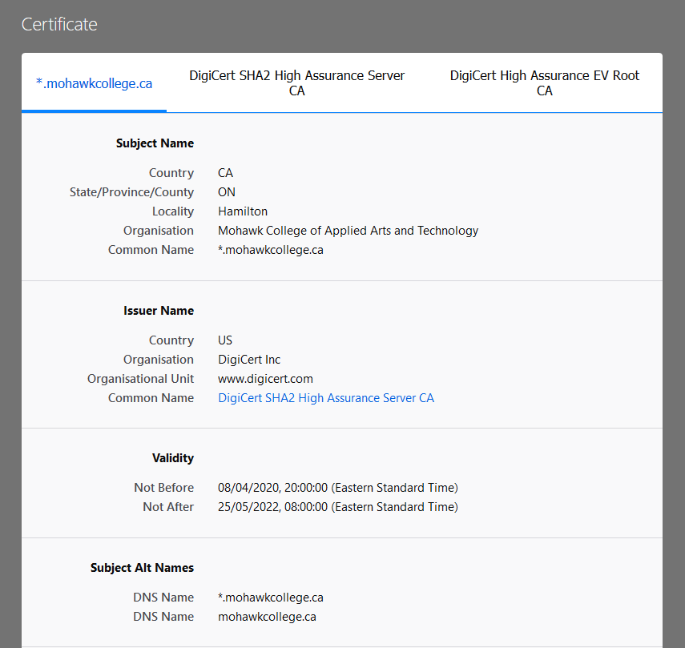
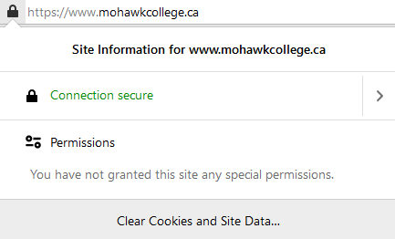
Internet Browser Security Certificate Examples
By clicking on the lock icon, you can view the security certificate of a website to verify it.

Slide 24
Encrypting Emails
PGP encryption has been cracked in the past, so it is important to research the various options available.
Many email clients use TLS to encrypt emails.
TLS only protects email information while the data is in transit, but not once it has been delivered and
is at rest.
There are free third-party add-ons for encrypting emails, such as browser extensions like FlowCrypt that uses PGP (Pretty Good Protection) to encrypt.
Both sender and receiver need to have the extension.

Slide 25
Encrypting Emails with S/MIME (1 of 2)
S/MIME:
Secure/Multipurpose Internet Mail Extensions.
S/MIME is a widely supported encryption protocol used for protecting emails with enhanced encryption.
Encryption occurs before the email is transmitted using a public key.
A private key is required by the recipient to decrypt the email.
  This allows S/MIME encryption to protect data both at-rest and in-transit.

Slide 26
Encrypting Emails with S/MIME (2 of 2)
Both the sender and receiver must have an email application that supports S/MIME and have it enabled.
  Gmail will display a green lock for emails that are encrypted with S/MIME.
S/MIME encryption is not free and requires digitally signed certificates installed on every device using it in order to be usable.

Slide 27
Wi-Fi Encryption (1 of 4)
The Pre-shared key is essentially your password required to access the network.
Wireless networks require their own security.
Any device operating on the same wireless frequency could potentially access the transmitted information if it is not properly encrypted.
Pre-shared key (PSK) authentication is used to secure and encrypt data shared between an access point and a client.

Slide 28
Wi-Fi Encryption (2 of 4)
Shared key authentication methods have included:
WEP – Wired Equivalent Privacy. An older encryption method involving an unchanging key to protect
the network.
WEP is obsolete, easy to hack, and should not
be used.

Slide 29
Wi-Fi Encryption (3 of 4)
A network packet is a unit of data that consists of control information and user data.
TKIP – Temporal Key Integrity Protocol
WPA – Wi-Fi Protected Access. Built from the foundation. WEP introduced with a much stronger protection algorithm called TKIP. The key changes with each network packet.
WPA2 – Using Advanced Encryption Standard (AES) as its method of encryption.
WPA2 is the current industry standard.

Slide 30
Wi-Fi Encryption (4 of 4)
WPA3 – The latest in Wi-Fi security. It refuses any legacy protocols and requires the use of new encryption methods such as Protected Management Frames (PMF).
Integration of WPA3 is not yet widely available
in devices.
While WPA3 is inherently more secure, WPA, WPA2, and WPA3 have all been cracked, so always be careful no matter which you use.

Slide 31
Home Router Encryption (1 of 3)
WPS ignores the need of a Pre-shared key. It is vulnerable and not recommended.
Most home routers include WEP, WPA, and WPA2 encryption methods.
WEP should never be used despite being an option.
WPA2 is the strongest of the three.
  Has both Personal and Enterprise options.
WPS – Wi-Fi Protected Setup that allows for quickly connecting devices to a network through a “single-button” setup with WPA2 networks.

Slide 32
Home Router Encryption (2 of 3)
WPA2-Enterprise provides additional security by requiring devices attempting to connect to the network to also authenticate on the RADIUS server.
WPA2-Personal, using AES encryption, is the recommended option for home networks. Users are required to know a pre-shared key (password) to access the network.
WPA2-Enterprise can be used for corporate networks. It requires a RADIUS (Remote Authentication Dial-In User Service) server for authentication.

Slide 33
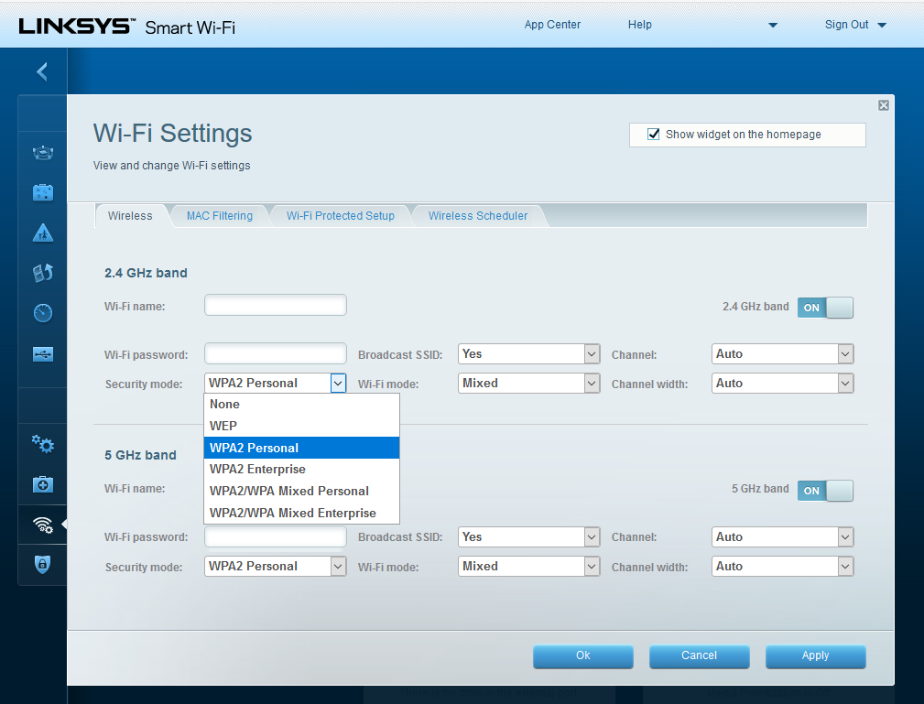
Home Router Encryption (3 of 3)
Example of a personal wireless router’s security settings.

Slide 34
WPA3 Encryption
SAE helps prevent threat actors from being able to guess the Pre-shared key.
Features WPA3-Personal, WPA3-Enterprise, Open Network, and IoT Onboarding.
WPA3-Personal is meant to cover the vulnerabilities
of WPA2-Personal.
WPA3-Personal ensures the Pre-shared key is never exposed by using a method called Simultaneous Authentication of Equals (SAE).

Slide 35
WPA3 Encryption (continued)
WPA3-Enterprise uses the same authentication requirement as WPA2-Enterprise.
  There is also an optional 192-bit encryption for additional security.
Open networks in WPA3 do not require authentication (Pre-shared Key).
An open network in WPA3 still encrypts all wireless traffic using OWE (Opportunistic Wireless Encryption).

Slide 36
WPA3 – IoT Onboarding
Having a hard-coded public key makes IoT Onboarding far more secure than WPS, which does not require a key for authentication.
IoT (Internet of Things) Onboarding is designed to replace WPS (Wi-Fi Protected Setup) utilized with WPA2.
Each device using it has a hard-coded public key.
The key is usually a QR-code that is often stamped on the outside of the device or packaging.
The QR-code can be scanned by a network administrator to connect it to the network.

Slide 37
VPN – Virtual Private Network
Fully encrypts your Internet activity.
  Prevents even your Internet Service Provider from viewing your usage data.
Any website you visit will not be able to see your home Internet address (IP address).
A VPN will encrypt and protect your device on public networks that lack security.
VPNs are strongly encouraged for work related devices.

Slide 38
Cloud Services
Data uploaded to cloud storage must be encrypted to ensure it is not readable or tampered with.
Reliable cloud services use at least AES 256-bit encryption.
The client should have full control over their
decryption key.
Should be in Canada to ensure your privacy is protected beyond the encryption.

Slide 39
Cloud Services (continued)
HMS are designed with controls such as tamper response, which will destroy all data stored within if it detects unauthorized attempts to access the keys.
Ideally a private key should be stored on separate hardware, such as a Hardware Security Module (HMS).
Cloud services should offer clients the ability to either:
  Manage the HMS on the customer’s behalf.
  Allow the customer to have control of the key(s) over a cloud-based HMS.
The client is responsible for deciding who can use the encryption keys.

Slide 40
Best Practices

Slide 41
Best Practices (1 of 3)
Never insert a USB drive of unknown origin into a computer.
Avoid clicking any suspicious links in emails or through websites.
Verify the website you are visiting is secure before giving any personal information.
Ensure only relevant individuals have access to a
Pre-shared key.

Slide 42
Best Practices (2 of 3)
Set user controls for what information each role
can access.
Have policies in place and follow any policies regarding encryption and key sharing.
Only use a secure workstation when managing accounts, tasks, and data.
Use encryption to help reduce the risks of unauthorized access.

Slide 43
Best Practices (3 of 3)
Be aware of what encryption methods will be applied to data that is stored in a cloud environment.
Use a VPN when connected to a public hotspot.
Disable WPS on a WPA2 enabled network.

Slide 44
Examples of Cybercrimes
Brute-force Attacks and Ransomware

Slide 45
Brute-force Attacks
A cybercrime in which an attacker repeatedly submits many passwords to a login in hopes of eventually getting access.
These repeated attempts are essentially using brute-force to gain access to accounts.
A brute-force attack calculates every possible combination that could make up a password.

Slide 46
Encryption and Brute-force Attacks
Longer passwords make brute force attacks significantly more difficult to crack.
A password should have no less than eight characters at minimum.
Both the complexity of a password and the encryption used can make an attack take from seconds to years.
At a higher level, a brute-force attempt against an AES 256-bit key (such as WPA2-Personal) could take trillions upon trillions of years.

Slide 47
Ransomware
The ransom should not be paid, as there is never a guarantee the criminal will deliver the decryption key.
Ransomware is a cybercrime that uses encryption as a weapon.
Individuals and full organizations have been targets of ransomware attacks.
The victim’s devices become encrypted and unusable.
A ransom is usually demanded by the attackers before they will provide a key to decrypt the devices and data.

Slide 48
Story
City of Baltimore Ransomware

Slide 49
Story – City of Baltimore Ransomware
(1 of 2)
In 2019 the city of Baltimore, Maryland, fell victim to a ransomware attack.
Various city servers across multiple offices were infected.
A Twitter account was used by the threat actor as a method of communicating their demands with the
city officials.

Slide 50
Story – City of Baltimore Ransomware
(2 of 2)
The demands made to the city was for bitcoin, equaling approximately $72,000 USD at the time. The city refused to pay the ransom.
The estimated costs of damages and legal fees to fix the problems caused by the ransomware cost the city approximately $18.2 million USD.
This attack made for a demonstration to many other cities of the high costs of a data breach.

Slide 51
Conclusions

Slide 52
In Conclusion (1 of 5)
Encryption is necessary for protecting important data and information.
Encryption scrambles data to an unreadable format.
It is a crucial tool in preventing unauthorized individuals from accessing private information.
As computers evolve, so does our need to improve our data protection methods.

Slide 53
In Conclusion (2 of 5)
Symmetric and Asymmetric are the two methods of encrypting data.
128-bit and 256-bit are the two most used key blocks for AES (Advance Encryption Standard), with 256-bit providing higher security.
At rest encryption is essential for protecting data that is in long term storage.

Slide 54
In Conclusion (3 of 5)
In transit encryption exists for data that is actively being sent and received, such as through email or browsing the Internet.
Cloud based applications are encrypted and considered data in use.
Websites with login authentication need a
security certificate to verify their identity and be considered secure.

Slide 55
In Conclusion (4 of 5)
Most websites are encrypted by Transport Layer Security (TLS), which is used by HTTPS.
A secure website does not prevent your Internet Service Provider from viewing your browsing habits.
Wi-Fi networks generally use a symmetric Pre-Shared Key (PSK) for encrypting connections.
There are different levels of encryption for personal and enterprise needs.

Slide 56
In Conclusion (5 of 5)
A Pre-shared key is meant to only be shared with necessary individuals.
A private key is never meant to be shared, and
stored safely.
Use a VPN when connecting to a public hotspot.
A VPN will protect your network and browsing data.
A reliable cloud storage solution should use 256-bit encryption.

Slide 57

Canadian Internet Registration Authority (CIRA)
These modules were made possible by the contributions of CIRA and their Community Investment Program.

Slide 58
References (1 of 6)
Johansen, Alison. "What is encryption and how does it protect your data?" Norton, July 2020, us.norton.com/internetsecurity-privacy-what-is-encryption.html. Accessed 28 Jan. 2021.
"Azure Data Encryption at rest." Microsoft, Aug. 2020, docs.microsoft.com/en-us/azure/security/fundamentals/encryption-atrest. Accessed 28 Jan. 2021.
"Azure data security and encryption best practices." Microsoft, Mar. 2020, docs.microsoft.com/en-us/azure/security/fundamentals/data-encryption-best-practices. Accessed 28 Jan. 2021.

Slide 59
References (2 of 6)
Carnes, Beau. "What is HTTPS? A Guide to Secure Web Browsing and Browser Encryption." freeCodeCamp, Nov. 2019, www.freecodecamp.org/news/what-is-https-a-guide-to-secure-web-browsing-and-browser-encryption/. Accessed 28 Jan. 2021.
Johnson, Allan. "Wireless Concepts." Cisco Press, Mar. 2020, www.ciscopress.com/articles/article.asp?p=2999384&seqNum=6. Accessed 28 Jan. 2021.
"How long would it take to brute force AES-256?" Scrambox, Oct. 2016, scrambox.com/article/brute-force-aes/. Accessed 28 Jan. 2021.

Slide 60
References (3 of 6)
"What is Asymmetric Encryption? Understand with Simple Examples." Savvy Security, Jan. 2021, cheapsslsecurity.com/blog/what-is-asymmetric-encryption-understand-with-simple-examples/. Accessed 28 Jan. 2021.
"128-Bit SSL Encryption Vs 256-Bit SSL Encryption – What is The Difference?" ClickSSL, Jan. 2021, www.clickssl.net/blog/128-bit-ssl-encryption-vs-256-bit-ssl-encryption. Accessed 28 Jan. 2021.
Mayes, Michael. "Top 10 Ransomware Stories of 2019." CPO Magazine, Dec. 2019, www.cpomagazine.com/cyber-security/top-10-ransomware-stories-of-2019/. Accessed 28 Jan. 2021.

Slide 61
References (4 of 6)
Allan, Michelle. "6 Types of Encryption That You Must Know About." GOODCORE, Oct. 2019, www.goodcore.co.uk/blog/types-of-encryption/. Accessed 28 Jan. 2021.
Geier, Eric. "What is WPA3? And some gotchas to watch out for in this Wi-Fi security upgrade." NETWORKWORLD, Nov. 2018, www.networkworld.com/article/3316567/what-is-wpa3-wi-fi-security-protocol-strengthens-connections.html. Accessed 28 Jan. 2021.

Slide 62
References (5 of 6)
"Protecting the three states of data." sealpath, June 2020, www.sealpath.com/protecting-the-three-states-of-data/. Accessed 28 Jan. 2021.
"What You Need to Know About S/MIME." hashedout, The SSL Store, May 2019, www.thesslstore.com/blog/what-you-need-to-know-about-s-mime/. Accessed 28 Jan. 2021.
"Guidance on Cloud Service Cryptography (ITSP.50.106)." Canadian Centre for Cyber Security, May 2020, www.cyber.gc.ca/en/guidance/guidance-cloud-service-cryptography-itsp50106. Accessed 28 Jan. 2021.

Slide 63
References (6 of 6)
Beer, Ken. "The importance of encryption and how AWS can help." AWS, The SSL Store, June 2020, aws.amazon.com/blogs/security/importance-of-encryption-and-how-aws-can-help/. Accessed 28 Jan. 2021.

