Slide 1
Protecting Files/Folders

Slide 2
Learning Outcomes for this Module
Learn how to place a password on files and folders on both Windows and Mac operating systems.
How to save Word documents with a password.
How to add a password to an existing Word document.
Learn how to remove metadata from a Word document.
Understand how to redact/hide information from both a Word document and a PDF.

Slide 3
Introduction

Slide 4
Protecting and Redacting
Sometimes we need to protect our files and folders we create on our devices.
Windows and Mac devices offer options to place password restrictions on our files.
Some documents need to have information protected within the document themselves.
We use redaction to hide sensitive, confidential, or deleted information in existing documents.

Slide 5
How to Protect Files and Folders
Options to protect files, folders, and redact information.

Slide 6
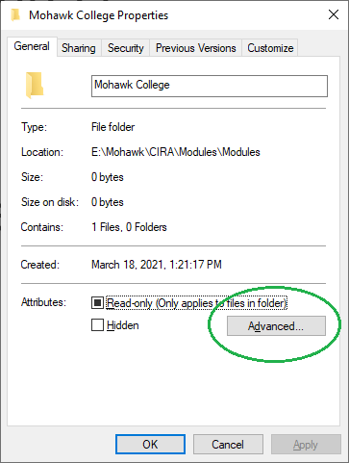
Password Protecting Files and Folders
Windows – (1 of 3)
On Windows 10
Right-click the folder or file you want to protect.
Select Properties
Click the ‘Advanced’ button under the
General tab.

Slide 7
Password Protecting Files and Folders
Windows – (2 of 3)
If the ‘Encrypt contents to secure data’ option is grayed out, you may need to edit your registry settings.
Alternatively, you can use a third-party program to protect your files.
This will open the Advanced Attributes menu.
Under the ‘Compress or Encrypt attributes’
  Check the ‘Encrypt contents to secure data’ box.
Click OK.
Click Apply.
You will be asked to Confirm Attribute Changes to either the folder, or the folder, subfolders, and files inside.

Slide 8
Password Protecting Files and Folders
Windows – (3 of 3)
Press OK.
You will receive a notification to backup your encryption key.
Insert a USB backup into your device and follow the on-screen instructions.

Slide 9
Password Protecting Files and Folders
Mac – (1 of 3)
Open the Applications folder.
Open the ‘Utilities’ folder and click ‘Drive Utility’.
At the top menu click on File.
  Highlight ‘New Image’
  Select ‘Image From Folder…’

Slide 10
Password Protecting Files and Folders
Mac – (2 of 3)
Select the file(s) that you want to protect and
click ‘Choose’.
In the menu that appears, you will see a drop down next to ‘Encryption’. Click the drop down.
Select either:
  128-bit AES encryption (recommended)
  256-bit AES encryption (more secure, but slower).

Slide 11
Password Protecting Files and Folders
Mac – (3 of 3)
You can delete your original unencrypted folder/files after you have finished encrypting.
A window will pop-up asking you to set the password you want.
  You can also have a password generated.
In the drop-down menu beside ‘Image’ select ‘Read/Write’.
Click Save.
This will create a *.dmg file that is encrypted.

Slide 12
Opening a Protected Folder on Mac
Double-click your *.dmg file.
  Enter your password you created.
In your Finder window, under Locations you will see the encrypted folder.
  You can add or remove files from this folder.
Right-click the folder and select ‘Eject’ to close the folder when you are finished. This will lock it again.

Slide 13
Saving a Word Document with a Password (1 of 4)
You can save a Word document with two different passwords.
A read-only password.
A password to edit and save over the document.
If a document has two passwords, anyone who wishes to edit and save over the document will also need the Read-Only Password.

Slide 14
Saving a Word Document with a Password (2 of 4)
Go to File and Save As…
After you name you file, next to the ‘Save’ button, click the ‘Tools’ option to bring up a menu. Select ‘General Options…’
In this menu you can enter one or two passwords, depending on what you want. After you enter the passwords click ‘Okay’.

Slide 15
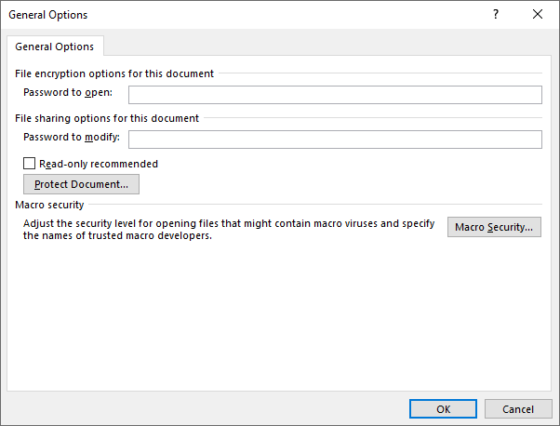
Saving a Word Document with a Password (3 of 4)

Slide 16
Saving a Word Document with a Password (4 of 4)
A dialogue will come up prompting you to re-enter
the password(s)
  This is to ensure you initially entered them correctly.
Save your document.

Slide 17
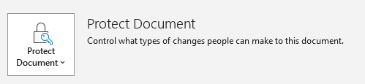
Adding a Password to an Existing Word Document
To add a password to an existing Word document, open your document in Word.
Go to File then Info
Click on Protect Document and select Encrypt with Password.

Slide 18
Adding a Password to an Existing Word Document (continued)
You will be prompted to enter a password twice. Now that password will be required to open the document.
To remove the password, follow the previous steps, and then just delete the password and click OK.

Slide 19
Removing Metadata from Word - 1
Sometimes you may need to remove personal information from a document that is added automatically by Microsoft Word.
Open your document in Word.
Click on File then Info
Click on Inspect Document and then from the drop-down click on Inspect Document.

Slide 20
Removing Metadata from Word - 2
Uncheck everything except Document Properties and Personal Information and click Inspect.
After it scans, click on ‘Remove All’ next to Document Properties and Personal Information.
Close the menu and save your file.

Slide 21
Redacting and Hiding Information in a Word Document (1 of 3)
There is no built-in method to redacting text from a Word document.
You can do a few things that can redact information.
To manually redact information, create a duplicate of your document.
Open your document in Word.
Delete or replace all content that needs to be redacted.

Slide 22
Redacting and Hiding Information in a Word Document (2 of 3)
You can replace information by stating it has been redacted, or replacing the text with characters such as: xxxxx
Rather than typing directly over text you can select the text and copy it.
Open the Find and Replace dialogue (CTRL+G) paste the text into the ‘Find what’ box, and type what you wish to replace it within the ‘Replace with’ box.

Slide 23
Redacting and Hiding Information in a Word Document (3 of 3)
As an image the text will no longer be selectable, and all redacted elements will be hidden. You can convert the image back to a PDF.
Another option that requires third-party tools is to highlight any text you want redacted in black and saving your Word document as a PDF.
Using a third-party tool, many of which are online such as PDF to Image, convert the PDF to an image file (.bmp, .jpg, .png).
  Using a third-party tool may introduce security risks and should only be done with trusted apps.

Slide 24
Redacting Information in a PDF - 1
Adobe Acrobat Pro has built-in redaction tools to hide sensitive information in a PDF.
Open a PDF in Adobe Acrobat DC.
Highlight the parts of the document you want to redact. In the Edit menu select Redact Text & Images.
Alternatively, highlight the portions of the document you want to redact and right-click. Select Redact.

Slide 25
Redacting Information in a PDF - 2
You can mark items by double-clicking individual words or images or selecting a boundary box around an area.
When you are finished selecting items to be redacted, click Apply in the React toolbar.
The Apply Redactions dialog box will come up. You can select Sanitize and Remove Hidden Information to permanently remove the redacted information.
Save your new document.

Slide 26
Conclusions

Slide 27
In Conclusion
Setting up a password for files and folders is relatively easy, and a great way to protect information.
Word documents can have two separate passwords depending the level of access you want to grant.
Documents often contain metadata that is generated by our devices containing some personal information.
There are many options available for redacting information from documents.

Slide 28

Canadian Internet Registration Authority (CIRA)
These modules were made possible by the contributions of CIRA and their Community Investment Program.

Slide 29
References
McCamy, Laura. "How to password protect any folder on a Mac computer to keep your files private." Business Insider, 5 July 2019, www.businessinsider.com/how-to-password-protect-a-folder-on-mac. Accessed Mar. 2021.
Weir, Melanie. "How to password protect a folder on a Windows PC and safeguard your files." Business Insider, 25 Aug. 2020, www.businessinsider.com/how-to-password-protect-a-folder. Accessed Mar. 2021.

