Slide 1
Mobile Security

Slide 2
Learning Outcomes for this Module
Understanding what Mobile Security is.
Properly locking and protecting your device.
How to be secure your mobile device while sharing its portable Wi-Fi hotspot.
Being secure while using Bluetooth or Airdrop.
The importance of antivirus for mobile devices.

Slide 3
Learning Outcomes for this Module (continued)
Identifying a fake website versus a real website.
How to check embedded links on your mobile device.
Learning of NFC (Near Field Communications) and its potential dangers.
Knowing how to be safe on public Wi-Fi.
Understanding what two-step authentication is.

Slide 4
Introduction

Slide 5
What is Mobile Security?
Mobile security is the practice of properly protecting our portable devices.
Smartphones, tablets, and other devices, are all at risk if they are not protected.
Unsecured networks such as cellular data and public hotspots leave mobile devices vulnerable to hacks and malware.

Slide 6
Why do we Need Mobile Security?
Mobile devices have become integrated into our everyday lives.
Devices that lack security are at risk of being manipulated by outside sources.
Our devices often contain personal information worth more than our devices and must be protected.
Identity theft and financial loss are among the very real threats.

Slide 7
Consider This
Do you have a smartphone? How often do you use it? Could function without it?
Your smartphone likely has your contacts, your texts, and photos all saved on it.
If your device were lost or stolen, how much of your personal information could be taken?
If you accidentally install spyware on your phone, all this data could still be stolen.

Slide 8
Mobile Device Features
Securely using the features of your devices

Slide 9
Device Lock (1 of 2)
Portable devices, such as smartphones and tablets, all feature lock screen functionality.
Devices can be unlocked through various settings including:
Passwords and PINs
Fingerprint scan
Retinal scan
Other biometric options

Slide 10
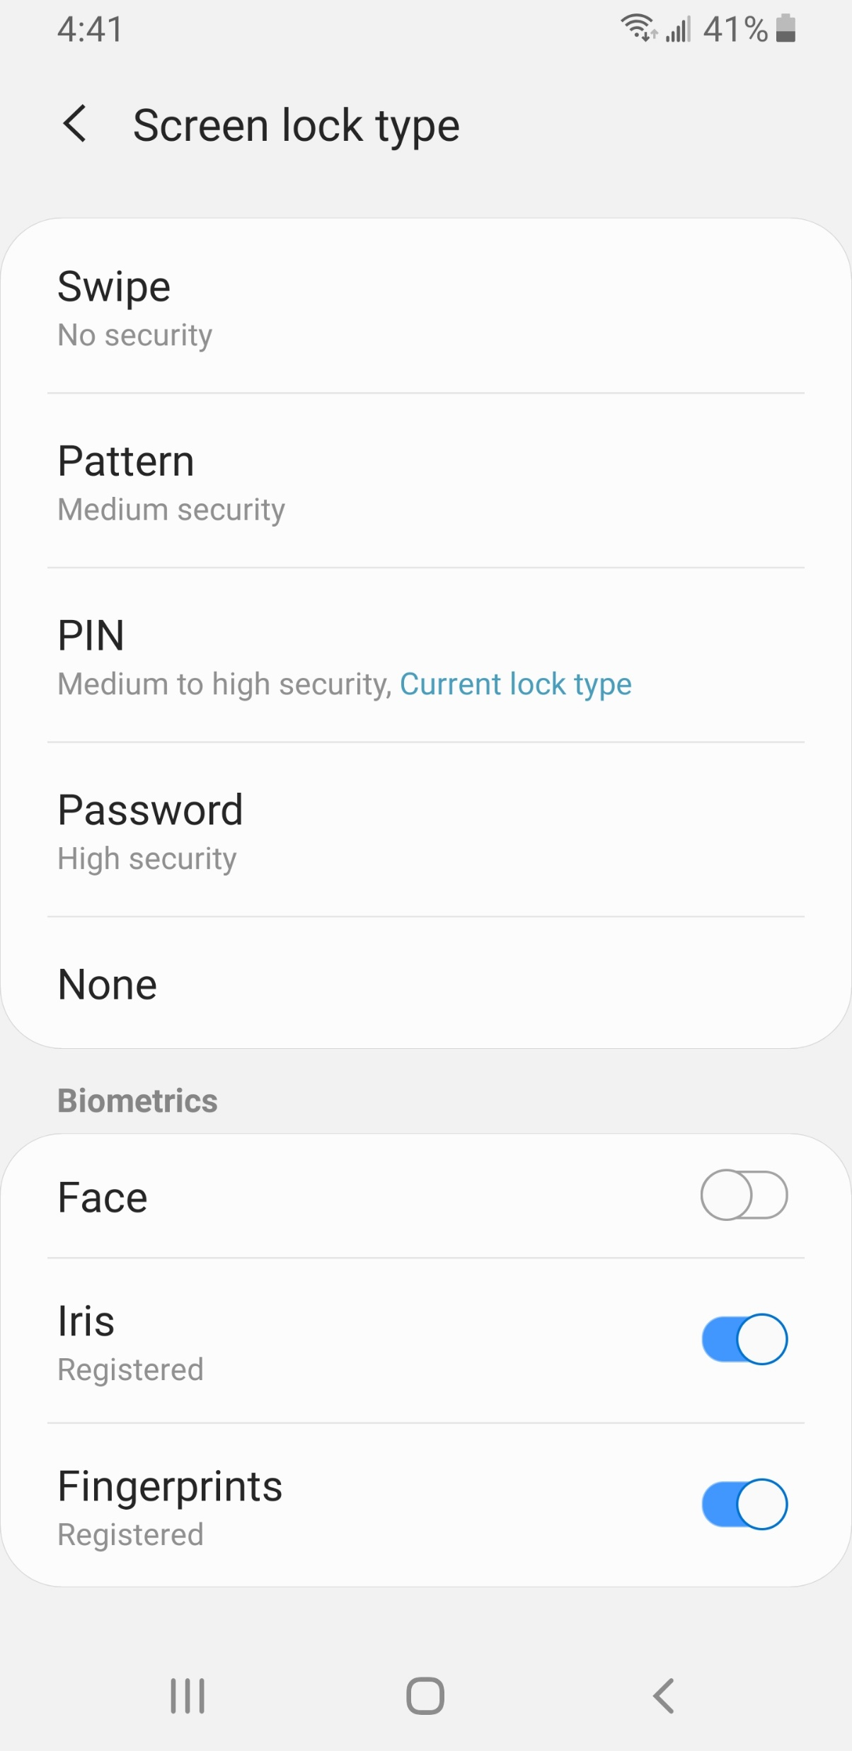
Device Lock (2 of 2)
An example of lock screen options available on a Samsung Android phone and the various security ratings for each.

Slide 11
Passwords and PINs
Passwords and PIN numbers are commonly used non-biometric security.
They protect mobile devices just as they would any account requiring them.
A PIN is a set number of digits and is therefore limited
A password is several characters, with longer passwords offering stronger protection.

Slide 12
Swipe Unlock and Pattern Unlock
Swipe unlock offers absolutely no security and anyone can unlock a device by dismissing the lock screen.
A pattern unlock is a visual option of unlocking a device.
Using a series of swipes along a grid allows a person to unlock a device.
This type of security offers less protection than a password or PIN.

Slide 13
Biometric Security
While biometrics offer a new level of security, there are disadvantages such as some methods that can either trick the system, or the owner of the device, into unlocking it.
Biometric verification is being implemented in mobile devices as an alternative to passwords an PINs.
Widely used biometrics include fingerprint scanners, retinal scanners, and facial identification.
Data, such as fingerprint biometrics, are encrypted and stored so that they cannot be exported to better protect a device and its owner.
This ensures the data stays on that device alone.

Slide 14
Installing Apps
Only install first-party apps and verified third-party apps to your devices.
On Android devices only install apps through the Google Play store.
On Apple devices only install apps through the iTunes App and the App Store.
Do not enable installation from unknown sources.
Look into the publisher and review before downloading.

Slide 15
NFC (Near Field Communication)
NFC is a wireless technology that is used for either sending or receiving information without contact.
It is often used by phones or debit cards featuring tap by waving the object over a card reader.
NFC is convenient but is also a large security risk.
Hackers may try to intercept the signal sent between two devices to gain access to an individual’s personal information This is called NFC Eavesdropping.

Slide 16
NFC (Near Field Communication) (continued)
To increase device security, disable NFC.
Android Devices: Settings > More Networks > NFC > Turn Off.
NFC cannot be disabled on an iPhone, just simply delete all cards on Apple Pay.

Slide 17
Bluetooth
Apps such as Facebook and Google also use Bluetooth to monitor location data.
Turning off Bluetooth stops that data from being transmitted This will also increase battery life.
Bluetooth technology is used to wirelessly exchange data between nearby devices.
Bluetooth has often had many security vulnerabilities.
Keeping devices updated helps ensure that vulnerabilities are properly patched.
Setup your primary device so that only trusted Bluetooth devices can connect to it.
Turn off Bluetooth when it is not in use.

Slide 18
AirDrop
AirDrop is a file transfer service available to Apple Devices.
It uses multiple different technologies to send files from one mobile device to another.
Bluetooth is used to find devices that you can send photos, videos, or files to.
AirDrop offers three options to determine who you can send files to.

Slide 19
AirDrop Options
To change the settings on an iPhone or iPad:
Settings > General > AirDrop
No One:
Eliminates all AirDrop access.
Contacts Only:
Displays AirDrop only for your contacts to see.
Everyone:
Anyone within range can send anything.
If settings are set to everyone, there are security risks of receiving unsolicited files.

Slide 20
Antivirus for Mobile
Mobile devices, especially Android smartphones, are just as vulnerable to malware as computers.
Antivirus solutions for mobile offer the same protections that computers have.
Anti-malware protection is a feature that protects against infections caused by viruses and other malware.
Real-time antivirus that scans files as they are downloaded before they can infect your device.

Slide 21
Antivirus for Mobile (continued)
Spyware is a malware that is used by hackers to gather personal information about a device’s owner and use it for their own benefit.
They can protect against fake websites that are scanned when results populate a search engine.
Antivirus software includes spyware removal.
Anti-phishing software is included that prevents hackers attempts to steal personal information.
Recommend antivirus software available on mobile:
TotalAV, McAfee, Norton
Bitdefender, Malwarebytes

Slide 22
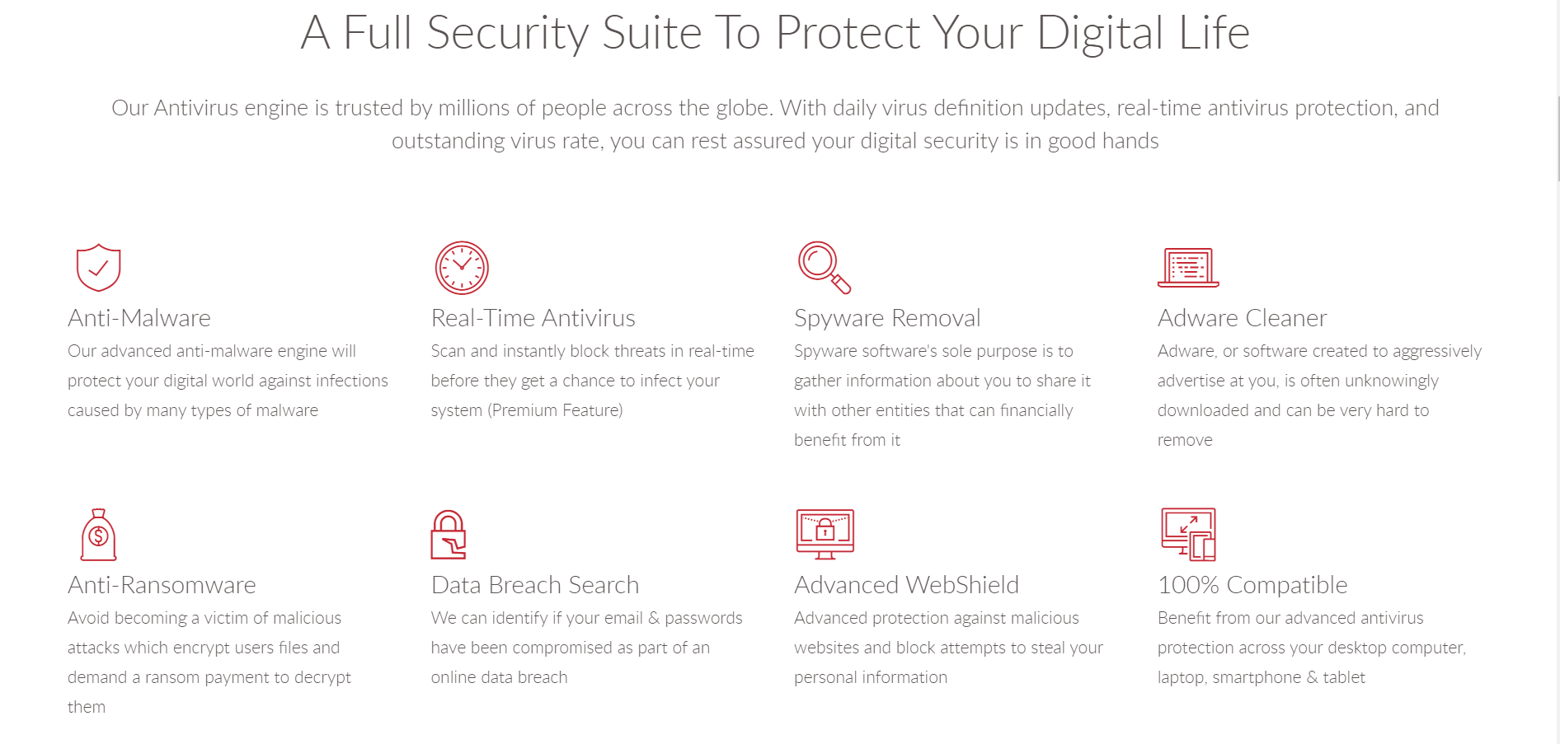
Antivirus Features - TotalAV

Slide 23
Browsing on a Mobile Device

Slide 24
Fake Websites
A fake website is designed to spoof a real website.
They are meant to manipulate a user into either giving personal information through phishing or downloading malware.
Often fake websites are can look authentic due to stolen assets from the website they are pretending to be, but they are not perfect.

Slide 25
Identifying Fake Websites
Quality of the Content on the Site
Poor-spelling, missing words, incomplete sentences, abnormal wording, etc.
Advertisements/Pop-ups
Ads that make you take a survey or complete a task before continuing.
Ads with explicit or suggestive content.

Slide 26
Identifying Fake Websites (continued)
Use your browser to research information about the website before clicking onto it.
A fake website URL make look similar to a real website, but often direct to a different domain.
Example of a real URL and a fraudulent URL:
Real: www.mohawkcollege.ca
Fake: www.mohawkcollegecasite.com
Fake websites tend to have overly long URL links.

Slide 27
Identifying a Safe Website
HTTPS stands for HyperText Transfer Protocol Secure.
Look for the ‘s’ in HTTPS.
URL’s that use HTTPS rather than HTTP indicate that they have a certificate which protects sensitive information.
Check for the website’s privacy policy.
A link is often available at the bottom of a page.

Slide 28
Identifying a Safe Website (continued)
Be aware of the signs of potential malware:
Suspicious pop-ups on a website.
Search engine warnings.
Some popular search engines will scan websites for malware prior to clicking any links and will warn you if a website is considered dangerous.

Slide 29
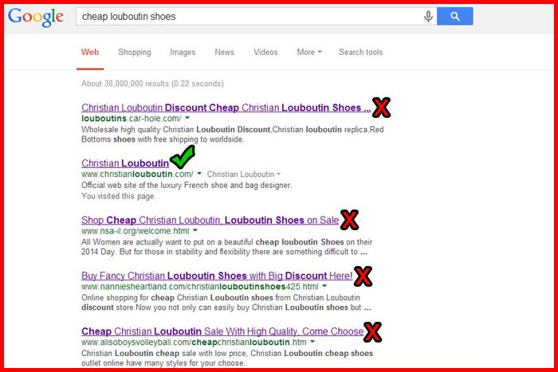
Fake vs Real Website Example
Comparing fake and real the Louboutin Websites.

Slide 30
Checking Links on a Mobile Device
Unlike a desktop or laptop computer where a mouse can hover over a link to see its source, mobile devices generally use touch screen input.
When using a mobile device such as Android or Apple, press and hold down on the link with your finger.
Holding the link will not open it.
After holding the link, it will become highlighted and a menu with several prompts will display.

Slide 31
Checking Links on a Mobile Device (continued)
Avoid websites that seem strange, if it looks suspicious, it most likely is.
The new menu will display the address of the link.
This address can be used to verify if the link will direct to where it claims it will.
Verifying links prior to opening them is an important habit to prevent falling victim to phishing scams.

Slide 32
Using Cellular Data as a Wi-Fi Tether
A VPN protects your identity and browsing activity by creating a secure connection to a network over the Internet.
Create a strong password as you would on any account.
Ensure your password is long, unique and hard to guess.
Make your password random if you are certain that you can remember it.
Secure your network by using at least WPA2 encryption.
Install a VPN (Virtual Private Network) on your phone This will encrypt your connection which greatly increases security against external threats.

Slide 33
Safely Using Public Wi-Fi
Public Wi-Fi or hotspots are unsecured networks.
Verify a network’s name before you connect to it.
Disable file sharing on your devices before connecting to a public network.
On an iPhone: Settings > System Preferences > Sharing > Internet Sharing > Turn off.
On an Android: Settings > Network Sharing Center > Change Advanced Sharing Settings > Turn off options.

Slide 34
Safely Using Public Wi-Fi (continued)
Install a VPN on your mobile device This will encrypt the connection.
Visit websites that are protected with security certificates and have HTTPS in their address.
Enable or install firewall software to protect the device from external connections.
Use antivirus software.

Slide 35
Two-Step Authentication
Two-step (also known as two-factor) authentication adds extra security to accounts.
Codes are randomly generated at fast intervals.
If a password is compromised an account is still inaccessible without the generated code being input.
Google Authenticator is an option available to download that many services feature compatibility with.

Slide 36
Additional Tips
Always turn off automatic connection This will prevent your device from connecting to a network accidentally.
Always forget the network after using public Wi-Fi This will remove a network from your phone’s memory.
Never share any personal information or make any financial transactions over a public network.

Slide 37
Mobile Security Best Practices

Slide 38
Best Practices
Update your devices’ operating systems regularly.
Consider enabling auto-updates.
Turn off Bluetooth, AirDrop, and Wi-Fi when not in use.
Disable NFC functionality on your devices.
Be aware of and avoid potential phishing scams.
Make sure to download and install an antivirus software.
Do not share confidential or financial information while using a public network.

Slide 39
Best Practices (continued)
Use passcode, PIN or biometric locks for your devices.
Think before you install applications on your phone.
Only download from the official app store for your device.
Look into the publisher prior to downloading.
Ensure you are visiting legitimate, safe websites.
See our Safe Remote Working module for more information on some of these topics.

Slide 40
Conclusions

Slide 41
In Conclusion
Protecting your mobile device from threats should be considered just as important as protecting it from cracks and scratches.
Properly lock devices and secure them with the offered security features.
Only install apps from trusted and verified sources.
Be aware of the various communication features your mobile device has and disable unused features.

Slide 42
In Conclusion (continued)
Never transmit personal data over an open connection.
Understand the potential security risks when browsing the Internet with your device.
Be aware of how to identify a safe site from a possibly malicious one.
Properly secure own mobile data when using it as a tether for other devices.
Connect only to verified public hotspots that are locked.

Slide 43

Canadian Internet Registration Authority (CIRA)
These modules were made possible by the contributions of CIRA and their Community Investment Program.

Slide 44
References (1 of 4)
Baig, Anas. "5 Tips for Staying Safe on Public Wi-Fi Networks." GlobalSign, Oct. 2018, www.globalsign.com/en/blog/staying-safe-using-public-wifi. Accessed 4 Feb. 2021.
Bicknell, Andin. "How to secure your phone's portable Wi-Fi hotspot." The Jakarta Post, Oct. 2019, www.thejakartapost.com/life/2019/10/29/how-to-secure-your-phones-portable-wi-fi-hotspot.html. Accessed 3 Feb. 2021.
"Do You Know How to Detect a Fraudulent Website?" Bralin Technology Solutions, sitelock.com/blog/is-this-website-safe/. Accessed 4 Feb. 2021.

Slide 45
References (2 of 4)
Heaven, Bill. "How to Check Embedded Links on Your Mobile Device." HBK, Dec. 2018, hbkcpa.com/how-to-check-embedded-links-on-your-mobile-device/. Accessed 4 Feb. 2021.
Marks, Tove. "How Safe is a Bluetooth Connection?" VPNOverview, May 2020, vpnoverview.com/privacy/devices/Bluetooth/. Accessed 5 Feb. 2021.
McElhearn, Kirk. "How to Use AirDrop to Securely Share or Transfer Files." The Mach Security Blog, intego, May 2018, www.intego.com/mac-security-blog/use-airdrop-to-securely-transfer-files-across-your-devices/. Accessed 3 Feb. 2021.

Slide 46
References (3 of 4)
"Mobile security 101." Norton, ca.norton.com/internetsecurity-mobile-mobile-security-101.html. Accessed Feb. 2021.
Murphy, David. "What's the Best Way to Unlock Your iPhone?" lifehacker, G/O Media Inc., Sept. 2018, lifehacker.com/whats-the-best-way-to-unlock-your-iphone-1828864810. Accessed 5 Feb. 2021.
"NFC Frequently Asked Questions." Secure Technology Alliance, securetechalliance.org/publications-nfc-frequently-asked-questions/. Accessed 5 Feb. 2021.

Slide 47
References (4 of 4)
Tammany, Joyce. "How Can I Tell If a Website Is Safe? Look For These 5 Signs." Site Lock, Aug. 2018, sitelock.com/blog/is-this-website-safe/. Accessed 4 Feb. 2021.

