Slide 1
Secure Remote Working

Slide 2
Learning Outcomes for this Module
Gain a better understanding of how to protect your data.
The advantages of good antivirus and firewall software.
Learn how to secure your network with a VPN.
Importance of separating your work and personal data.
Explore methods of backing up your data.
Understanding that secure remote working goes beyond the computer screen.

Slide 3
Introduction

Slide 4
Secure Remote Working – What?
Working remotely has become essential for modern businesses.
Remote work environments, such as the home, often lack the same safeguards the office provides.
A lack of proper security tools, such as an antivirus, increases the risk of malware getting into a computer.
Many individuals access networks without understanding the risks of an unsecure connection.

Slide 5
Secure Remote Working – Why?
It is your responsibility to protect yourself and your organization’s information when working.
Working with a vulnerable network can have severe consequences.
Access to personal and corporate information can cause a lot of damage.
Damages can include stolen data, harm to an organization’s image, and costly legal fees.

Slide 6
Self Check-Up
Do you use public Wi-Fi?
Have you accessed your social media accounts or financial accounts on a work device?
Have you ever accepted an incoming connection on a website without verifying the connection?
Answering “yes” to any of these could be a potential security risk

Slide 7
Tools for Remote Security
Software to use and actions to take to improve your security while working remotely

Slide 8
Firewall
Firewalls exist to prevent security threats such as malware and cybercriminals from being able to gain access to a network or device.
It is a security tool for a network that monitors incoming and outgoing traffic and will allow, or block connections based on the set security rules.
Consider it the first line of defense against threats to your devices and network.

Slide 9
Firewall (continued)
Imagine your network is an island surrounded by a wall of flames:
Approved connections, such as your organization’s remote network, can safely pass through the flames with no difficulty.
Unapproved connections, such as a random site on the Internet, find the flames too hot and cannot pass through.

Slide 10
How do I get a Firewall?
There are many firewalls available.
You might already have one!
Certain operating systems come pre-installed with their own.
Some firewalls are provided by:
The computer’s operating system.
Included within an antivirus software.
Some are a hardware device.

Slide 11
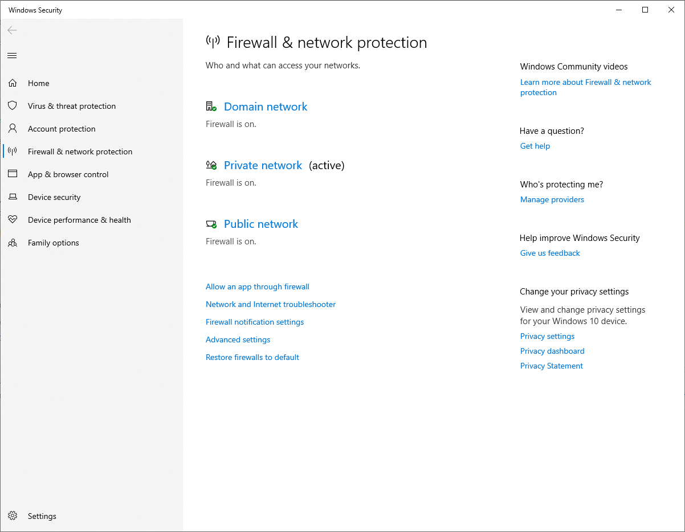
Check Firewall Status
On Windows 10 you can see if you have an active firewall in the Windows Security Centre.

Slide 12
Do you have Antivirus Software?
Despite the security provided, a firewall is not guaranteed to stop all forms of malware.
If malware has infected your device, then you will need to use an antivirus program to scan your system to remove it.
It is encouraged to have a primary antivirus scanner, as well as a secondary, portable antivirus for the best chance of removing unwanted viruses and malware.

Slide 13
Antivirus Software
Antivirus software helps to detect, isolate, and remove viruses, malware, and other security threats that made it onto a device.
There are many types of antivirus software available.
Some are rated higher than others depending on features.
Some may have different tiers of protection based on pricing, or other associated products.

Slide 14
Common Antivirus Features
Anti-Phishing and Anti-Fraud: Automatic scans of email and websites while browsing.
Web Attack Prevention: Filters out websites so they are hidden from view when doing a web search.
Vulnerability Assessment: Checks your device for outdated and vulnerable software.

Slide 15
How to Run an Antivirus Scan (1 of 4)
Many antivirus software tends to automatically setup routine scans to better protect your computer.
Running multiple scans with different programs is also encouraged.
To manually run a scan, open the antivirus program that is installed.

Slide 16
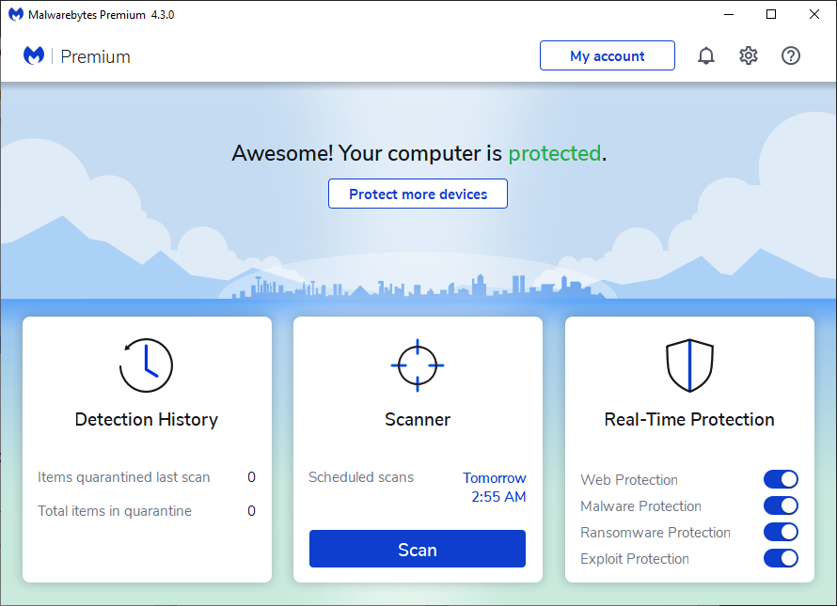
How to Run an Antivirus Scan (2 of 4)
Consider having a professional help run a more in-depth scan.
After opening, usually greeted with a splash screen and a “Scan” button.
This can vary depending on the software.

Slide 17
How to Run an Antivirus Scan (3 of 4)
If Something is Detected
A summary screen will show what was deemed suspicious.
Read the list of detected items to verify the files.
Ensure all suspicious files are checked.
Quarantine the checked items by clicking the appropriate button.

Slide 18
How to Run an Antivirus Scan (4 of 4)
If Something is Detected
Restart your system.
Ensures no lingering malware that was quarantined is still running in the background.
Delete/Clean the quarantined malware to fully remove it.

Slide 19
What are my Antivirus Options?
Some of the most well received antivirus software available on Windows, Mac, and Linux operating systems are:
Norton Antivirus Plus
Bitdefender Antivirus Plus
Webroot SecureAnywhere Antivirus
McAfee Antivirus
Malwarebytes Anti-malware (PC/Mac only)

Slide 20
What is a VPN?
You have likely seen advertisements for numerous VPN services online.
Ask yourself:
Will I be accessing anything that requires my personal information?
Would I prefer enhanced security and privacy options when browsing the Internet?
Do I often use public hotspots?

Slide 21
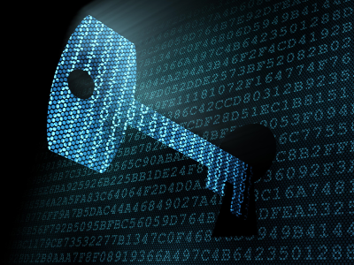
VPN – Virtual Private Network
A VPN, short for a Virtual Private Network, which gives your device a higher level of Internet security and privacy.
This Photo by Unknown Author is licensed under CC BY-SA-NC

Slide 22
What Does a VPN do? (1 of 4)
It masks and encrypts your Internet’s home address:
Your Internet’s home address is referred to as an Internet Protocol or IP.
An IP is made up of numbers, but an easier way to imagine it is instead of your address being: “123 Main Street” the Internet sees it as: “789 Fake Road” while using a VPN.

Slide 23
What Does a VPN do? (2 of 4)
Browsing the Internet without a secure connection can expose our browsing habits and possibly private information.
Connecting to the Internet and browsing without a VPN enables any site or network you access to see your IP Address.
Enables secure private browsing even on unsecured public Wi-Fi.
Can help protect against identity theft by protecting any private and personal information sent and received over a network.

Slide 24
What Does a VPN do? (3 of 4)
Encrypts your data and adds protection to all your online actions including:
Browsing websites
Sending emails
Video conferencing
Accessing financial accounts
Online shopping

Slide 25
What Does a VPN do? (4 of 4)
Blocks others on the same network from accessing your data.
Your data is scrambled through encryption, making it unreadable to outside sources.
If your organization provides a VPN, be certain to use only theirs when accessing their network.
Your organization may block your connection otherwise as an additional level of security.

Slide 26
What Should I Look for in a VPN?
Not all VPN services are made equal, but most of the well-known services will generally offer what you should require.
“Do you want to be able to surf the web anonymously by masking your IP address? Are you afraid that your information could be stolen on public Wi-Fi? Are you a frequent traveler who wants to be able to watch your favorite shows while you’re on the go? A good VPN can help you check all three boxes.” – Norton

Slide 27
What VPN Services are Available? - 1
Some of the top recommended dedicated VPN services, rated for security, speed, and pricing are:
ExpressVPN
NordVPN
Surfshark
Each provides easy one-click setup and multiple device compatibility including mobile devices.

Slide 28
What VPN Services are Available? - 2
Alternatively, many antivirus and firewall software, such as Norton, offer plans that include their own VPN solutions.
Relying on a free VPN solution is not recommended.
Often lack the latest security protocols.
They have slow connection speeds.
Lack support for troubleshooting.

Slide 29
Example Features - ExpressVPN
A network lock ensures that there is no accidental use of the Internet while a device is on an unsecure connection.
Private browsing through encrypted connection.
Network lock and kill-switch.
Blocks all Internet traffic if the VPN connection drops.
Split tunneling.
A feature that allows a device or some data to be encrypted through VPN and others directly connected to the Internet.

Slide 30
Your Home Network - Routers
When setting up a network in a home it is most common to have a router.
Routers allow for multiple devices to connect to a network through both wired ethernet and wireless.
Wireless routers are necessary for creating a Wi-Fi network.
Include multiple security options for safe networking.

Slide 31
Types of Routers
There are many types of routers designed for different purposes.
Most modern routers are designed to be wireless with various speed options.
Popular brands include ASUS, Linksys, Netgear, and D-Link routers.

Slide 32
How to Secure your Home Router
Many individuals never change their router’s password, so while the network itself is protected, untrusted sources could still potentially access the router’s main settings.
Ensure Wi-Fi is encrypted with a strong password.
Settings will show either WPA2 or WPA3 as the encryption method.
Change your router’s password from the default one provided.
Disable WPS or similar features, that allows for a one-button operation to connect to a network, ignoring security keys.

Slide 33
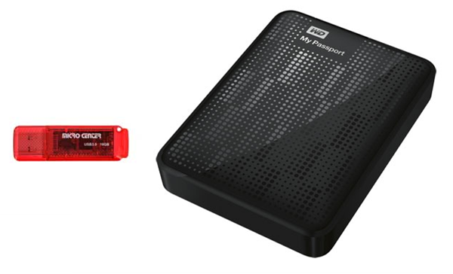
Data Backup Options – Physical Drives (1 of 2)
USB Flash Drives and External Hard Disk Drives.
Are easy plug-and-play solutions for moving data between devices without a network.
This Photo by Unknown Author is licensed under CC BY-SA

Slide 34
Data Backup Options – Physical Drives (2 of 2)
Compatible with most computers.
Many modern drives have Wi-Fi capabilities, allowing for personalized cloud storage.
Avoid cheap drives that have a higher risk of failure.
Can be misplaced and lost.
Easy to damage or break and lose data as a result.

Slide 35
Physical Drive Brands You Can Trust
Do not insert an unknown USB device into your computer. It may contain malware.
USB Flash Drives:
Lexar
SanDisk
Kingston
External Hard Disk Drives (HDD):
Western Digital
Seagate
LaCie

Slide 36
Data Backup – Cloud Storage - Good
Online storage that is accessible if your device is connected to the Internet.
No need to carry around a physical drive.
Data is easily sharable between multiple devices and users.
Very unlikely for any data loss to occur.

Slide 37
Data Backup – Cloud Storage - Bad
Security and privacy concerns by relying on a third-party for data storage.
Internet connection speed determines how quickly files are transferred.
Costs of cloud storage and bandwidth usage.

Slide 38
Cloud Storage Security
When looking for a cloud storage solution, ask the following questions:
Does the data reside in Canada?
Does the service properly encrypt data?
Is password protection offered per file?
Are there security access level options?
Has the company ever experienced a data breach in the past?

Slide 39
Cloud Storage Options
Some popular cloud storage options for business and personal use are:
Dropbox
Microsoft OneDrive
Google Drive
IDrive

Slide 40
Conclusions

Slide 41
In Conclusion (1 of 6)
Always have a firewall, it is your first line of protection against malware and cybercriminals.
Firewalls are not perfect and will not prevent all malware from getting onto your device.
Have at least one antivirus software installed, having multiple is encouraged.
Never turn off or disable security software.
Keep your software updated.

Slide 42
In Conclusion (2 of 6)
A VPN can greatly improve your security and privacy on the Internet.
VPNs can secure your connection, even on unsecured public networks.
Never connect to a public hotspot without a VPN if you plan to work, lookup financial information, or browse social media.
Using a VPN can help protect against identity theft.

Slide 43
In Conclusion (3 of 6)
A VPN will prevent websites from tracking your browsing and online shopping habits.
Always use your organization’s VPN for work if they have one.
Keep your home network secure.
Change your router’s default password and ensure your Wi-Fi network has a strong encrypted password.

Slide 44
In Conclusion (4 of 6)
Always keep your work and personal data separate.
Do not use a work device for personal usage.
If you only have one device:
Ensure all work-related documents are closed when in personal use.
Consider storing all work documents on an external drive only to secure them in the event your device becomes compromised.

Slide 45
In Conclusion (5 of 6)
Regularly backup your data, both physical storage and cloud storage options are available.
Block sightlines in public and lock your devices when not in use.
Never leave a device such as a laptop unattended.
Remote security goes beyond our devices.
Think about your surroundings when discussing personal and private information.

Slide 46
In Conclusion (6 of 6)
Use different strong passwords for all your accounts.
Use two-factor authentication whenever possible.
Stay alerted of suspicious activity by enabling security alerts on all of your accounts.
Only use software and hardware approved by your organization.

Slide 47
Canadian Internet Registration Authority (CIRA)
These modules were made possible by the contributions of CIRA and their Community Investment Program.

Slide 48
References (1 of 4)
"Secure remote work." Microsoft, www.microsoft.com/security/blog/secure-remote-work/. Accessed 19 Jan. 2021.
Laws, Alex. "8 Best Practices for Working Remotely." CI Security, ci.security/resources/news/article/8-best-practices-for-working-remotely. Accessed 19 Jan. 2021.
Raywood, Dan. "Top Ten: Ways to Secure Remote Workers." info security group, Sept. 2020, www.infosecurity-magazine.com/magazine-features/top-ten-secure-remote-workers/. Accessed 20 Jan. 2021.

Slide 49
References (2 of 4)
Martins, Andrew. "Cybersecurity Tips for Working From Home." Business News Daily, June 2020, www.businessnewsdaily.com/15701-coronavirus-remote-cybersecurity.html. Accessed 20 Jan. 2021
Rivera, Andreas. "8 Benefits of Online Data Storage." Business News Daily, Jan. 2019, www.businessnewsdaily.com/6294-benefits-of-online-data-storage.html. Accessed 20 Jan. 2021.
"What is a virtual machine?" vmware, www.vmware.com/topics/glossary/content/virtual-machine. Accessed 25 Jan. 2021.

Slide 50
References (3 of 4)
O'Driscoll, Aimee. "13 cybersecurity tips for staff working remotely." comparitech, Mar. 2020, www.comparitech.com/blog/information-security/security-remote-working/. Accessed 21 Jan. 2021.
"What is a firewall?" Cisco, 2020, www.cisco.com/c/en_ca/products/security/firewalls/what-is-a-firewall.html. Accessed 21 Jan. 2021.
Johansen, Alison G. "What is antivirus software?" Norton, Feb. 2019, us.norton.com/internetsecurity-malware-what-is-antivirus.html. Accessed 21 Jan. 2021.

Slide 51
References (4 of 4)
Symanovich, Steve. "What is a VPN?" Norton, Jan. 2021, us.norton.com/internetsecurity-privacy-what-is-a-vpn.html. Accessed 21 Jan. 2021.
Tunggal, Abi T. "25 Working from Home Security Tips for Staff and Employers." UpGuard, Oct. 2020, www.upguard.com/blog/working-from-home-security-tips. Accessed 22 Jan. 2021.
Hodge, Rae, and David Gewirtz. "Best VPN service of 2021." CNET, Jan. 2021, www.cnet.com/news/best-vpn/. Accessed 23 Jan. 2021.

