Slide 1
Password Security

Slide 2
Learning Outcomes for this Module
Learn how to securely manage your passwords.
How to create a secure password.
Learn why using the same password for multiple websites/accounts can hurt you.
Discover tools to check if your username/password has been compromised.
Other security features such as two-factor authentication.

Slide 3
Personal Assessment
Do any of the following apply to you?
I use the same password for multiple websites, or software.
I save my passwords in my browser.
I have some passwords that are very short (8 or less characters).
Someone else in my life know all of my passwords.

Slide 4
Introduction

Slide 5
What is Password Security? (1 of 3)
Password security consists of many different parts.
Using long, complex passwords.
Changing your passwords often.
Using different passwords for different applications/websites.
Using a secure password manager.
Not sharing your passwords with others.

Slide 6
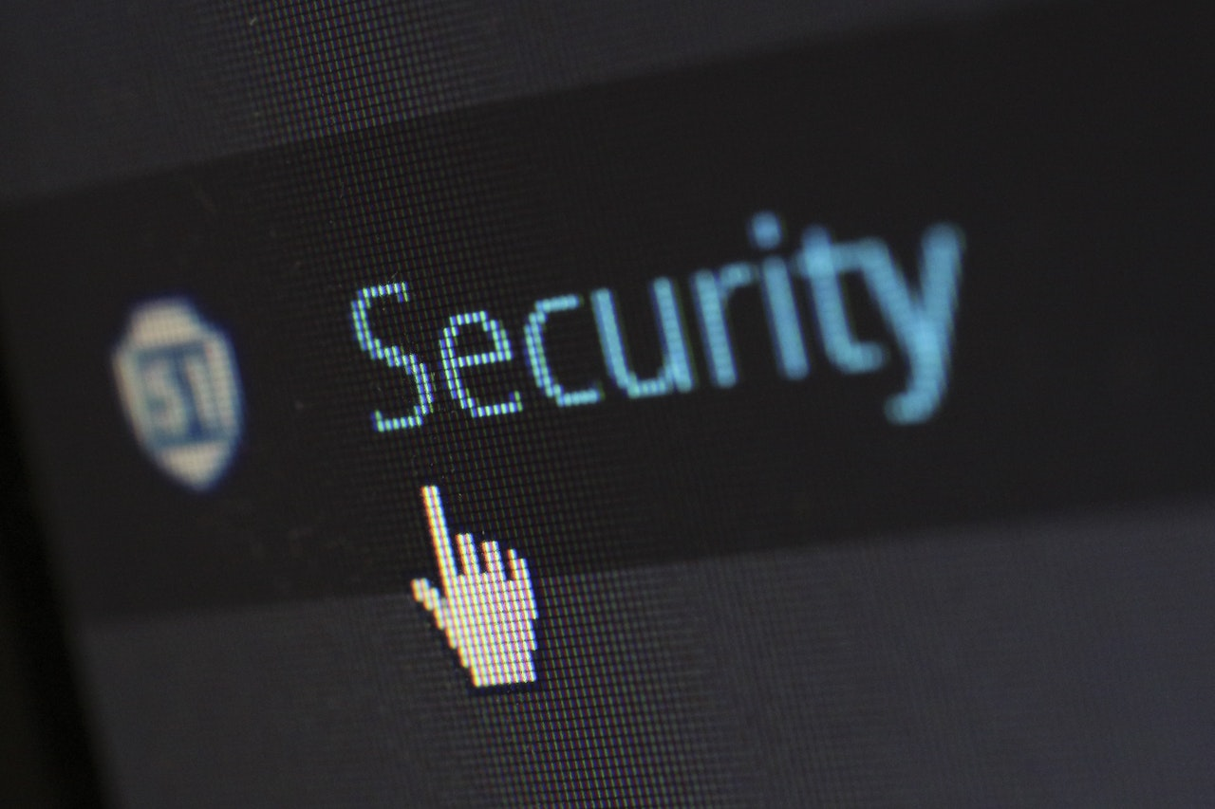
What is Password Security? (2 of 3)
Password security is not just making sure your passwords are long or saved properly but making sure you are being safe with other activities you do online.

Slide 7
What is Password Security? (3 of 3)
Password security also includes being safe during other online activities. Some examples include:
Being aware of what phishing is and how to guard against it.
Being careful about what you download online to not download any malware.
Being careful about what websites you visit and making sure they are legitimate.

Slide 8
Password Security – Why?
Almost everything is online, and almost everything you do is protected with a password.
Attackers are primarily after your personal information, so you want to make it as difficult as possible for them to get it.
If someone gets access to your personal information, they can do a lot of damage.

Slide 9
Common Passwords (1 of 4)
Can you guess what the most commonly used passwords are?
Every year, lists of the most common passwords of the year are posted
If you are using on of the passwords found on the list, change it immediately

Slide 10
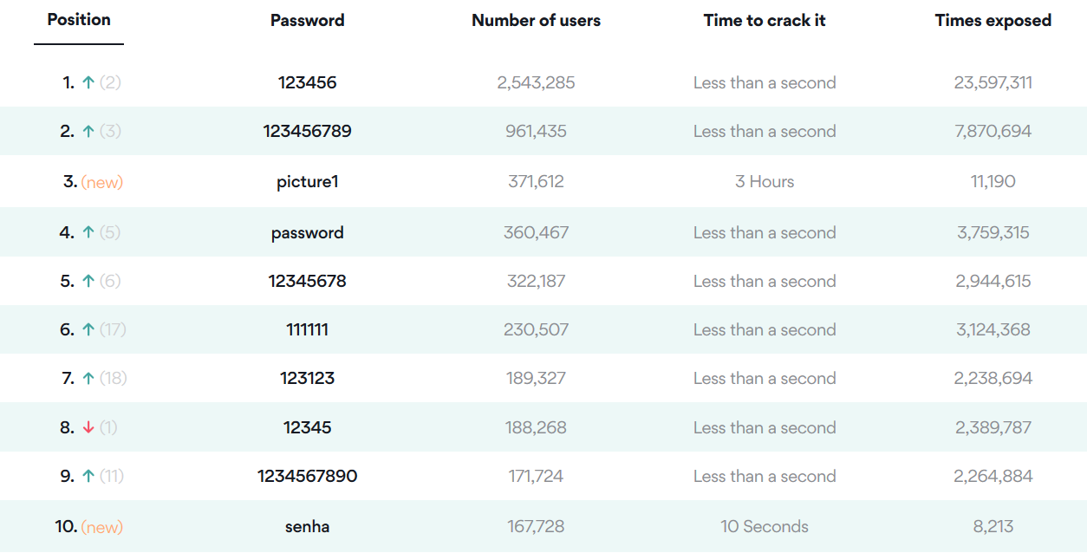
Common Passwords (2 of 4)
This year’s list can be found on the NordPass Website:

Slide 11
Common Passwords (3 of 4)
What do they have in common?
Most of them are variations on “123…”
None of them are complex passwords .
All but one only consist of lowercase letters, or numbers.
All but picture1 will take less than 10 seconds to crack.

Slide 12
Common Passwords (4 of 4)
Often, people will also use names, birthdays or pet names for passwords.
These aren’t much better, as anyone who is able to get a bit of information about you can probably figure it out.
Watch this video to see this in action:
https://www.youtube.com/watch?v=opRMrEfAIiI

Slide 13
Facebook Password Compromised
A personal story

Slide 14
Story - Password Compromised (1 of 3)
About 10 years ago, I received a phishing email from someone pretending to be Facebook saying I had a new message.
I quickly clicked the message, not paying attention to specific details.
I was led to a page that looked incredibly similar to the real Facebook login.

Slide 15
Story - Password Compromised (2 of 3)
Without hesitation, I entered my email and password.
I then got an error message, and then closed the page and forgot about it.
A couple weeks later, I was getting messages from friends asking why I was sending weird emails with video links to them.
I realized my account had been compromised.

Slide 16
Story - Password Compromised (3 of 3)
My account was being used to send malware filled links to friends and family.
I was able to change my password and the usage stopped.
Luckily, I only used that password for my Facebook, or that could have gotten a lot worse.

Slide 17
Story - What Could Have Happened?
The person who had my account details could have changed my password and tried to lock me out of my account fully.
They could also post hateful or harmful things using my identity.
If I used the same password for my email or banking, they could effectively have control of my identity, money and more.

Slide 18
Story – Lessons Learned (1 of 2)
Even though it was 10 years ago, this is still something that happens frequently.
You might think you’re not a potential target for hackers, but you always have something valuable for them to take.
In this case, my personal information, my network of friends of family, and my reputation were compromised.

Slide 19
Story – Lessons Learned (2 of 2)
Think before you click – some phishing emails can be very sophisticated, but there are some ways to identify them – this will be covered in the Phishing module.
Use different passwords for everything.
When something has been compromised, change your password.

Slide 20
Password Strength

Slide 21
Password Complexity
Password complexity is the combination of different characters you’re using in a password.
Uppercase letters, lowercase letters, symbols and numbers.
Using all the above, different kinds of characters in a password makes it more secure.

Slide 22
Consider the Following
For each character in a password:
Lowercase letters only: 26 possible characters.
Adding numbers to the above: 36 possible characters (26 + 10).
Adding uppercase letters to the above: 62 possible characters (26 + 10 + 26).
Adding symbols to the above: 96 possible characters (26 + 10 + 26 + 34).

Slide 23
Password Strength Misconceptions (1 of 2)
In the past, password strength recommendations emphasized complexity more than anything.
If you had a combinations of upper and lowercase letters, numbers, and special characters, that was the best way to secure a password.

Slide 24
Password Strength Misconceptions (2 of 2)
Even now, on many websites, you will see password requirements such as ‘8 or more characters, 1 capital letter, 1 lowercase letter, 1 number, 1 special character’.
Even that many conditions is uncommon. It is more common to only ask for 3 of these.

Slide 25
Password Length
Increasing password length exponentially increases security.
While adding a mix of alphanumeric and special characters does increase your password strength, length is just as important.
Knowing this, a long password with a mix of different characters would make it significantly harder to crack.

Slide 26
Consider This
The average keyboard has about 96 distinct characters by default.
Therefore, each character of your password could be one of the 96.
The formula for the total number of possible character combinations for a password is 96^{x}.
This means that it’s equal to 96 times 96, for however long it is.

Slide 27
Calculating Password Length
1 Character: 96¹ = 96 possible passwords.
2 Characters: 96² = 96 * 96 =9,216 possible passwords.
3 Characters: 96³ = 96 * 96 * 96 = 884,736 possible passwords.
4 Characters: 96² = 96 * 96 * 96 *96 =84,934,656 possible passwords.
And so on….

Slide 28
So, Which Matters More?
Considering the following:
There are 96 possible different characters you could use in an 8-character long password.
A 12-character long password would be harder to crack, even if it has only lower-case letters (even though it’s only 26 possible characters).

Slide 29
Let’s Test it
8-character long password using symbols, uppercase and lowercase letters, and numbers (96 possible character choices for each).
96⁸ = 7e+15 combination (7, followed by 15 zeros, or 7 quadrillion possible passwords).
12-character long password only using lowercase letters (26 possible character choices for each).
26¹² = 95e+15 (95, followed by 15 zeros, or 95 quadrillion possible passwords).

Slide 30
In Summary – Password Strength
A combination of a long password (at least 16 characters), using a combination of lowercase and uppercase letters, numbers and symbols is ideal.
The math: 96¹⁶ = 5e+31 (5 followed by 31 zeroes) possible password combinations.

Slide 31
How Do They Get My Password?

Slide 32
How is Someone Going to get my Password?
Keyloggers read what you type on your computer and relay that to the owner of the keylogger.
There are a lot of ways for an attacker to get your password, but some are more likely than others.
The most common method of someone acquiring your password is through phishing, malware/keyloggers or data breaches of a company that you have a login for.
The above combined with people often using the same password for multiple websites/services makes it difficult to fully protect yourself online.

Slide 33
Attack Types
A lot of websites use a lockout feature after a certain number of incorrect passwords to combat these methods – but not every website or service has this.
Dictionary Attacks:
Attackers test your password against lists of well-known passwords (Contains millions of passwords).
Brute Force Attacks:
They can also just try different combinations of random letters/numbers until they get it right
Longer passwords take longer to crack.

Slide 34
What’s the Point?
If a company is breached, your password may be put out on the internet in a list for other people to try on any website they want.
If I can’t always control my password being leaked, why bother?

Slide 35
What’s the Point? (continued)
While you can’t control a company getting hacked and your password being compromised in this way, it’s still important to safeguard yourself to minimize the impact.
If you don’t use the same password for every website, you reduce the impact of a password being leaked to only one website or service.

Slide 36
Coworker’s Computer
A Personal Story: What Happened, What Could Have Happened, Lessons Learned

Slide 37
Story – Coworker’s Computer (1 of 2)
At a previous job, a coworker wanted me to clear all their saved web history/passwords before returning a laptop they had borrowed.
I told them how to do it themselves, as I didn’t want to access their information.
They couldn’t figure it out and wanted me to do it.

Slide 38
Story – Coworker’s Computer (2 of 2)
They had saved all of their passwords, including banking passwords, in plain sight, on their browser, and given someone access to all those passwords.
They also put all of their passwords for their personal and financial information on a work computer.
They were also slight variations on a single password – that is related to their personal lives.

Slide 39
Story – What Could Have Happened
Those passwords could be recorded, someone could access their accounts, then lock them out of them.
The accounts could be used for financial or personal gain.
Passwords for other accounts could be guessed by knowing the other ones.

Slide 40
Story – Lessons Learned
Don’t use the same password for everything.
Don’t save all your passwords on your browser.
Don’t give other people your passwords.
Don’t store personal or financial information on public, work or school computers.
Don’t give your computer to other people if possible.

Slide 41
How to Secure your Password

Slide 42
Make your Password long and Complex
An example of a long complex password might be EyeReallY$L1kepi22@
As discussed previously, length is more important than complexity, however making a complex password still makes a difference.
A 16 to 20 character minimum will make your password extremely difficult and time consuming to break.
Use a passphrase comprised of multiple words.

Slide 43
Examples of Good Passwords (1 of 2)
Create a phrase that’s easy to remember, maybe it has some meaning to you, or aligns with one of your interests.
But not something that would be easy to figure out or guess.
Passphrase (multiple words even if not complex).
"Bluedinosaureggs" (Not complex but long and multiple words)
"Mypetdogsnameissam"

Slide 44
Examples of Good Passwords (2 of 2)
Complex Passphrases (taking a phrase and adding complexity, for example).
B1ueD!n0s@ureggs90
Randomly generated passwords with a password manager.
"dk3harLbL2DW77X6tzbB"

Slide 45
Examples of Bad Passwords (1 of 3)
Anything involving easily accessible personal information:
Phone numbers
Addresses
Family member or pet names
Your name
Birthdays

Slide 46
Examples of Bad Passwords (2 of 3)
Very short passwords:
999555
spaces
Letters
Commonly used passwords:
Password
111111111
123456

Slide 47
Examples of Bad Passwords (3 of 3)
Simple passwords with commonly used words:
Password1
Summer2020
Teacher9
Common or short passwords even if they are complex:
P@ssw0rd1
Gr8P&ssw0rd

Slide 48
Don’t Use Passwords for More than one Website/Service
Having different passwords for everything, reduces the impact of this happening.
If one of your passwords get leaked from a website that got hacked – it will often be put out on the internet.
Attackers will then put your username (Which is almost always your email) and password from this list and try them on different websites hoping for it to work.

Slide 49
Be Mindful of Storing Your Password
Do not have a physical copy of your password written down somewhere it is easy to find.
In video games and movies this is often used so that a character can locate a password and advance the story, but in real life this is a major security risk.

Slide 50
Use a Password Manager
It’s hard to keep track of all your passwords when each one is different, and they are very long.
Using a password manager helps you keep track of all of those passwords.
It gives you the ability to create complex passwords without having to memorize them all.
Also allows you to quickly copy passwords and automatically input them into fields.

Slide 51
Internet Browser Password Managers
For more information on the security of these browsers, see our Web Browser Security module.
Built right into your web browser.
They can share information across devices as long as you log into the browser.
They do not cost any money.
Can be used to autofill fields very quickly while browsing the web.
Often don’t have very good security as they are protected by your computer’s password.

Slide 52
Third Party Password Managers
Autofill can take more time than internet browser password managers.
Some of them can save passwords across devices.
Can autofill fields as well.
More secure as they mostly have a master password that should be separate from any password you use for anything else.
While some of these are free, some of them have a monthly cost associated with them which will give additional features depending on the application.

Slide 53
What Should I Use?
A third party password manager is more secure than an in-browser one.
Make sure you find the right one for you.
Look at free and paid options, and decide based off the features included, user and company reviews, and the budgetary features.
You can find recommendations online of which one to choose from various tech sites.

Slide 54
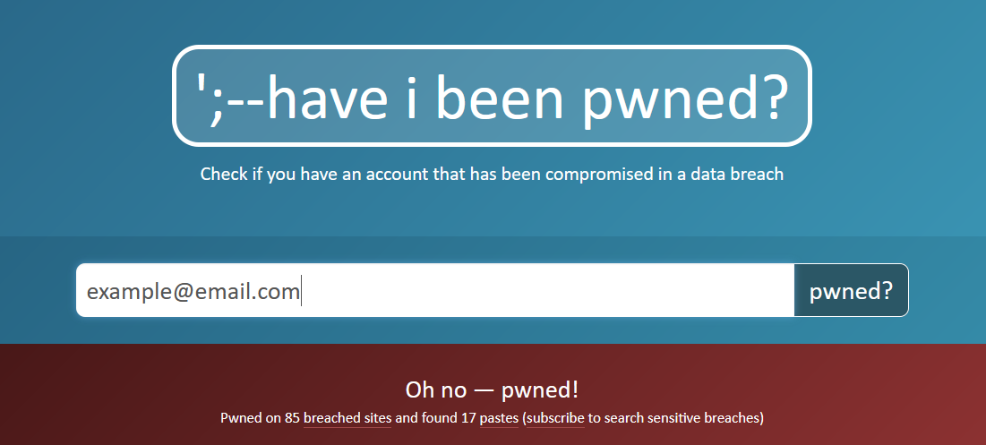
Are your Passwords Compromised?
Check the Have I Been Pwned Website.
You can enter your email on this website, and it will let you know if your email/password was leaked.

Slide 55
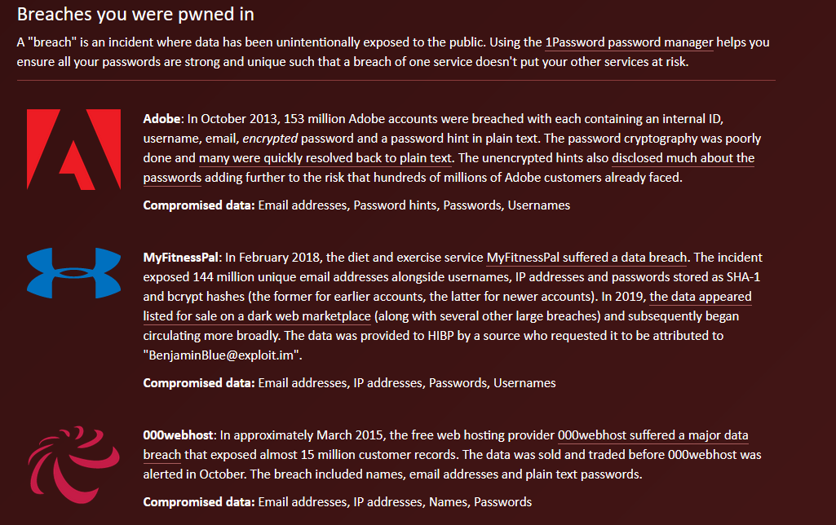
Are your Passwords Compromised
It will also break down which websites caused the breach.
Knowing this, you can change any accounts you have that use the same password.

Slide 56
Two-Factor Authentication (1 of 3)
Two-factor authentication (2FA) is a way of protecting yourself in case your password does get compromised.
When you or someone else signs into your account (often only the first time on a device, browser etc.), you will receive a notification.

Slide 57
Two-Factor Authentication (2 of 3)
Depending on how you set it up, that notification can be in many forms:
SMS/Text message
Email notification
Push notification to device
Phones and tablets also offer biometric authentication which is near impossible for someone to duplicate.
Face scanning, or fingerprint IDs.

Slide 58
Two-Factor Authentication (3 of 3)
Two-factor authentication should be used whenever it is available. It will greatly increase your account security.
Some companies attempt to incentivize 2FA in order to promote its use.
The online game Final Fantasy XIV gives an in-game bonus to anyone who enables two-factor authentication on their account.

Slide 59
Conclusion

Slide 60
How to Protect Yourself (1 of 3)
You can’t always protect yourself from your password being leaked.
When a company has a data breach, your information could be put out on the internet for others to see and there was nothing you could do.
Your goal is to minimize the impact of something like this happening by following good password hygiene and security rules.

Slide 61
How to Protect Yourself (2 of 3)
Ensure that you use a long complex password (16 to 20 characters minimum).
Use a passphrase consisting of multiple words.
Don’t use the same password for more than one application.

Slide 62
How to Protect Yourself (3 of 3)
Use a password manager .
Generate random long passwords.
Only remember one password to open the manager itself.
Enable two factor authentication on everything that has it as an option.
Consider biometric authentication.

Slide 63
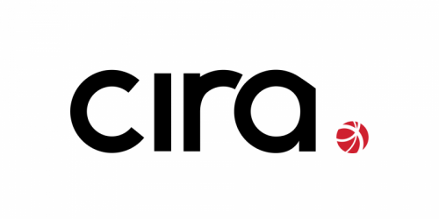
Canadian Internet Registration Authority (CIRA)
These modules were made possible by the contributions of CIRA and their Community Investment Program.

Slide 64
References
"Password Security: Complexity vs. Length." INFOSEC, 8 Sept. 2019, resources.infosecinstitute.com/password-security-complexity-vs-length/. (Accessed October 2020)

