Slide 1
Spyware and Other Malware

Slide 2
Learning Outcomes for this Module
Understand what spyware is and the different types of spyware.
Learn about different kinds of malware.
How malware and spyware attack devices and how to prevent them.
How ransomware impacts companies and individuals.
What a firewall and antivirus software are.

Slide 3
Introduction

Slide 4
Introduction to Spyware
Spyware is a type of Malware that can infect both computers and mobile devices.
It is designed to get on a victim’s computer and run secretly in the background.
Spyware gathers information about an individual to be sent to the attacker.
Often the information gathered can be used for purposes such as identity theft and financial loss.

Slide 5
Introduction to Spyware (continued)
Information that spyware can gather from includes:
Personal information
Sites visited
Downloads
Usernames and Passwords
Payment information

Slide 6
Types of Spyware (1 of 3)
Adware
Can infect your system and cause pop-ups and ads on your system, even while offline. Some may track your browsing habits.
Banking Trojans
Cybercriminals take advantage of weaknesses in security settings and modify web pages, and banking transactions.

Slide 7
Types of Spyware (2 of 3)
Password Stealer
An application that is designed to harvest passwords from infected computers.
Infostealers
Hackers will scan an infected computer in search of information such as usernames, passwords, email addresses, files, system information, documents, etc.

Slide 8
Types of Spyware (3 of 3)
Tracking Cookies
Uses browser cookies to track a user’s browsing habits, search history, and downloads for market research.
System Monitors
Can track nearly anything that a person does on their computer including keystrokes, applications run, and text on screen such as emails being read.

Slide 9
What is a Keylogger?
This is a malware often packaged with spyware.
It can read and record the keystrokes that are being used on the victim’s device.
They can allow a cybercriminal to gain knowledge such as login and password information.
Keyloggers are largely used for identity theft purposes.

Slide 10
How Can Spyware Infect Me? - 1
Installing programs from legitimate sites can still contain malware if the website itself has been compromised.
Computers, smartphones, and tablets are all vulnerable to spyware infection.
Downloading software from unreliable sources.
Opening links or downloading attachments from suspicious emails (often related to Phishing).
Accepting prompts without reading first.
Visiting unsafe websites.

Slide 11
How Can Spyware Infect Me? - 2
Have you ever tried downloading software from an unauthorized source or visited suspicious links in a website ad banner?
Often these websites may contain spyware!
Attackers often attach spyware to things you want so that you will download it and compromise your device.

Slide 12
Methods of Infecting Devices
Phishing or Spoofing
Cybercriminals lure users to click malware infected links, emails, illegitimate websites, or convince users to give up their login credentials.
Misleading Marketing
Advertising a spyware program as a useful tool to download (hard drive cleaner, download manager, etc.)

Slide 13
Mobile Spyware
Spyware that is often included in apps installed through Other Sources.
Users cannot see what is being run in the background of a mobile device as easily as a laptop or desktop.
Only download apps from legitimate sources such as the Google Play Store (Android) or the App Store and iTunes (Apple devices) to prevent risk of spyware.

Slide 14
How to Identify If You Have Spyware
Devices slow down, crash, or freeze frequently.
Random pop-ups suddenly populating your screen, even when you are not connected to the Internet.
Disk space fills up inexplicably.
Browser settings randomly change.
Antivirus applications stop working.
Access to applications and files become lost.

Slide 15
What is Malware?
Malware is a software that is designed to cause harm to a device, server, network, etc.
The most common types of malware include:
viruses, worms, trojans, spyware, adware, rootkits, and ransomware.

Slide 16
Types of Malware (1 of 3)
Virus
Viruses attach their infected code to clean code and wait for a victim to execute them.
Worm
Worms are a self-replicating malware. They infect one device and then move through a network to spread the infection to other devices without a user even needing to run an infected application.

Slide 17
Types of Malware (2 of 3)
Spyware
Applications designed to hide in the background of computers and mobile devices to spy on what the victim is doing.
Trojan
Any form of malware that misleads users of its true intentions. Often disguised as other software.

Slide 18
Types of Malware (3 of 3)
Ransomware
An attack that can lock down networks and lock out users from their devices using encryption while demanding a ransom.
Rootkit
Software that can give control of a victim’s system to an attacker with administrator privileges. Can include and spread other malware.

Slide 19
What is Ransomware?
The ransom should not be paid, as there is never a guarantee the criminal will deliver the decryption key.
Ransomware is a cybercrime that uses encryption as a weapon.
Individuals and full organizations have been targets of ransomware attacks.
The victim’s devices become encrypted and unusable.
A ransom is usually demanded by the attackers before they will provide a key to decrypt the devices and data.

Slide 20
How Ransomware Impacts a Person
Removes the ability to work on a device as all files become encrypted and unreadable.
Becomes costly to get all data and information back.
A damaged reputation, depending on the information stored on a device.

Slide 21
How Ransomware Impacts a Company
The loss or destruction of crucial or private information.
Damage to systems, files, and data.
Reputation damage to the company after the attack.
Possible shutdown of all company operations.
Financial loss.

Slide 22
Preventing Spyware and Malware

Slide 23
Prevent Malware and Spyware Attacks
Install antivirus software and a firewall.
Avoid untrustworthy websites.
Avoid emails or advertisements that look too good to be true. These are likely phishing scams.
Avoid clicking links or downloading attachments in emails that come from unknown senders.
Update device systems regularly.

Slide 24
What is a Firewall?
Firewalls help prevent security threats including malware from getting onto your system or network.
A firewall can monitor the incoming and outgoing traffic on your network.
Some firewalls are provided by:
The computer’s operating system.
Included within an antivirus software.
Some are a hardware device.

Slide 25
Get a Recommend Antivirus
Purchase and download antivirus software from a retailer or online.
Recommended antivirus software include:
Norton Antivirus Plus
Bitdefender Antivirus Plus
Webroot SecureAnywhere Antivirus
McAfee Antivirus
Malwarebytes Anti-malware

Slide 26
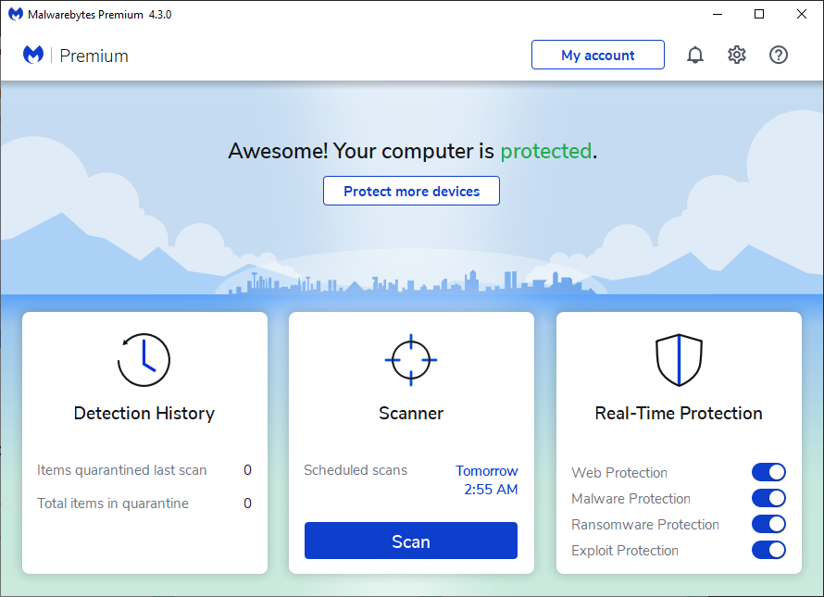
Run an Antivirus Scan (1 of 3)
Consider having a professional help run a more in-depth scan.
Open your antivirus software. Usually, you will be greeted with a splash screen and a “Scan” button.
This can vary depending on the software.

Slide 27
Run an Antivirus Scan (2 of 3)
If Something is Detected
A summary screen will show what was deemed suspicious.
Read the list of detected items to verify the files.
Ensure all suspicious files are checked.
Quarantine the checked items by clicking the appropriate button.

Slide 28
Run an Antivirus Scan (3 of 3)
If Something is Detected
Restart your system.
Ensures no lingering malware that was quarantined is still running in the background.
Delete/Clean the quarantined malware to fully remove it.

Slide 29
Best Practices
Best practices for preventing spyware and malware

Slide 30
Best Practices (1 of 2)
Never click links or download anything you are uncertain of.
Keep devices up-to-date with latest software updates.
When installing freeware, read the license agreements before accepting. If it mentions information gathering you may be installing spyware.

Slide 31
Best Practices (2 of 2)
Download a legitimate antivirus software to decrease chances of becoming a victim.
Avoid supposed free “anti-spyware” programs. Many of these are scams that either:
Falsely detect spyware on your system attempting to sell their product.
Install spyware on your machine.

Slide 32
Conclusions

Slide 33
In Conclusion
Spyware is a type of malware that secretly collects a user's personal information and private data.
Spyware and other malware can be downloaded through deceptive means such as phishing.
Always be mindful of links you are clicking through websites or emails.
Ensure you have firewall always running and an antivirus software installed.

Slide 34
Canadian Internet Registration Authority (CIRA)
These modules were made possible by the contributions of CIRA and their Community Investment Program.

Slide 35
References (1 of 3)
"The effect of ransomware attacks." UAB Collat School of Business, businessdegrees.uab.edu/blog/the-effect-of-ransomware-attacks/. Accessed 1 Mar. 2021.
"How Can You Prevent Spyware and Adware?" Logsign, 17 June 2020, www.logsign.com/blog/what-are-the-benefits-of-a-security-risk-assessment/. Accessed 1 Mar. 2021.
"Learn about Malware and how to tell if you're infected." Malwarebytes, www.malwarebytes.com/malware/. Accessed 1 Mar. 2021.

Slide 36
References (2 of 3)
Palozza, Fabio. "The Origin of Ransomware and Its Impact on Businesses." UAB Collat School of Business, 4 Oct. 2018, blog.radware.com/security/2018/10/origin-of-ransomware/. Accessed 2 Mar. 2021.
"Spyware: What is it and how to remove it?" Malwarebytes, www.malwarebytes.com/spyware/. Accessed 28 Feb. 2021.
"Spyware." Eset, www.eset.com/uk/types-of-cyber-threats/spyware/. Accessed 9 Mar. 2021.

Slide 37
References (3 of 3)
"Three Negative Effects of Ransomware." dms Technology, 22 June 2017, dmstechnology.com/three-negative-effects-ransomware/. Accessed 3 Mar. 2021.
"What is Malware?" Forcepoint, forcepoint.com/cyber-edu/malware. Accessed 28 Feb. 2021.
"What is spyware? And how to remove it." Norton, 9 Aug. 2019, us.norton.com/internetsecurity-how-to-catch-spyware-before-it-snags-you.html. Accessed 28 Feb. 2021.

