Slide 1
Social Media Security

Slide 2
What Will you Learn?
Gain a better understanding of how to protect yourself online through your social media settings.
Security and privacy settings and concerns for social media platforms.
What social engineering is and how it relates to social media.
Learn about geotagging.

Slide 3
Improve Social Media Security and Privacy

Slide 4
Facebook

Slide 5



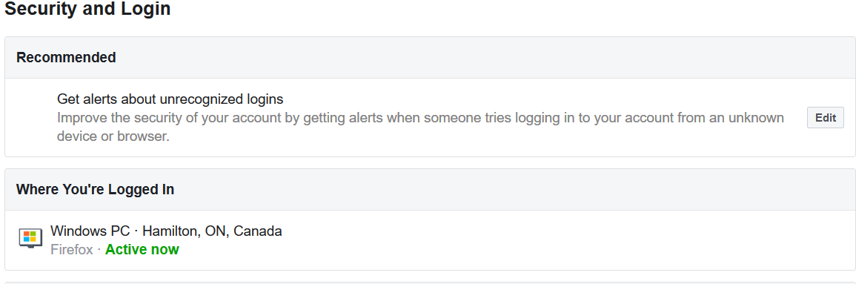
Increasing Facebook Security
Click on the profile icon in the upper right corner.
Click “Settings and Privacy”.
Click “Settings” and select “Security and Login”.
On this page, you can sign up for alerts when an unrecognized device accesses your account.

Slide 6
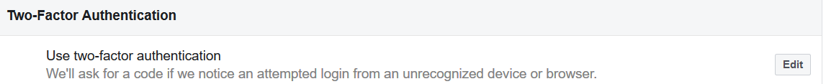
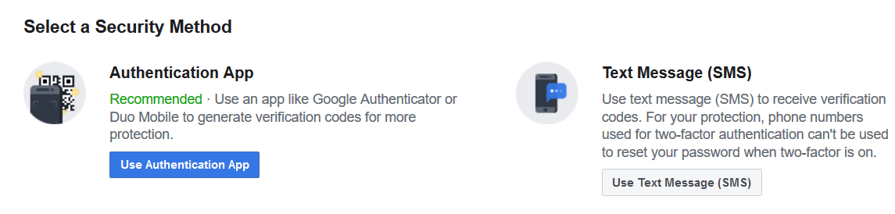

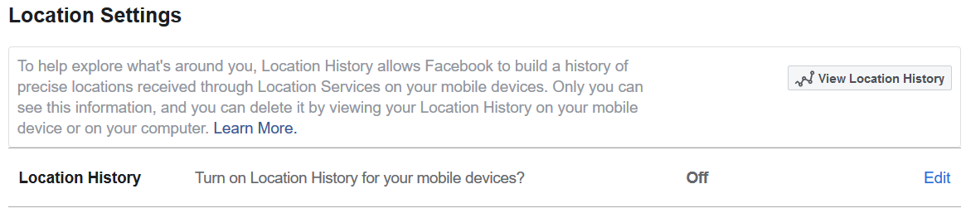
Increasing Facebook Security (cont.)
Click “Edit” under “use two-factor authentication”.
Select your authentication method and follow the steps involved.
Next, click on “Location” and make sure your location services are turned off.

Slide 7
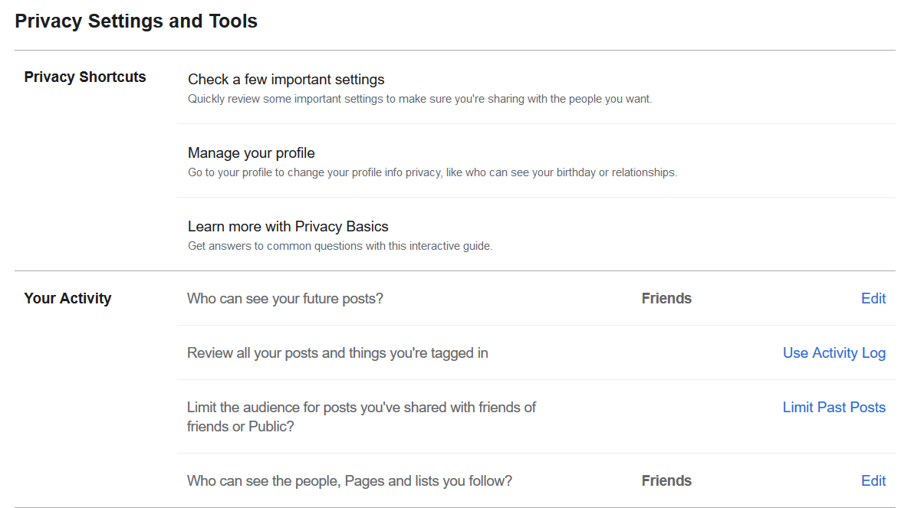
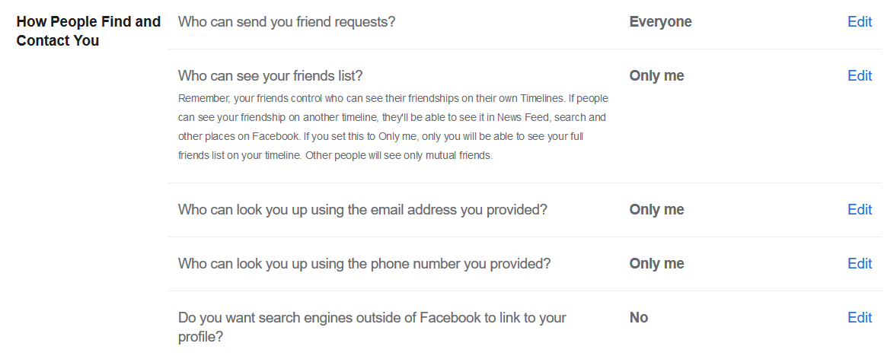
Increasing Facebook Privacy (1 of 4)
Click on “Privacy”.
You can now edit all of the settings found on your right.
We recommend turning off public search engine linkages and looking you up via phone and email.

Slide 8
Increasing Facebook Privacy (2 of 4)
We also recommend editing all of the options to either only share with friends, or only you.
Click “Limit Past Posts” to remove any previously publicly available posts.
Click “Use Activity Log” to see and edit what you’re tagged in.

Slide 9

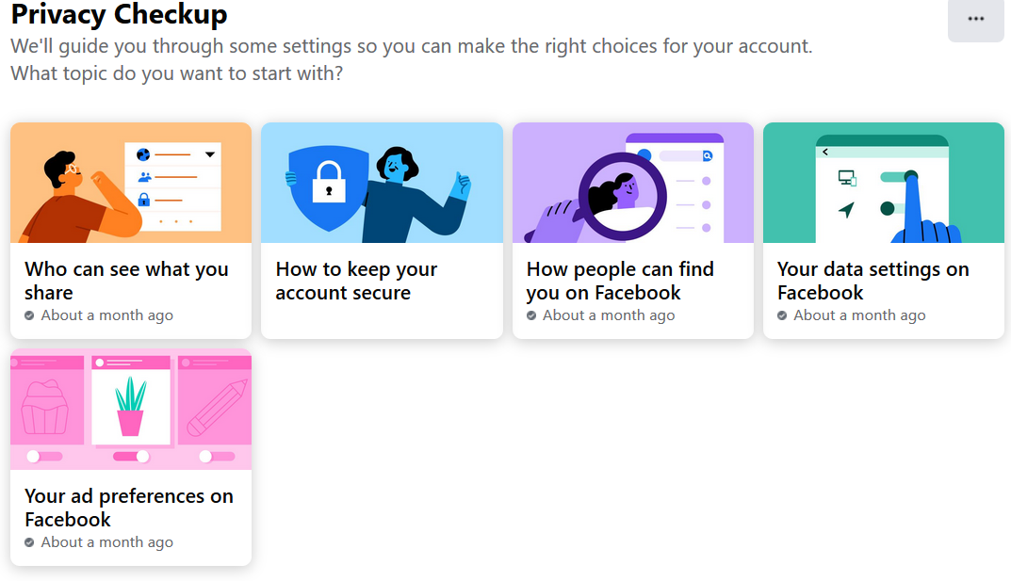
Increasing Facebook Privacy (3 of 4)
Click “Privacy Shortcuts”.
You will then be taken to the screen shown on the right.
By clicking on the three dots in the upper right corner, you can set automatic privacy checkup reminders.

Slide 10
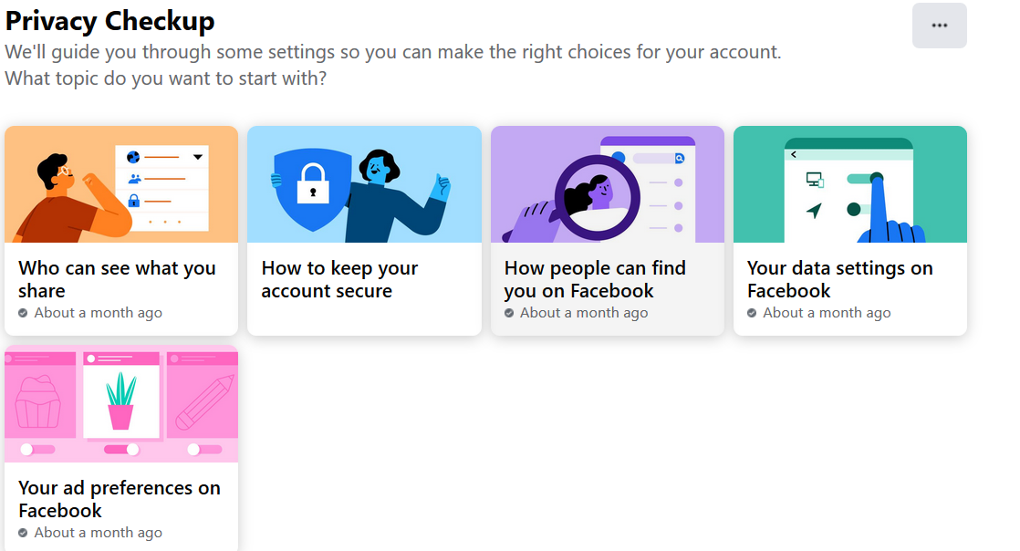
Increasing Facebook Privacy (4 of 4)
Click on all the icons found below and follow the steps to edit your privacy settings, your ad settings, view the apps you share information with, and ensure your account is secure.

Slide 11

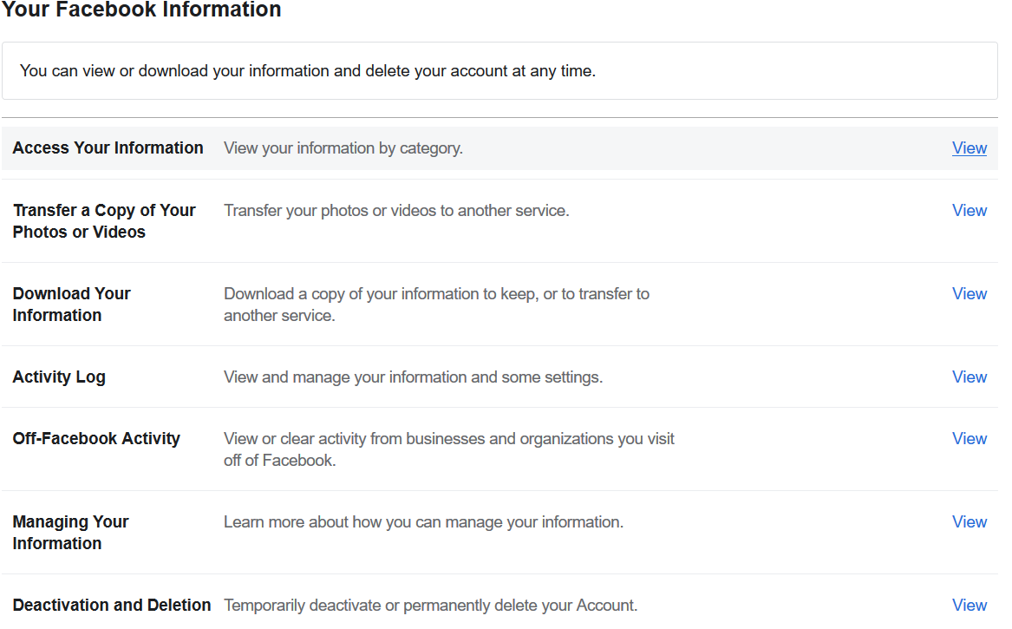
View Facebook Data and Account
Under settings, click “Your Facebook Information”.
You can then download your information, deactivate or delete your account.

Slide 12
Other Facebook Considerations
Facebook has had multiple breaches of user information such as email addresses, profile information and passwords.
Data has been harvested through Facebook third party applications to target advertisements and build personality and political profiles of users.
The most prominent security incident involving Facebook is the Cambridge Analytica incident.

Slide 13
Real Life Example – Facebook/Cambridge Analytica
The personal information of 87 million people was collected through a quiz application.
The application gave the creator access to the profile information of the user, as well as the information of everyone in their network.
The data was then sold to Cambridge Analytica, which used the data for advertising and psychological profiling.

Slide 14
Twitter

Slide 15





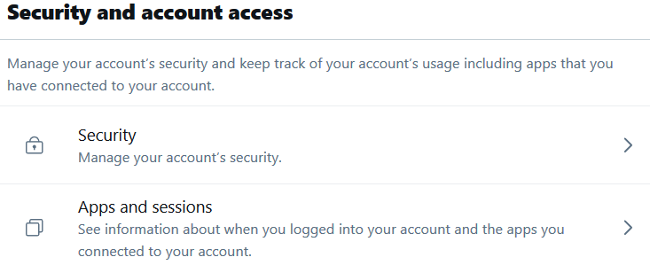
Increasing Twitter Security (1 of 5)
Select “More” from the option bar.
Click “Settings and Privacy”.
You will see options to deactivate your account and view your data.
Click on “Security and Account Access”.

Slide 16

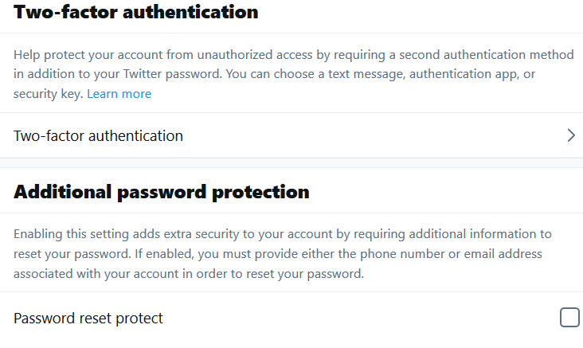

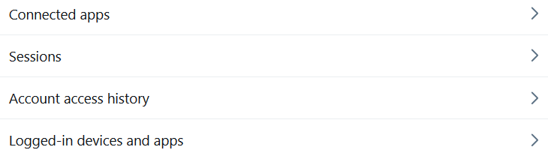
Increasing Twitter Security (2 of 5)
Under “Security” you can set up two-factor authentication and require additional information to reset your password.
By clicking “Apps and sessions” you can view all applications connected to Twitter, your access and login history, and all devices logged in to your account.

Slide 17

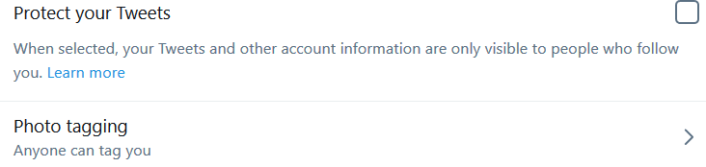
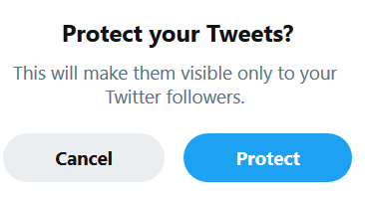

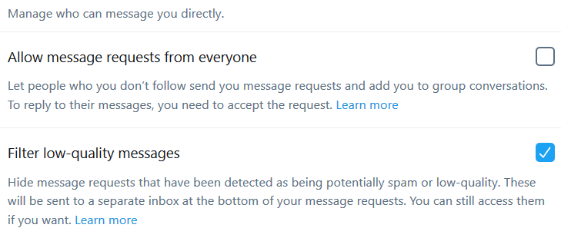
Increasing Twitter Privacy (3 of 5)
Select “Privacy and Safety”.
In “Audience and Tagging” select the checkbox to limit the visibility of tweets and stop people from tagging you in photos.
In “Direct Messages” ensure allow “messages from everyone” is turned off and “Filter low-quality messages is turned on”.

Slide 18


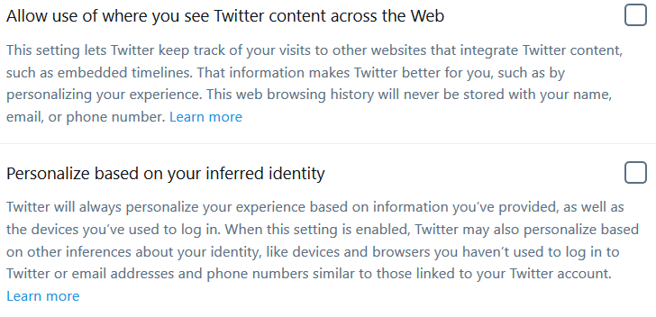
Increasing Twitter Privacy (4 of 5)
Click “Discoverability and Contacts” to edit the ability for people who have your email or phone number to find your account.
Under “Ads Preference” you can turn off targeted ads.
In “Off-Twitter Activity”, ensure both settings are turned off.

Slide 19
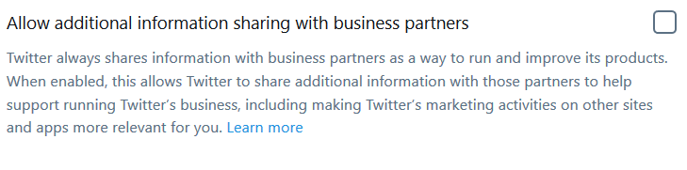
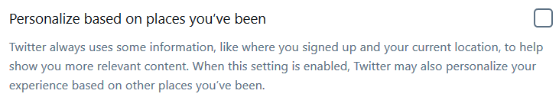
Increasing Twitter Privacy (5 of 5)
Under “Data Sharing with Business Partners” ensure that the checkbox is clicked off.
Under “Location Information”, make sure that checkbox is clicked off.

Slide 20
Other Twitter Considerations
In 2020, there was a breach of Twitter, allowing hackers to compromise the accounts of users including celebrities and politicians.
There have also been massive breaches of user information, including email addresses, names and passwords in 2016.
Twitter is an attractive target for hackers to damage a victim’s reputation.

Slide 21
Instagram

Slide 22
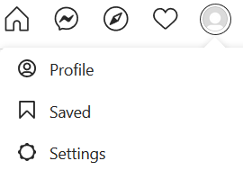

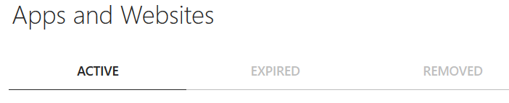
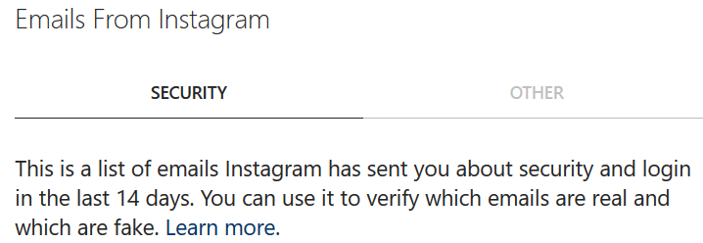
Increasing Instagram Privacy
Select “Settings” in the top right menu.
Turn off “Similar Account Suggestion”.
Click “Apps and Websites” to view and edit different applications and websites you have used Instagram to sign in with.
Under “Emails from Instagram” you can cross reference the list to avoid being scammed by fake emails.

Slide 23

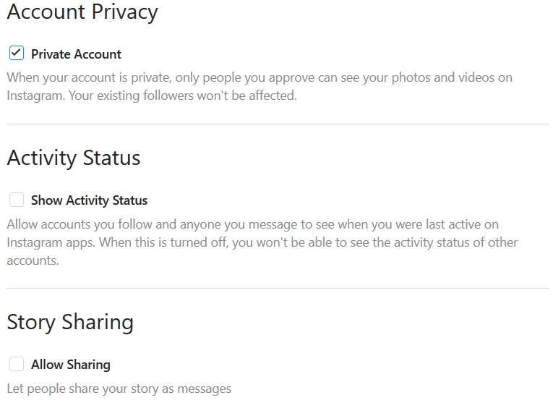
Increasing Instagram Privacy (cont.)
Select “Privacy and Security”.
In this section, you can make your account private by clicking the checkbox.
This will stop random users from viewing your account, photos and videos.

Slide 24
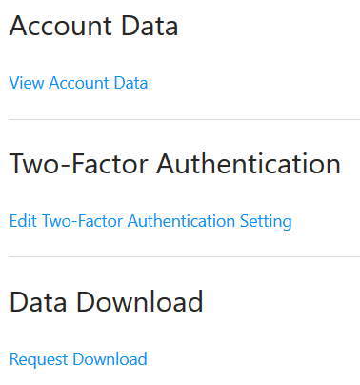
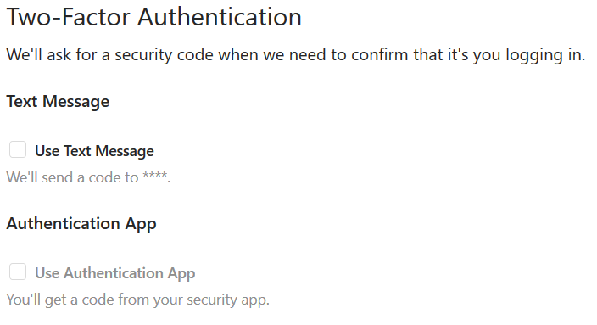
Increasing Instagram Security
In this section, you can also view and download your data.
You can also enable two-factor authentication.

Slide 25
Snapchat

Slide 26
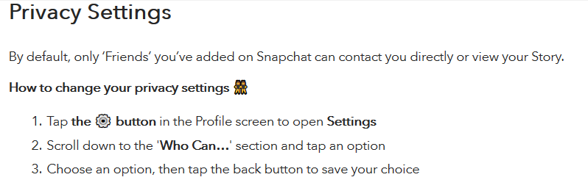
Increasing Snapchat Privacy
This information is from Snapchat’s Website: https://support.snapchat.com/en-US/a/privacy-settings2

Slide 27
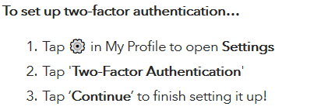
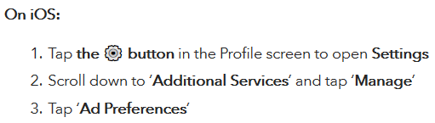
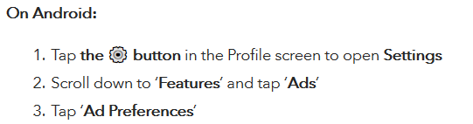
Increasing Snapchat Security
Enable two-factor authentication
Disable advertising and interest preferences depending on your device

Slide 28
Delete Snapchat Profile
In order to delete Snapchat, you will have to go into their Accounts portal and enter your information
Once this is complete, along with all subsequent steps, your account will be deleted 30 days after the request
Logging in again will cancel the request
Link to Delete Snapchat Account

Slide 29
Other Snapchat Considerations
There have been reports of Snapchat not deleting your data or photos, while this has been denied by the company, there is no way to verify this with certainty.
Snapchat has location settings that should be turned off to avoid people tracking you.
Although you will be notified, there is nothing stopping recipients from screen capping or saving photos before they disappear.

Slide 30
LinkedIn

Slide 31


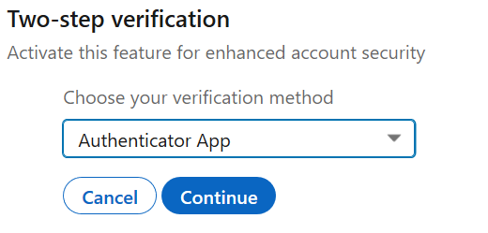

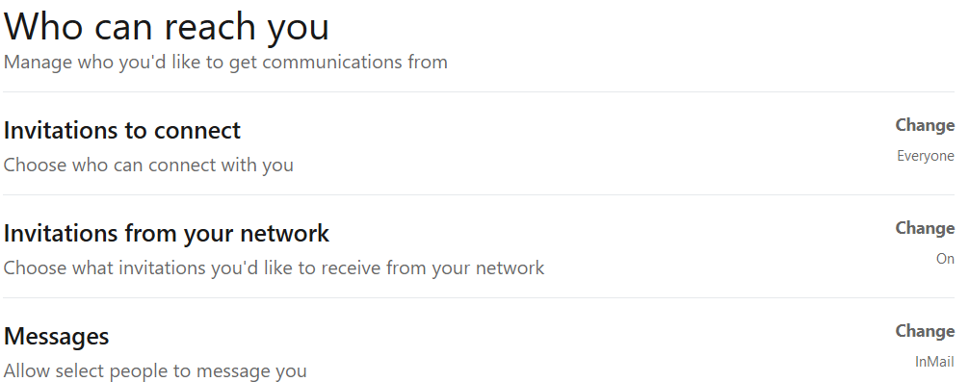
Increasing LinkedIn Privacy (1 of 4)
Click the dropdown menu under “Me” then select “Privacy and Security”.
Under “Sign in and Security” you can view all current sessions and enable two factor authentication.
Under “Communications” you can change who can contact or connect with you.

Slide 32
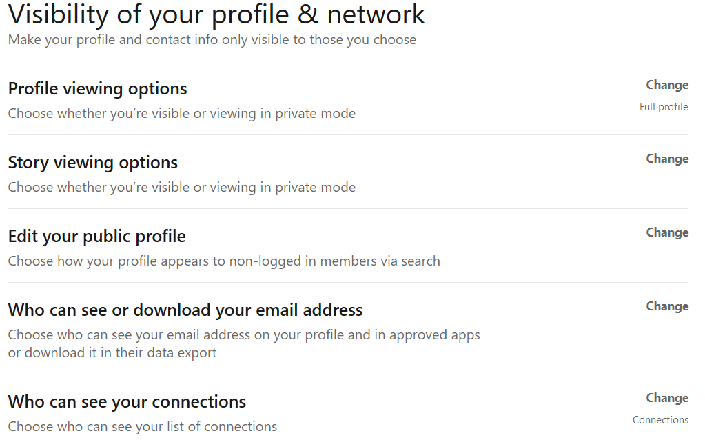
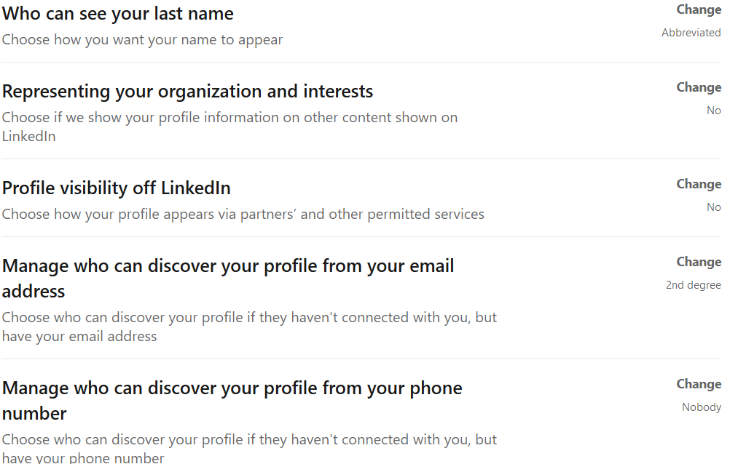
Increasing LinkedIn Privacy (2 of 4)
Under “Visibility” you can edit settings related to who can see you, or who your information is shared with.
We recommend turning off “Profile visibility off LinkedIn”, “Representing your organization and interests”.

Slide 33
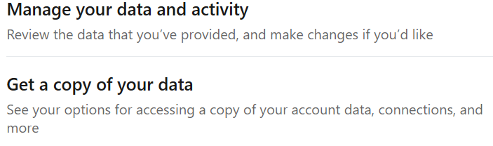

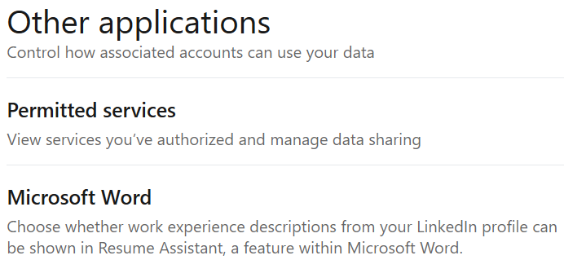
Increasing LinkedIn Privacy (3 of 4)
Under “Data Privacy” you can view, manage and download your data.
You can stop them from sharing information with third parties by selecting “no”.
You can also view and change connected applications.

Slide 34

Increasing LinkedIn Privacy (4 of 4)
Under “Advertising preferences we recommend you select “no” to all options to stop them from sharing your information with third-parties and targeting you with ads.

Slide 35
Other LinkedIn Considerations
By default, all third-party sharing options are turned on, including sharing your data with search engines, and advertising groups.
By design, LinkedIn contains a lot of information about your work history, education and current job.
This could lead to convincing targeted phishing attempts.

Slide 36
Pinterest

Slide 37
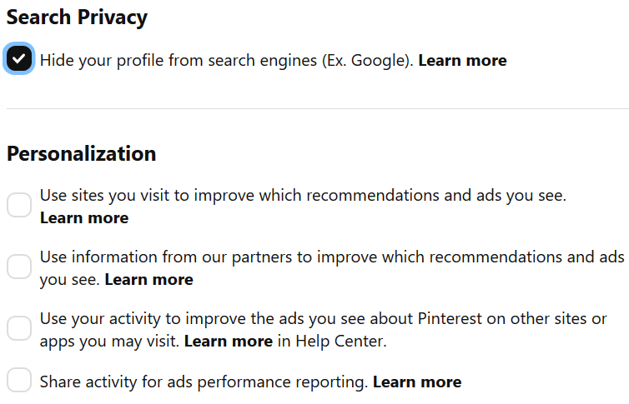
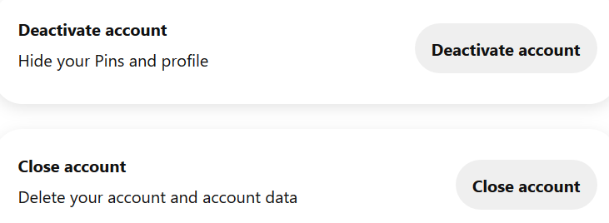
Increasing Pinterest Privacy
Under “Settings” select “Privacy and Data”.
Ensure “Search Privacy” is turned on and “Personalization” is turned off.
Under “Account Settings” you can deactivate or delete your profile.

Slide 38
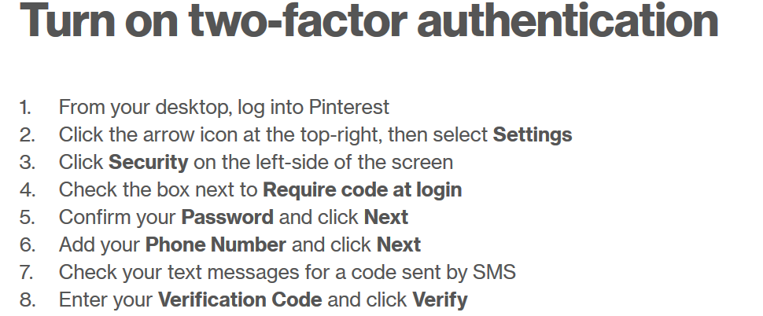
Increasing Pinterest Security
This information is from Pinterest’s site: https://help.pinterest.com/en/article/two-factor-authentication

Slide 39
TikTok

Slide 40
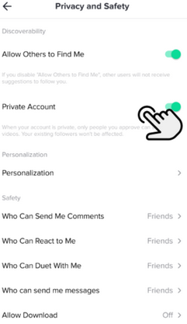
Increasing TikTok Privacy
Photo from: https://www.internetmatters.org/parental-controls/social-media/tiktok-privacy-and-safety-settings/
Go to your profile page and select the three dots in the upper right-hand corner
Select “Privacy and Settings” then select “Privacy and Security”
You can then edit the ability for people to find you, make your account private and who can view and contact you

Slide 41
Other TikTok Considerations
There have been confirmed reports of TikTok pasting keystroke data from other applications.
Many countries, including the United States believe that TikTok is being used as a spyware application and are moving to ban it, these claims are not confirmed, and potentially politically motivated.

Slide 42
Conclusions

Slide 43
In Conclusion (1 of 3)
Think before you post.
Do not share private information on social media.
Only share posts, information and pictures you are comfortable with the whole word seeing.
Think before you click.
If an email, post or message seems suspicious, has spelling or grammatical errors, is too good to be true or has a sense of urgency, don’t click it.

Slide 44
In Conclusion (2 of 3)
Enable two-factor authentication on social media platforms.
Edit your privacy and security settings on all social media platforms.
Be aware of who can see your information, and if it is publicly searchable.
Use different long, complex passwords for all social media accounts and all other accounts.

Slide 45
In Conclusion (3 of 3)
Be careful with which third party applications you use through social media.
Always lock your devices when not in use.
Disable location services.
Manage your networks, don’t add people you do not know.
Be aware of common social media threats and look out for them.

Slide 46

Canadian Internet Registration Authority (CIRA)
These modules were made possible by the contributions of CIRA and their Community Investment Program.

Slide 47
References (1 of 4)
"TikTok Privacy Settings." internetmatters.org, www.internetmatters.org/parental-controls/social-media/tiktok-privacy-and-safety-settings/. Accessed 10 Dec. 2020.
"13 Social Media Security Best Practices." Fraud Watch International, Jan. 2019, fraudwatchinternational.com/social-media/social-media-security-best-practices/. Accessed 4 Dec. 2020.
"Social Media Security Guide." UCLA IT Security, www.it.ucla.edu/security/resources/security-best-practices/social-media-security-guide. Accessed 5 Dec. 2020.

Slide 48
References (2 of 4)
Doffman, Zak. "Is TikTok Spying On You For China?" Forbes, July 2020 www.forbes.com/sites/zakdoffman/2020/07/25/beware-tiktok-really-is-spying-on-you-new-security-report-update-trump-pompeo-china-warning/?sh=17006d454014. Accessed 1 Dec. 2020.
Doffman, Zak. "Warning—Apple Suddenly Catches TikTok Secretly Spying On Millions Of iPhone Users” Forbes, June 2020 https://www.forbes.com/sites/zakdoffman/2020/06/26/warning-apple-suddenly-catches-tiktok-secretly-spying-on-millions-of-iphone-users/?sh=feccc334ef05. Accessed 1 Dec. 2020.

Slide 49
References (3 of 4)
Patterson, Dan. "Facebook data privacy scandal: A cheat sheet." TechRepublic, July 2020, www.techrepublic.com/article/facebook-data-privacy-scandal-a-cheat-sheet/. Accessed 7 Dec. 2020.
"Protect your account, Edit Account Privacy." Pinterest, help.pinterest.com. Accessed 10 Dec. 2020.
Symanovich, Steve. "What is social engineering? Tips to help avoid becoming a victim." Norton, July 2018, us.norton.com/internetsecurity-emerging-threats-what-is-social-engineering.html. Accessed 6 Dec. 2020.

Slide 50
References (4 of 4)
"Privacy Settings." Snapchat, support.snapchat.com/en-US/a/privacy-settings2. Accessed 10 Dec. 2020.
"15 Social Networking Safety Tips." Norton Security Online, www.nortonsecurityonline.com/security-center/15-social-networking-safety-tips.html. Accessed 6 Dec. 2020.
"An update on our security incident." Twitter Inc., July 2020, blog.twitter.com/en_us/topics/company/2020/an-update-on-our-security-incident.html. Accessed 14 Dec. 2020.

