Slide 1
Introduction to Cybersecurity

Slide 2
Learning Outcomes for this Module
Understanding of why someone would hack you.
What phishing and social engineering are and how they can affect social media.
Staying secure a public network and cellular data.
How you can install an antivirus.
What you should do if you are a hack victim.
Tips for increasing your password security.

Slide 3
Introduction

Slide 4
What is Cybersecurity?
Your information, devices, and networks are valuable and need to be protected from others who have malicious intent.
Attacks can happen beyond the screen through social means, and it is important to identify different types of attacks. This is why cybersecurity is important.

Slide 5
Why Would a Hacker Target Me?

Slide 6
What Motivates Hackers?
There are many motivations for hackers including:
Financial gain
Reputation Damage
Activism and Political
Revenge
Pride and challenges
Fun or because they can

Slide 7
It is Often Not Personal
A lot of attacks are low effort attempts on thousands of users at a time.
These types of attacks include phishing emails, fake social media giveaways, and unsecure websites full of malware.
The idea behind these attacks if they target enough people, someone will fall for it eventually.

Slide 8
Your Information is Worth Money
Regardless of how much money you have, cybercriminals can still profit from hacking you.
Personal information, email addresses, financial information, passwords, and account information are all worth money on the dark web.
When hackers can compromise hundreds or thousands of people with the same attack, they can make a lot of money selling collections of information.

Slide 9
Phishing, Social Engineering, and Social Media

Slide 10
What is Phishing?
Phishing is a type of cyberattack which involves contacting someone through email, phone, websites, or text message.
The victim is then asked to click or do something that the attacker wants, such as:
Clicking a link
Opening a document
Sending money

Slide 11
Personal Account Phishing
When you get a phishing email on a personal email, or your personal phone, there are a few things it could be after:
Money or financial information.
Personal information.
Account information.
They are often widespread attacks after smaller amounts of money or passwords.

Slide 12
Identify Phishing
Look at the source of the email or text message.
These two emails look similar:
donotreply@mohawkcollege.ca
donotreply@mohawkcollege.ca.scm.com
Only the first email would be from Mohawk College, while the other is from scm.com.

Slide 13
Social Engineering (1 of 2)
This is a technique used to manipulate people into giving up information or access through human error.
It can be done on a computer through means such as phishing or off a computer with methods such as spam phone calls.
Criminals use Social Engineering to gain access to sensitive information.

Slide 14
Social Engineering (2 of 2)
Criminals will often claim to be someone who should have access, without being checked for proper authorization.
Social media websites are often filled with alleged games or quizzes that will not allow a user to “play” them until they authorize giving access to personal information.

Slide 15
Examples of Social Engineering (1/2)
Quizzes and games trying to elicit personal information.
“Want to find out your superhero name? The first half corresponds with your birth day and the second half corresponds with your birth month”.
“Enter your first crush, full name, mother’s name, home city…. Tag 10 of your friends”.

Slide 16
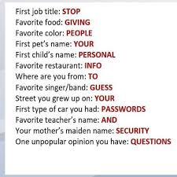
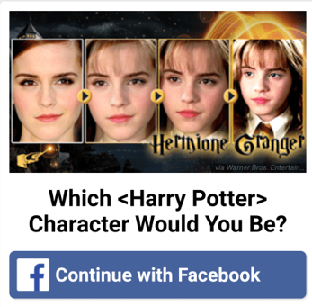
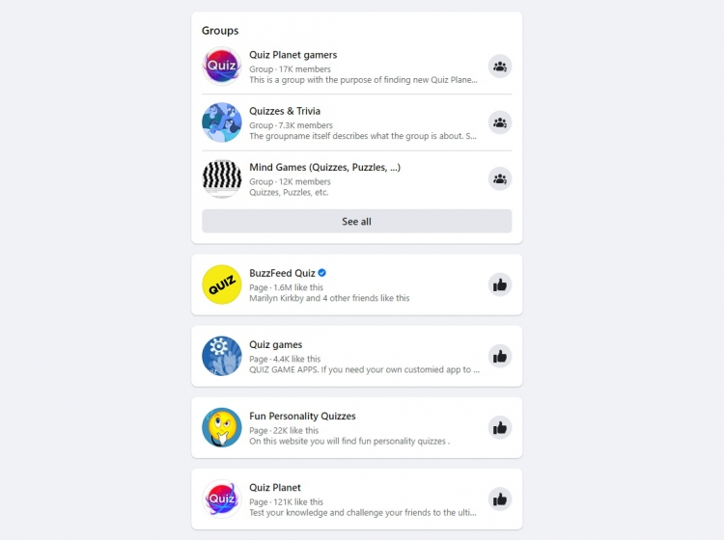
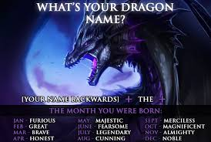
Examples of Social Engineering (2/2)

Slide 17
How Social Engineering Impacts Social Media (1/2)
Social media networks contain a ton of information about users and have wide user bases.
Everyone who uses any social media service has information about them, potentially including:
Email addresses, phone numbers, photographs, ages, birthdays, friends/followers, geographical locations.

Slide 18
How Social Engineering Impacts Social Media (2/2)
Some may not be aware of what they are sharing, who they are sharing it with, or how the information could be used against them.
By default, social media platforms have very minimal security and privacy settings enabled.
Most platforms do not tell you who is looking at your profile or what they are accessing on it.

Slide 19
Tips to Avoid Social Engineering (1/2)
Don’t share personal information.
Even if it seems unimportant. Your dog’s name, hometown or favourite movie; these are common security questions.
If you get a suspicious message or see a suspicious post from someone you know, do not click it. Verify they sent it using an alternative contact method.

Slide 20
Tips to Avoid Social Engineering (2/2)
Be careful with the applications you install on your devices and social media platforms.
Avoid putting financial information on social media.
Do not post anything online that you would not be okay with anyone in the world seeing.
Edit your security and privacy settings.
See our Improve Social Media Security module for more detailed information.

Slide 21
Stalking and Cyberbullying
Cyberbullying is a very serious concern, and it is important to protect ourselves online.
Previous coworkers, friends, partners, and random people and groups can use social media to find out information about you and find your location.
Your personal information could be used to bully, harass or threaten you.
Social media can provide stalkers with a ton of information including your location, common places you go, your network, and how to get a hold of you.

Slide 22
Public Wi-Fi and Cellular Data

Slide 23
For Consideration – Public Wi-Fi
We understand that a lot of people may need to use public Wi-Fi for one of many reasons:
Bad internet or cellular coverage.
Small data plans for cellular devices.
No access to devices or Wi-Fi.
Sudden outages or dropped connections.
This could include accessing Wi-Fi at your school, library, or even a Tim Horton’s.

Slide 24
Public Hotspots and Security
Public Wi-Fi is a completely unsecured network.
A public hotspot introduces major security risks.
Connecting to a public hotspot makes your device visible to any other device on the same network.
Do not enter any confidential information while on a public network.
There are methods that you can use to secure your devices on a public network!

Slide 25
Public Wi-Fi Best Practices
If you need to connect to a public hotspot, use a VPN (Virtual Private Network). This will secure your device.
Popular VPNs include NordVPN and ExpressVPN.
When using a public hotspot without a VPN, avoid entering any confidential or financial information if possible.
Look for the lock when connecting to a network to verify that it is a secured connection.

Slide 26
Cellular Data
Like a public hotspot, you should avoid giving out personal information over a cellular network.
Using your phone’s cellular data may prevent others from sharing the network, but the connection still is not secure.
It is still preferable to using a public hotspot, however.
Both cellular data and public hotspots can leave you open to an exploit called a Wi-Fi Pineapple.

Slide 27
What is a Wi-Fi Pineapple? (Wi-Fi🍍)
A Wi-Fi Pineapple is a device that is used to intercept data flowing between a device and a network.
A Wi-Fi Pineapple can deauthorize you from your current network and can connect you to an attacker’s if you are not paying attention.
This can allow the attacker to see everything you are doing and access your information.

Slide 28
What to do if You Have Been Hacked

Slide 29
If You Have Been Hacked
If your system is compromised disconnect your system from your network.
Scan your computer with an antivirus to see if there is any malware installed and remove it.
Immediately change your password information if you still have access to the account.
Update your password recovery security questions.

Slide 30
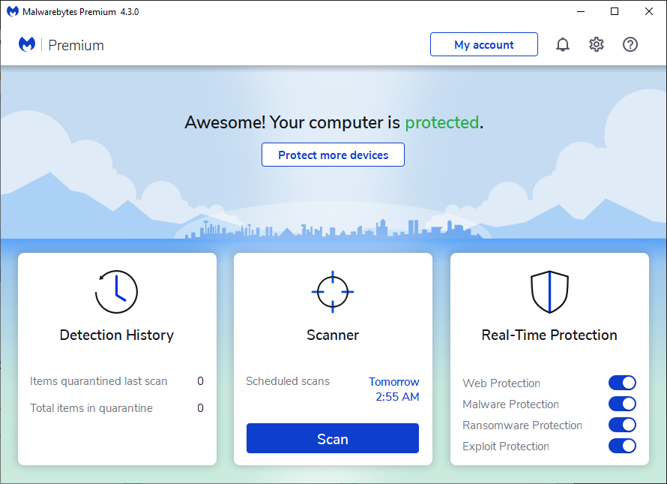
Run an Antivirus Scan (1 of 3)
Consider having a professional help run a more in-depth scan.
Open your antivirus software. Usually, you will be greeted with a splash screen and a “Scan” button.
This can vary depending on the software.

Slide 31
Run an Antivirus Scan (2 of 3)
If Something is Detected
A summary screen will show what was deemed suspicious.
Read the list of detected items to verify the files.
Ensure all suspicious files are checked.
Quarantine the checked items by clicking the appropriate button.

Slide 32
Run an Antivirus Scan (3 of 3)
If Something is Detected
Restart your system.
Ensures no lingering malware that was quarantined is still running in the background.
Delete/Clean the quarantined malware to fully remove it.

Slide 33
Report to Proper Authorities
If the device belongs to your school or work, immediately inform your teacher or boss, and designated IT specialists.
Contact the proper channels, such as website administration, if you are locked out of an account.
With hacks involving your financial credentials you should contact your financial institution immediately.
Contact your local police or the RCMP if necessary.

Slide 34
Check if You Have Been Compromised
Visit a website such as Have I Been Pwned: https://haveibeenpwned.com/
This website allows users to enter an email address and it will check if it has been used on a website that has had a previous data breach.
If your email populates results you will be able to see which websites have experienced a data breach.

Slide 35
Increasing Your Password Security

Slide 36
Password Security
Your password should be a minimum of 8 characters long, however we recommend that you use a password between 16–24 characters.
A longer password can make it significantly difficult to be cracked by a hack.
Adding in complex characters can help improve your password as well. Example:
B1ueD!n0s@ureggs90

Slide 37
Two-Factor Authentication
Two-factor authentication is a way of protecting yourself in case your password does get compromised.
There are many forms of two-factor authentication:
Randomly generated numbers through an authentication app, SMS text, or unlocking through biometric identification.
Google Authenticator is a recommended app for anyone who has a smartphone.

Slide 38
Third-Party Password Managers
These are applications that can save passwords across devices.
They can autofill fields for you to save time.
Your passwords are kept safe in the cloud, and you only need to remember a master password.
While some of these are free, some have a monthly cost associated with them which will give additional features depending on the application.

Slide 39
Best Practices
Best practices for keeping yourself safe from hackers

Slide 40
Lock your Computer, Lock your Phone
Protecting your device with a password or passcode will prevent people from accessing your information, posting from your accounts and doing other damage to your devices.
Always lock your devices when you are not using them, especially if you will be leaving them unattended.

Slide 41
Stay Safe on Social Media
Do not freely give out your personal information.
Be careful with which third-party applications you use through social media.
Avoid adding contacts unless you are familiar with the person.
See our Social Media Security module for more information.

Slide 42
Use Strong Passwords
A hack can compromise your personal information, including your financial and social media accounts.
Use strong varied passwords and update them regularly.
Be creative with security questions.
Turn on two-factor authentication when able.

Slide 43
Be Careful on Public Networks
Never connect to a public hotspot without a VPN if you plan to work, lookup financial information, or browse social media.
VPNs can secure your connection, even on unsecured public networks.
Using a VPN can help protect against cybercrimes such as identity theft.

Slide 44
Be Careful on Cellular Networks
When setting up your cellular data for tethering, encrypt the connection with a strong password.
Consider setting up a VPN for your mobile devices.
When connecting to a network be sure to confirm the network name (SSID) before connecting, and only connect to locked networks.

Slide 45
Scan with Antivirus Software
Always have an antivirus scanner installed.
Scan your system often to ensure it remains free of any malware.
Keep your software up to date.
Turn on periodic scans so you do not need to remember to manually scan your device.

Slide 46
Canadian Internet Registration Authority (CIRA)
These modules were made possible by the contributions of CIRA and their Community Investment Program.

Slide 47
References (1 of 4)
"13 Social Media Security Best Practices." Fraud Watch International, Jan. 2019, fraudwatchinternational.com/social-media/social-media-security-best-practices/. Accessed 4 Dec. 2020.
"15 Social Networking Safety Tips." Norton Security Online, www.nortonsecurityonline.com/security-center/15-social-networking-safety-tips.html. Accessed 6 Dec. 2020.
Grimes, Roger A. "15 signs you've been hacked—and how to fight back." CSO, Aug. 2020, www.csoonline.com/article/2457873/signs-youve-been-hacked-and-how-to-fight-back.html. Accessed 4 Feb. 2021.

Slide 48
References (2 of 4)
Johansen, Alison G. "What is antivirus software?" Norton, Feb. 2019, https://us.norton.com/internetsecurity-malware-what-is-antivirus.html. Accessed 4 Feb. 2021.
Laws, Alex. "8 Best Practices for Working Remotely." CI Security, ci.security/resources/news/article/8-best-practices-for-working-remotely. Accessed 19 Jan. 2021.
Raywood, Dan. "Top Ten: Ways to Secure Remote Workers." info security group, Sept. 2020, www.infosecurity-magazine.com/magazine-features/top-ten-secure-remote-workers/. Accessed 20 Jan. 2021.

Slide 49
References (3 of 4)
Rubenking, Neil J. "What to Do When You've Been Hacked." PC Mag, July 2019, www.pcmag.com/how-to/what-to-do-when-youve-been-hacked. Accessed 3 Feb. 2021.
"Social Media Security Guide." UCLA IT Security, www.it.ucla.edu/security/resources/security-best-practices/social-media-security-guide. Accessed 5 Dec. 2020.
Symanovich, Steve. "What is social engineering? Tips to help avoid becoming a victim." Norton, July 2018, us.norton.com/internetsecurity-emerging-threats-what-is-social-engineering.html. Accessed 6 Dec. 2020.

Slide 50
References (4 of 4)
Symanovich, Steve. "What is a VPN?" Norton, Jan. 2021, us.norton.com/internetsecurity-privacy-what-is-a-vpn.html. Accessed 21 Jan. 2021.
"What is a firewall?" Cisco, 2020, www.cisco.com/c/en_ca/products/security/firewalls/what-is-a-firewall.html. Accessed 21 Jan. 2021.
Zurkus, Kacy. "Are hackers gonna hack anymore? Not if we keep reusing passwords ." Malwarebytes, Nov. 2019, blog.malwarebytes.com/cybercrime/2019/03/hackers-gonna-hack-anymore-not-keep-reusing-passwords/. Accessed 3 Feb. 2021.

