Slide 1
Cybersecurity Threats and Journalism

Slide 2
Learning Outcomes for this Module
Understand what phishing and social engineering are.
Know what spyware is.
What doxing is and tips to avoid it.
An understanding of listening and recording devices, and tips to locate and stop them.
Learn what geotagging is.
Why you need to secure yourself when working remotely.

Slide 3
Introduction

Slide 4
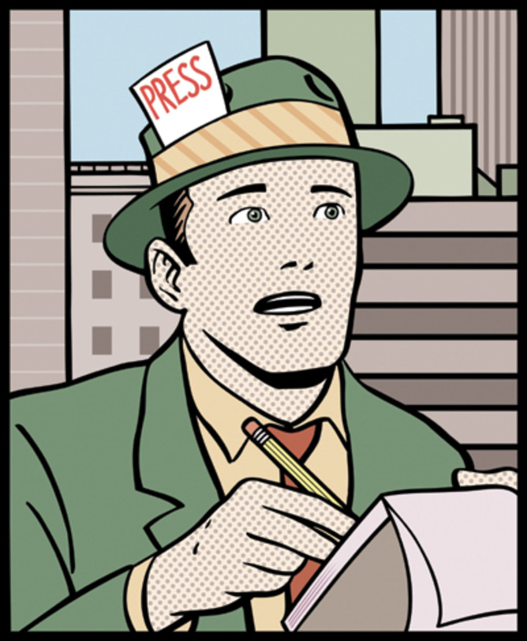

Journalism & Cybersecurity
This Photo by Unknown Author is licensed under CC BY-ND
This Photo by Unknown Author is licensed under CC BY-NC-ND

Slide 5
Cybersecurity & Journalism, why? - 1
Many journalists have been the targets of assault, both physical and digital.
Hackers have managed to destroy journalists’ data or evidence.
Journalists have had their personal information stolen and leaked.
Some journalists have faced life-threatening situations.

Slide 6
Cybersecurity & Journalism, why? - 2
Proper security helps protect a journalist’s sources.
Data is kept secure if a device needs to be turned over to authorities.
Communications are kept secure from potential eavesdroppers using some form of surveillance.

Slide 7
Possible Threats

Slide 8
Phishing
Phishing is a type of cyber attack which involves contacting someone through email, phone, websites, or text message.
The victim is then asked to click or do something that the attacker wants, such as:
  Clicking a link
  Opening a document
  Sending money

Slide 9
Personal Account Phishing
When you get a phishing email there are a few things it could be after:
  Money or financial information.
  Personal information.
  Account information.
They are often widespread attacks after smaller amounts of money or passwords.

Slide 10
Identify Phishing
Look at the source of the email or text message.
These two emails look similar:
  donotreply@mohawkcollege.ca
  donotreply@mohawkcollege.ca.scm.com
Only the first email would be from Mohawk College, while the other is from scm.com.
See our Phishing module for more information.

Slide 11
Social Engineering
Criminals mainly use Social Engineering to gain access to sensitive information.
This is a technique used to manipulate people into giving up information or access through human error.
It can be done on a computer through means such as phishing or off a computer with methods such as spam phone calls.
Criminals will often claim to be someone who should have access, without being checked for proper authorization.

Slide 12
Examples of Social Engineering
General examples include:
  Fake emails from companies saying there is an issue with your account and asking you to log in and fix it.
  Phone calls reporting a virus on your computer, asking for information about your devices.
  Messages from alleged contests claiming you have won a prize and need to provide personal information to claim it.

Slide 13
Sources and Scams
The USB drive could have malware like spyware or ransomware. It could do things such as steal your personal data or even wipe your system clean.
Imagine you receive an anonymous tip regarding a publication you are writing.
The tip claims to have additional information for you on a provided USB flash drive.
If you were to insert this unknown flash drive into your device, you could cause great harm to your system and your network!
Never connect a suspicious drive to your devices.

Slide 14
Spyware
See our Spyware module for additional information and how to remove spyware.
Spyware is a type of Malware that can infect both computers and mobile devices.
It is designed to get on a victim’s computer and run secretly in the background.
Spyware gathers information about an individual to be sent to the attacker.
  Often the information gathered can be used for purposes such as identity theft and financial loss.

Slide 15
Spyware and Journalism
Spyware can compromise the integrity of information by allowing it to leak to unauthorized individuals.
Personal information for yourself and your sources could potentially be stolen.
This could include names, addresses, and contact information, which could put you or others at risk.

Slide 16
Doxing
A term derived from slang. It means “dropping documents.”
It is an act that involves identifying personal information of someone else and revealing it publicly without a victim’s consent.
Journalists have been frequent targets of doxing, along with celebrities and politicians.

Slide 17
Doxing (continued)
These are not the only examples of personal information that could be publicly leaked.
The main purpose of doxing is to violate someone’s privacy.
Information often includes:
  A person’s real name
  A home or work address.
  Phone numbers.
  Financial account information.
  Government issued ID numbers such as a SIN.

Slide 18
Staying Safe from Doxing
Use a VPN to mask your IP address, even at home.
Use different strong passwords for all your accounts and enable two-factor authentication.
  For examples and information on strong passwords, see our Passwords module.
Be aware of phishing and social engineering.
  See our Phishing module and Social Media Threats module for more information.

Slide 19
Staying Safe from Doxing (continued)
Consider using different usernames across different platforms.
  Using the same name makes it easier to identify the websites you frequent.
Adjust your privacy and security settings on social media platforms.
  See our Improve Social Media Security module for more information.

Slide 20
Check Yourself Online
Use a web search engine like Google or Bing to look up your own name.
Consider doing a reverse image search of pictures featuring you.
How much information comes up?
Is there any information you see that you would rather keep private?

Slide 21
Geotagging
Geotagging is a feature that adds geographical location information to data such as pictures, videos, and even messages.
  For example, if you post a picture on Facebook, you have the option to tag your location.
The built-in GPS on devices such as smartphones is what allows for data to be geotagged.

Slide 22
Geotagging (continued)
Location data can range from a general area to specific addresses. This could potentially reveal the home address of a journalist or their source.
It is important to check the metadata of digital
photos, as sometimes they may contain GPS
location information.
It is highly encouraged to disable geotagging features to better increase your security.

Slide 23
Hidden Listening/Recording Devices
Security threats in physical spaces exist. These can be potentially setup in your home, hotel room, air B&B, office, and more.
Possible threats could include hidden objects such as cameras, microphones, and other tools.
Being able to scan an area for such eavesdropping devices can affect how safe one may feel.

Slide 24
Bug Sweeping
Carefully look around your surroundings.
  If it is an area that you are familiar with check if anything is new or out of place.
Monitor your wireless network to see if there are any unknown devices connected to it.
Check outlets and follow wires to determine if anything is being sourced for power.

Slide 25
Bug Sweeping – RF Devices (1 of 2)
Turn off all your wireless devices, including your wireless network.
Use a RF (radiofrequency) detector to scan for transmitters.
  Cheaper models can be purchased from retailers like Amazon.
  More expensive models can detect a higher range of frequencies.

Slide 26
Bug Sweeping – RF Devices (2 of 2)
You can sweep a room by slowly moving the device around a room.
  Signals vary depending how close you are to an object that is broadcasting a RF signal.
White noise machines can help act as an audio jammer to recording bugs.
  You can get white noise apps for your smartphone to accomplish this as well.

Slide 27
Bug Sweeping – NV Camera
Night-vision cameras can be swept for using an infrared scanner.
Android and iOS devices have apps that can use your smartphone’s flash to scan for camera lenses in a room.
These are only tips, and we cannot guarantee that these will completely identify all eavesdropping devices should you be in a situation involving them.

Slide 28
Public Hotspots
Public Wi-Fi is a completely unsecured network.
Connecting to a public hotspot makes your device visible to any other device on the same network.
  This can introduce a variety of security risks.
Do not enter any confidential information while on a public network. Another device on the same network could potentially intercept the information.

Slide 29
Public Hotspots (continued)
If you need to connect to a public hotspot, use a VPN (Virtual Private Network). This will secure your device.
When using a public hotspot without a VPN, avoid entering any confidential or financial information if possible.
Look for the lock when connecting to a network to verify that it is a secured connection. Avoid unlocked networks.

Slide 30
Conclusions

Slide 31
In Conclusion
Be aware of phishing attempts through email, text, and phone calls.
Avoid social engineering attempts by limiting the amount of personal information you give.
Periodically scan your computer with an antivirus to find and remove spyware.
Focus on protecting your identity online by using various usernames across different platforms.

Slide 32
In Conclusion (continued)
Disable geotagging to prevent anything you upload from sharing location data.
Recording and listening devices are actual threats to journalists, but there are methods to deal with them.
Secure your devices when you are working remotely away from the office or home.

Slide 33

Canadian Internet Registration Authority (CIRA)
These modules were made possible by the contributions of CIRA and their Community Investment Program.

Slide 34
References (1 of 4)
".ca Domains." Canadian Internet Registration Authority, www.cira.ca/ca-domains. Accessed 16 Mar. 2021.
Arntz, Pieter. "Cybersecurity for journalists: How to defeat threat actors and defend freedom of the press ." Malwarebytes Labs, 10 Jan. 2020, blog.malwarebytes.com/how-tos-2/2019/11/cybersecurity-for-journalists-how-to-defeat-threat-actors-and-defend-freedom-of-the-press/. Accessed 11 Mar. 2021.

Slide 35
References (2 of 4)
Baldwin, M., et al. "Azure data security and encryption best practices." Microsoft Docs, 9 Mar. 2020, docs.microsoft.com/en-us/azure/security/fundamentals/data-encryption-best-practices. Accessed 12 Mar. 2021.
"Evaluating Digital Sources." Purdue Online Writing Lab, owl.purdue.edu/owl/research_and_citation/conducting_research/evaluating_sources_of_information/evaluating_digital_sources.html. Accessed 16 Mar. 2021.

Slide 36
References (3 of 4)
"How Cybersecurity Makes Journalism Safer." Infoguard Cyber Security, 25 Sept. 2020, www.infoguardsecurity.com/how-cybersecurity-makes-journalism-safer/. Accessed 11 Mar. 2021.
Newman, Lily H. "How to Sweep For Bugs and Hidden Cameras." Wired, 9 Dec. 2017, www.wired.com/story/how-to-sweep-for-bugs/. Accessed 16 Mar. 2021.
"Researching with Wikipedia." Wikipedia, en.wikipedia.org/wiki/Wikipedia:Researching_with_Wikipedia. Accessed 16 Mar. 2021.

Slide 37
References (4 of 4)
"What is Doxing – Definition and Explanation." Kaspersky, www.kaspersky.com/resource-center/definitions/what-is-doxing. Accessed 16 Mar. 2021.
"Verification Tools." DataJournalism.com, datajournalism.com/read/handbook/verification-1/verification-tools/10-verification-tools. Accessed 17 Mar. 2021.

