Slide 1
Online Payments

Slide 2
Learning Outcomes for this Module - 1
Understand how your information is secured when using the Internet.
How safe it is to access financial accounts online, and the possible risks.
Understand the security requirements of creating an online account with the CRA.
Understanding using credit cards, debit cards, and e-commerce payment systems online.

Slide 3
Learning Outcomes for this Module - 2
Ways you can increase your security.
What a firewall is.
What a VPN is.
The dangers of public devices and networks.
Best practices when accessing financial accounts online.

Slide 4
Introduction

Slide 5
Finances and the Internet (1 of 2)
The Internet can be used in a variety of financial situations including banking, paying bills, online shopping, and money transfers.
Entering your financial information online can be a scary thought, due to the potential security risks.

Slide 6
Finances and the Internet (2 of 2)
There have been instances of credit cards being stolen and identity theft due to poor security measures.
It is good to be cautious, however there are many ways to remain safe online.

Slide 7
Online Encryption
How your Internet browser protects you

Slide 8
Online Encryption (1 of 3)
Whenever information is being shared online in a secure way it is using encryption.
All online financial institutions and digital retailers utilize encryption to protect your personal information while you use the website.
You should never input any personal information over a network that is not secured.

Slide 9
Online Encryption (2 of 3)
Even though websites may be encrypted, there is no perfect system. Some may link to unencrypted locations which could leak your data.
Often your web browser will warn you if a website is unsecured.
Modern encryption web browsers use is called TLS (Transport Layer Security) encryption. There is also a depreciated method called SSL (Secured Socket Layer).

Slide 10
Online Encryption (3 of 3)
TLS is designed to encrypt any data that is being transferred.
When you enter information, such as your name and address, into a form and then hit the ‘Submit’ button the information becomes encrypted as it is sent to its location, then unencrypts upon arrival.
For more in-depth information see our module on Encryption.

Slide 11
How to Tell if a Website is Secured
All website addresses are preceded by HTTP or HTTPS.
HTTPS stands for HyperText Transfer Protocol Secure.
HTTPS encrypts data using either TLS or SSL.
Websites that require a sign-in or that you can make a purchase from should all be using HTTPS.

Slide 12
Online Browser Security Certificate
Any website that requires sharing personal information should have a security certificate issued to them.
On your browser’s address bar, there may be an icon of a lock. This can be used to view the certificate.
The security certificate exists to verify that the website is who they say they are.

Slide 13
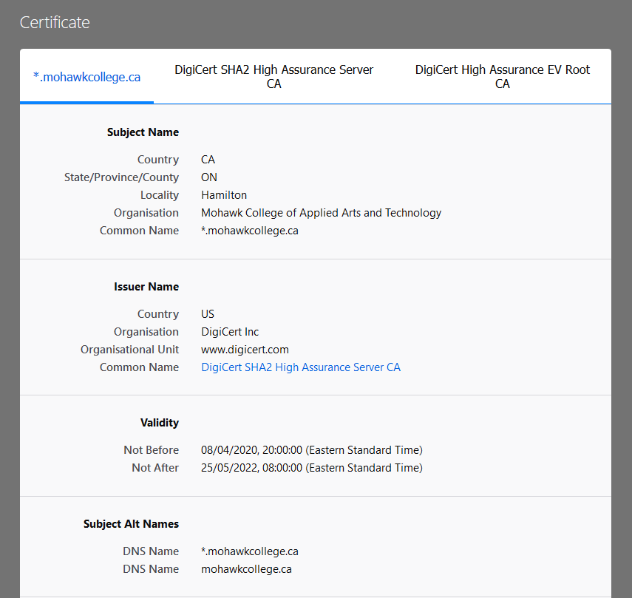
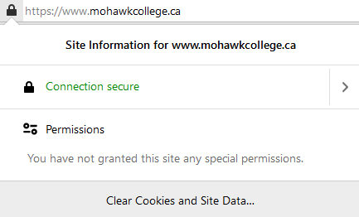
Internet Browser Security Certificate Examples
By clicking on the lock icon, you can view the security certificate of a website to verify it.

Slide 14
Online Financial Transactions
Banking online, shopping online, and methods of payment.

Slide 15
Online Banking (1 of 6)
Financial institutions across Canada offer the convenience of online banking.
Many individuals may be hesitant to access their financial accounts online.
This is understandable, but as time goes online banking is becoming more of a necessity.

Slide 16
Online Banking (2 of 6)
If you have properly secured your home network, it is quite safe to access an online bank account from your home.
Financial websites use at least 128-bit encryption and online firewalls to protect their site and your accounts.
When you setup an account be sure to use a strong password that is at minimum eight characters long.

Slide 17
Online Banking (3 of 6)
Many financial websites will allow you to enable two-factor authentication (sometimes referred to as multi-factor) to improve your account security.
Two-factor authentication can act as a secondary password that will protect your account.
It uses a randomly generated code you receive usually through an app or a text message.

Slide 18
Online Banking (4 of 6)
See our Passwords module for more information about setting up a strong password.
You should avoid accessing your financial accounts from a mobile device that is using either public Wi-Fi or your cellular data.
These are not secured connections.

Slide 19
Online Banking (5 of 6)
Information you send from your unsecure connection may possibly be seen from other devices on the same network.
You can secure your connection using a VPN (virtual private network).
It is a good idea to use a paid VPN service when using public Wi-Fi, and even at home for extra security.

Slide 20
Online Banking (6 of 6)
Once you are setup for online banking you can perform many convenient actions including:
Viewing, setting up, and closing accounts
Paying bills
Ordering cheques
e-Transfer funds

Slide 21
Filing Taxes Online
Filing personal taxes online is fast and convenient.
There are many services available that you can use to setup and file your taxes in your web browser.
These services can connect directly to the Canadian Revenue Agency and file your return online using the CRA’s NETFILE service.
If an individual is uncomfortable filing through NETFILE, they can download and mail their return.

Slide 22
Filing Taxes Online (continued)
Certified tax software that are used include:
Intuit TurboTax
UFile
Wealthsimple Tax
H&R Block Online
CloudTax

Slide 23
Online CRA Account (1 of 2)
You can create an online account with the Canada Revenue Agency’s secure website.
This website will allow you to do things such as:
Check tax slip information
Check your tax return status
Arrange direct deposit from the CRA
View specific payment schedules such as GST

Slide 24
Online CRA Account (2 of 2)
Setting up an online account through the CRA has additional security measures for your benefit.
An account cannot be fully created until an access code is entered that can only be received through regular mail. This is for verification purposes.
Security questions need to be setup upon account creation. One will be asked during any login attempt on a new device or network connection.

Slide 25
Be Aware of Fake Emails
See our Phishing module for more information.
Financial institutions and the CRA will never send you an email asking for personal information.
Their emails will not contain a link for you to click, but instead request you visit their site to access your account.
There are many phishing scams that pretend to be government and financial institutions to take advantage of people.

Slide 26
Debit, Credit, and e-Commerce Payment

Slide 27
Debit Cards
Many online retailers are beginning to offer service for debit cards with Visa or Mastercard.
Ideally you should never link your debit card directly to a website.
Debit cards can have direct access to your bank account(s).
If your debit card information were compromised, this could lead to various problems including financial loss.

Slide 28
Credit Cards
Before entering credit card information online ensure the website is secured (preceded by HTTPS).
Never share your credit card number through email.
While larger retailers like Amazon are generally safe, smaller retailers may lack the resources to properly protect against hackers.
There are alternative methods to pay with your credit card while protecting its visibility from a website.

Slide 29
Credit Cards (continued)
It is strongly encouraged that you do not share your credit card information on individual websites.
There are electronic commerce payment systems that you can link your card information to.
E-commerce payment systems act as an in-between to better protect your financial information from websites.

Slide 30
E-Commerce Payment Systems - 1
These are also known as digital payment systems or payment gateways.
You can input your credit card and debit card information into them.
They can offer payment processing for cards and hide personal information from online merchants.
Only necessary information such as your name and address will be shared with merchants.

Slide 31
E-Commerce Payment Systems - 2
Percentage fees are applied to a transaction that a merchant is required to pay.
These fees are often why smaller businesses may not use e-commerce payment systems.
Examples of e-commerce payment systems include PayPal, Stripe, and Square.
There are also digital wallets such as Apple Pay and Google Pay that function similarly.

Slide 32
PayPal
PayPal is the most used payment platform in the world.
It is available in over 200 combined countries/regions.
You can connect your credit card information to PayPal, and even your bank account details.
With PayPal you can withdraw and deposit funds to an account and send and receive funds.
It is recommended that you create a PayPal account if you plan to do any shopping online.

Slide 33
Online Shopping
Inputting your credit card information directly onto a website, even one with a security certificate, could still potentially place you at risk if their checkout security is not properly setup.
Many online merchants offer various payment methods when shopping online.
Credit card and PayPal are the most widely accepted methods of payment with online retailers.
It is strongly recommended that you use PayPal for checking out.
PayPal will process the transaction and protect your financial information.

Slide 34
If a Website Only Accepts a Card
There are reasons that some websites may only accept credit or debit payments.
Smaller businesses may not be able to afford the required fees from systems such as PayPal or Stripe.
Before you input your financial information and make a transaction, research the website to ensure that they have not previously experienced a data breach.
Consider purchasing and using a a prepaid credit card.

Slide 35
Prepaid Credit Card
There is a small processing fee when using a prepaid credit card.
Visa and Mastercard both offer prepaid cards that can be purchased in many locations such as drug stores and department stores.
You can use these cards like any credit card.
They contain no information aside from the funds you load onto them, so your personal financial information remains safe.

Slide 36
Mobile Payment Apps

Slide 37
Mobile Payment Apps (1 of 2)
Apple Pay and Google pay are two of the largest mobile payment apps.
Apple Pay is limited to Apple devices.
They consolidate multiple payment options into a single app.
There are additional options such as Samsung Pay, Visa Checkout, PayPal, and others.

Slide 38
Mobile Payment Apps (2 of 2)
NFC stands for Near-Field Communication.
Mobile payment apps are largely used for local payments through NFC, like debit cards with tap functionality, but they can be used online as well.
These applications can combine your credit card, debit card, and some gift cards to be accessed through your smartphone.
The number of e-commerce businesses that allow for these payment methods continues to grow each year.

Slide 39
Mobile Payment Security (1 of 2)
There is an understandable concern that anything you purchase using these apps is information gathered by the platformer holder (Google, Apple, etc.)
Your financial information is stored on your device, rather than a cloud service, to protect your information.
These services provide you a virtual account number so that your bank account numbers remain private.

Slide 40
Mobile Payment Security (2 of 2)
If your device is lost or stolen, you can remotely wipe your financial information that is stored on the device.
When making purchases these apps often require additional authentication such as pin, passcode, or biometrics.

Slide 41
Increasing Your Protection

Slide 42
Have a Firewall Enabled (1 of 2)
Firewalls exist to prevent security threats from being able to gain access to a network or device.
It is a security tool for a network that monitors incoming and outgoing traffic and will allow, or block connections based on the set security rules.
Consider it the first line of defense against threats to your devices and network.

Slide 43
Have a Firewall Enabled (2 of 2)
By preventing unauthorized connections, information you send over a network remains better protected.
A firewall is not only important for protecting personal and financial information, but for protecting your device from threats in general.

Slide 44
How do I get a Firewall?
There are many firewalls available.
Certain operating systems come pre-installed with their own.
Some firewalls are provided by:
The computer’s operating system.
Included within an antivirus software.
Some are a hardware device.

Slide 45
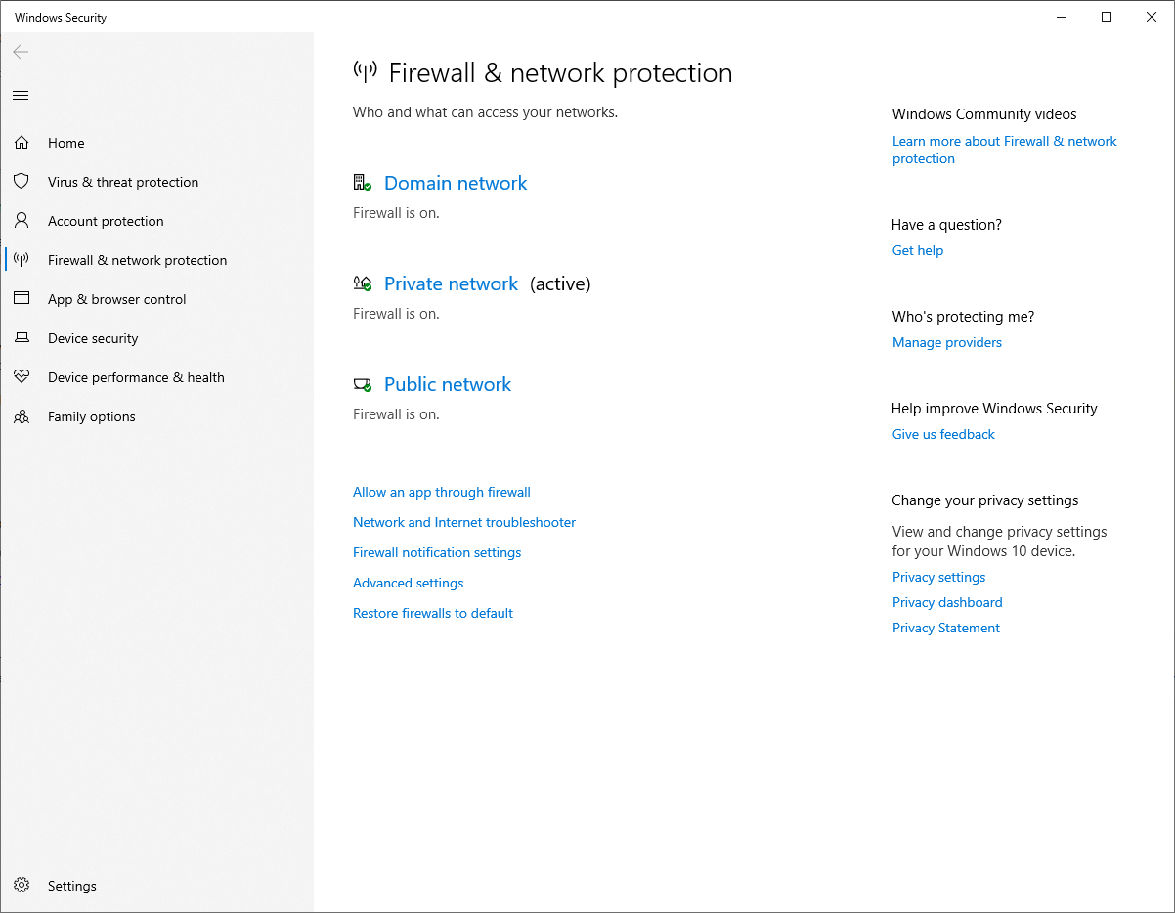
Check Firewall Status
On Windows 10 you can see if you have an active firewall in the Windows Security Centre.

Slide 46
Avoid Public Networks and Devices - 1
Sometimes the only way we can access the Internet may be through a public hotspot.
Examples include Wi-Fi at Tim Horton’s, or on a public machine at a library.
While these are convenient methods to access the Internet, the devices are on a shared network.
Being on a shared network can allow other devices on the same network to see each other.

Slide 47
Avoid Public Networks and Devices - 2
You should never share personal information online when using a public device.
You do not know who else has used the device, and if they could have potentially compromised it.
When using a public network or hotspot with your own device, you should never share personal information.
You can secure your device on a public network by using a VPN.

Slide 48
Use a VPN (1 of 3)
Connecting to the Internet and browsing without a VPN enables any site or network you access to see your IP (Internet Protocol) Address.
A VPN cn help protect against identity theft by protecting any private and personal information sent and received over a network.

Slide 49
Use a VPN (2 of 3)
By encrypting your data, a VPN adds protection to your online actions including online banking and online shopping.
Other devices on the same network are blocked from accessing your data.
This is important when using public Wi-Fi.

Slide 50
Use a VPN (3 of 3)
Relying on a free VPN solution is not recommended.
Free services often lack the latest security protocols, have slow speeds, and lack support for troubleshooting.
Some of the top recommended dedicated VPN services, rated for security, speed, and pricing are:
ExpressVPN
NordVPN
Surfshark
Each provides easy one-click setup and multiple device compatibility including mobile devices.

Slide 51
Clear Your Cookies and History - 1
Many websites track our general Internet usage using data called cookies.
Cookies are also how a website ‘remembers’ who we are when we access them again from the same web browser.
This is how an online merchant keeps track of our shopping cart, and even just how we can remain logged into a website after leaving it.

Slide 52
Clear Your Cookies and History - 2
Clearing this information will help prevent your information from being accessed if another person uses your device, or if your device becomes compromised.
For more information on clearing browsing data, see our Web Browsers Desktop Instructions module.

Slide 53
Story – Credit Card Fraud

Slide 54
Story – Stolen Credit Card (1 of 3)
A few years ago, there was an online Canadian merchant that I wanted to make a purchase from.
At the time, the website did not offer PayPal or any other e-commerce payment service, and I needed to enter my credit card information.
I made the purchase, and everything seemed fine. I received my product and thought that was the end of it.

Slide 55
Story – Stolen Credit Card (2 of 3)
Around 2–3 months later I received a call from my credit card issuer.
I was informed of suspicious activity on my card, and they wanted to confirm.
After listing out several, some embarrassing, transactions that were not mine, it was determined that my credit card information had been stolen and used by someone else.

Slide 56
Story – Stolen Credit Card (3 of 3)
The credit card institution fortunately cancelled the charges so I would not suffer any financial loss.
They canceled the card and sent me one with a new number.
I later searched online and learned that many others who had purchased from the same website I had, also had their credit card information compromised.

Slide 57
Story – Lesson Learned
Today the website does offer PayPal, but there are still reports of individuals having their credit card information leaked if they use it there.
The lesson learned was that even though everything seemed fine, a few months later problems occurred.
It is much safer to use an e-commerce system such as PayPal to protect your information rather than relying on the encryption offered through a web browser.

Slide 58
Conclusions

Slide 59
In Conclusion (1 of 2)
It is very safe to bank and shop online.
However, we still need to remain aware of potential threats.
Government institutions such as the CRA use online services for personal accounts.
No digital platform is perfect. Even with encryption many organizations have still been victims of hacks.

Slide 60
In Conclusion (2 of 2)
Never share any personal information if you are not on a secured personal device.
E-commerce payment systems are a much better alternative to using your credit card or debit card online.
PayPal is a highly recommended option.
Always have a firewall running and use a VPN if you are on a public network.

Slide 61

Canadian Internet Registration Authority (CIRA)
These modules were made possible by the contributions of CIRA and their Community Investment Program.

Slide 62
References (1 of 3)
Cook, Sam. "How to stay safe when paying online, here’s what you should know." comparitech, 23 Jan. 2017, www.comparitech.com/blog/information-security/stay-safe-when-paying-online/. Accessed 23 Mar. 2021.
Lake, Josh. "What is TLS and how does it work?" comparitech, 18 Mar. 2021, www.comparitech.com/blog/information-security/tls-encryption/. Accessed 23 Mar. 2021.
"Credit card fraud." Government of Canada, Financial Consumer Agency of Canada, www.canada.ca/en/financial-consumer-agency/services/credit-fraud.html. 24 Mar. Accessed 2021.

Slide 63
References (2 of 3)
Fearn, Nicholas, et al. "Best payment gateways of 2021: for payment processing online." techradar Pro, 12 Jan. 2021, www.techradar.com/best/best-payment-gateways. Accessed 23 Mar. 2021.
"File your taxes online: Certified tax software." Government of Canada, www.canada.ca/en/revenue-agency/services/e-services/e-services-individuals/netfile-overview/certified-software-netfile-program.html. Accessed 25 Mar. 2021.
Hodge, Rae, and David Gewirtz. "Best VPN service of 2021." CNET, Jan. 2021, www.cnet.com/news/best-vpn/. Accessed 24 Mar. 2021.

Slide 64
References (3 of 3)
Baldwin, Roberto. "How to pay for things securely." engadget, 29 Aug. 2019, www.engadget.com/2019-08-29-how-to-make-online-payments-safely-and-securely.html. Accessed 24 Mar. 2021.
Uzialko, Adam. "Mobile Wallet Guide: Google Pay vs. Apple Pay vs. Samsung Pay." business.com, 9 Sept. 2020, www.business.com/articles/google-pay-vs-apple-pay-vs-samsung-pay/. Accessed 23 Mar. 2021.
Symanovich, Steve. "What is a VPN?" Norton, Jan. 2021, us.norton.com/internetsecurity-privacy-what-is-a-vpn.html. Accessed 23 Mar. 2021.

