Slide 1

Phishing

Slide 2
History and Definitions

Slide 3
History
In 2004 the first Phishing lawsuit was filed in California against a 17-year-old who had constructed a false copy of a well known website, “America Online”.
In creating this fake website the young man was able to obtain credit card details from users, which he then used to withdraw money from their accounts.
Notes:
References:
https://www.phishing.org/what-is-phishing

Slide 4
Definition
Perpetrators often pose as legitimate organizations
Phishing is a cybercrime where individuals are targeted via email, text messages or phone calls in order to retrieve private information.
Information acquired can be passwords, documents pertaining to identification, or credit cards and banking information.
Notes:
References:
https://www.phishing.org/what-is-phishing

Slide 5
Phone calls
“Vishing” (Voice Phishing) is the telephone version of Phishing.
This method of Phishing aims to verbally coerce a user into revealing sensitive information, with most cases ending in identity theft.
Notes:
References:
https://whatismyipaddress.com/vishing

Slide 6
Text Messages
“Smishing” seeks to accomplish these tasks yet use text messaging platforms as a medium.
Text Message Phishing is also known as “Smishing” (SMS Phishing).
When a “phish” occurs, cybercriminals send deceptive messages that attempt to persuade individuals into clicking harmful links or opening malicious attachments.
Notes:
References:
https://www.phishing.org/what-is-phishing

Slide 7
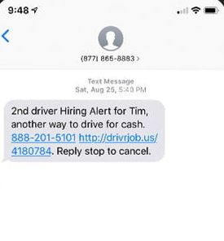
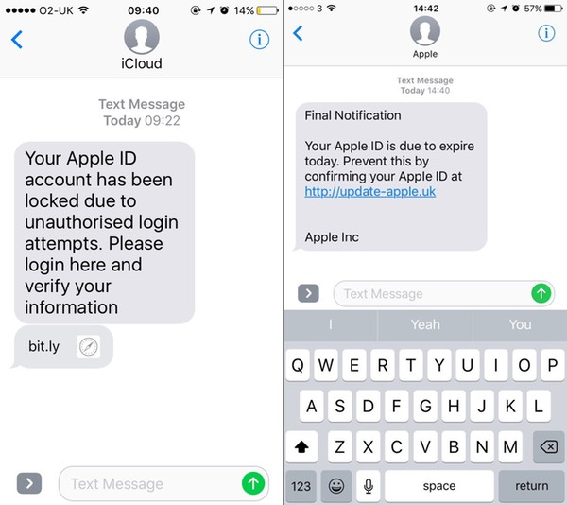
Examples of “Smishing”
Do any of these texts seem suspicious?
Notes:
References:
https://www.welivesecurity.com/2016/11/10/apple-id-smishing-evolves-lure-victims/
https://www.digitaltrends.com/computing/smishing-threat-targets-phones-by-text-message/

Slide 8
Email
Phishing scams are found commonly in emails.
Common signs of a Phishing email are:
Unidentified senders.
When the email seems too good to be true.
There is a sense of urgency for the target to respond.
Contains suspicious looking links or attachments.
Notes:
References:
https://www.phishing.org/what-is-phishing

Slide 9
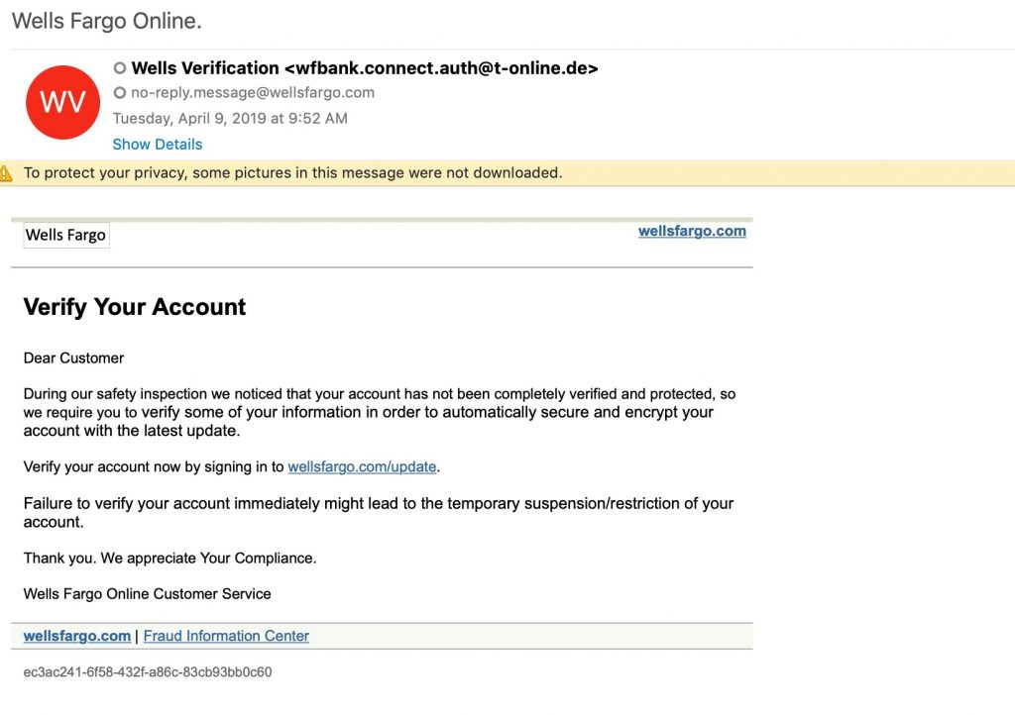
Email Phishing Example
Does anything seem suspicious about this email?
Notes:
References:
https://www.wellsfargo.com/privacy-security/fraud/report/phish/
https://www.vadesecure.com/en/anatomy-of-a-phishing-email/

Slide 10
Identifying Phishing Emails

Slide 11
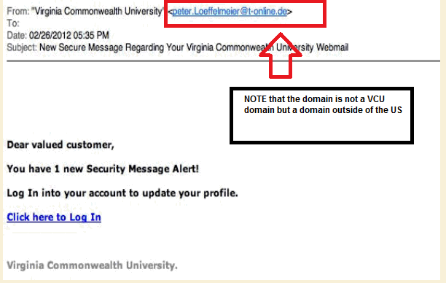
Unknown Senders
When receiving emails be on alert for unfamiliar senders.
Even if the email is from a known contact, be aware if the content of the email seems out of the ordinary or unexpected, it could be a scheme.
Notes:
References:
https://www.phishing.org/what-is-phishing
https://blogs.vcu.edu/phishing/how-to-identify-scams/

Slide 12
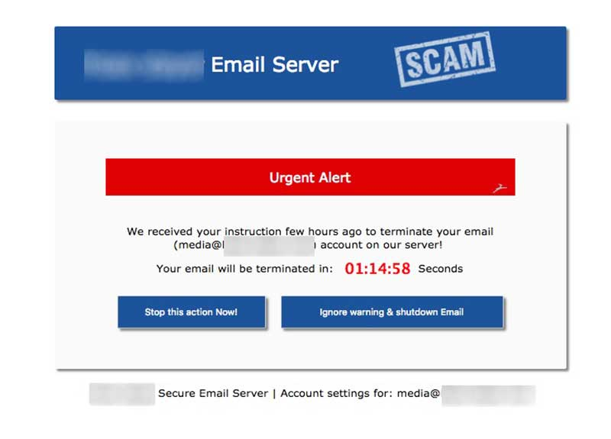
Urgency
Some email content may pressure you to respond fast or claim that an account or subscription you hold will be suspended.
It is beneficial to be mindful of the urgency within an email, this is a primary sign of a Phishing scam.
Notes:
References:
https://www.phishing.org/what-is-phishing
https://www.hoax-slayer.net/urgent-server-warning/

Slide 13
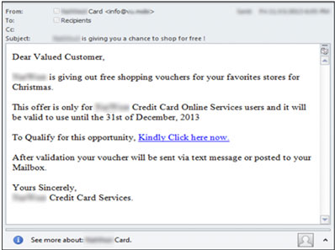
To Good to be True
Phishing emails can contain promising rewards for the designated target.
Suspicious attention-grabbing emails often guarantee the recipients that they will receive items or cash prizes.
Notes:
References:
https://www.phishing.org/what-is-phishing
https://sites.udel.edu/threat/2013/12/04/voucher-for-one-free-scam/

Slide 14
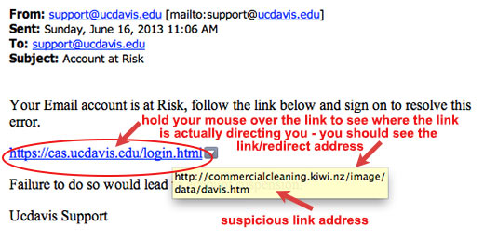
Attachments & Hyperlinks
Think before you click!
In Phishing emails it is common to see attachments or links requesting your attention.
Be cautious of suspicious looking links or attachments.
Notes:
References:
https://www.phishing.org/what-is-phishing
https://www.brock-it.ca/phishing-think-before-you-click/

Slide 15
Preventative Measures

Slide 16
Preventative Measures
There are a number of ways to avoid being caught by Phishing scams.
Delete suspiciously “urgent” looking emails.
Utilizing spam filters. Filters can determine the source and software used in creating spam emails. Additionally, filters may also block legitimate sources, therefore it is not completely accurate.
Notes:
References:
https://www.phishing.org/what-is-phishing

Slide 17
Preventative Measures Continued
There are a number of ways to avoid being caught by Phishing scams.
Change passwords regularly for accounts and never use the same password for every account.
Utilize the number of security awareness training sessions and materials that may be available.
Avoid using public networks when accessing sensitive information such as identification documents and banking platforms.
Notes:
References:
https://www.phishing.org/what-is-phishing

Slide 18
Preventative Measures Continued
There are a number of ways to avoid being caught by Phishing scams.
If attachments are present, refrain from downloading suspicious documents, .txt files are the only safe file to download.
If there are hyperlinks, hover over the URL, the link may direct to a different site completely. Pay attention to URL spelling, small changes in a valid looking link may go unnoticed.
  Example: “google.com” vs “goggle.com”
Notes:
References:
https://www.phishing.org/what-is-phishing

Slide 19
Preventative Measures Continued
There are a number of ways to avoid being caught by Phishing scams.
Configure browsing settings to avert deceitful websites from opening. Secure websites begin with “https:”. All sites will ultimately be required to have valid security protocols in place.
Be aware that a bank will not request personal verification via email. Banks will not request an individual to update their account within a designated time period.
Notes:
References:
https://www.phishing.org/what-is-phishing

