Slide 1
Phishing
Introduction, Types of Phishing Attempts and What to Do if you Click a Phishing Link

Slide 2
Learning Outcomes for this Module
Discover the different types of phishing and common examples of them.
Why phishing is so prevalent.
Being able to recognize the signs of a phishing attempt.
What to do if you accidentally click on a phishing link.

Slide 3
Introduction

Slide 4
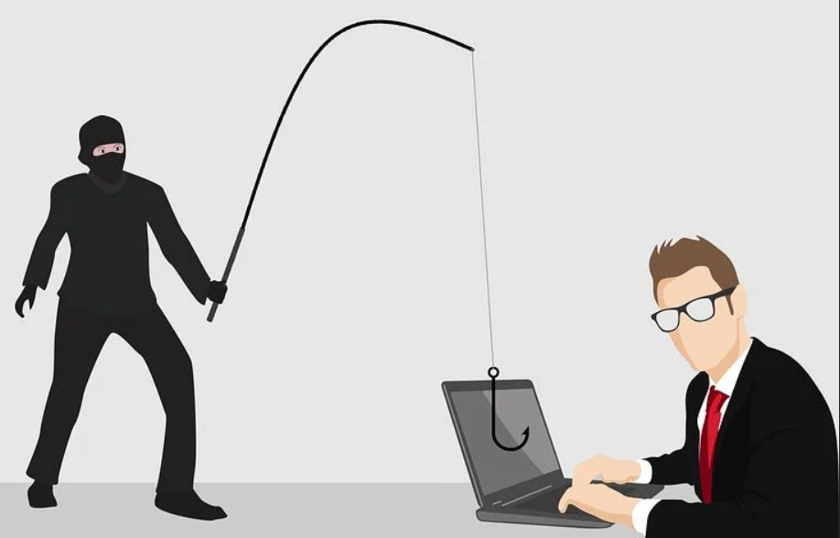
What is Phishing? (Image)
What is Phishing?
Image Source: https://pixabay.com
Image Source: https://pixabay.com

Slide 5
What is Phishing?
Phishing is a type of cyberattack which involves contacting someone through email, phone, websites, or text message.
The victim is then asked to click or do something that the attacker wants, such as:
  Clicking a link
  Opening a document
  Sending money

Slide 6
Why Send the Phishing Message?
There are many different motives for sending a phishing message.
They can be different depending on the target.
  Attackers will target individuals in a business to infect a network, steal information, steal money, or ransom a business.
  Attackers target individuals for personal, account, and financial information.

Slide 7
Personal Account Phishing
When you get a phishing email on a personal email, or your personal phone, there are a few things it could be after:
  Money or financial information.
  Personal information.
  Account information.
They are often widespread attacks after smaller amounts of money or passwords.

Slide 8
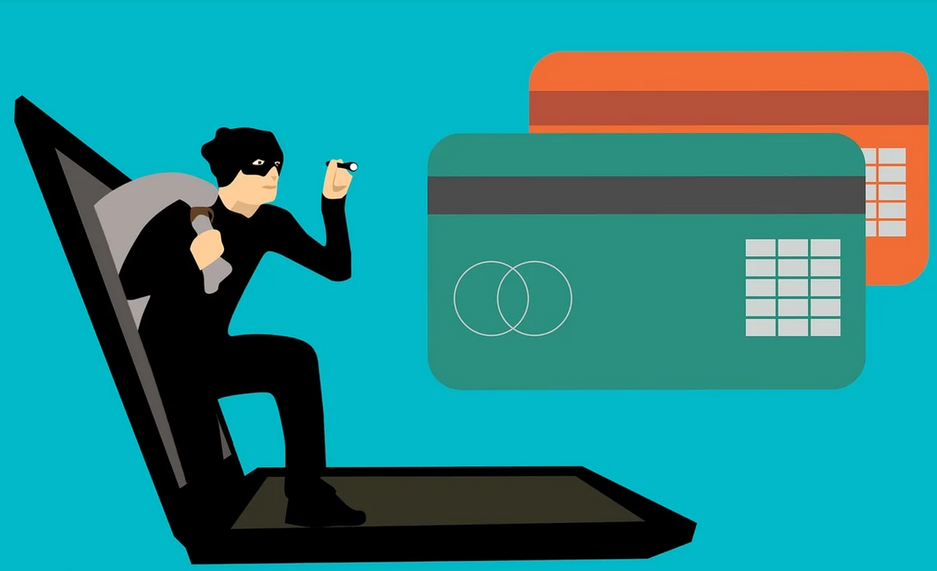
Personal Account Phishing (Image)
Personal Account Phishing
Image Source: https://pixabay.com

Slide 9
Personal Account Phishing
Common Examples Include
Tricking you into revealing your financial details by pretending to be your bank.
Getting your password by asking you to log on to your account.
Installing malware or ransomware on your computer.
Getting you to input account credentials on their fake site.

Slide 10
Organization Phishing
When an attacker targets a business, it is often after something more specific.
These types of ransomware will also very often contain information about the company.
Phishing attacks are almost always the first step for an attacker getting access to a company’s network for a data breach.

Slide 11
Organization Phishing
Common Examples Include
A request from the CEO to transfer them money.
Emails spoofed to look internal to a company.
An email from a potential supplier, vendor, or client containing an attachment.

Slide 12
Types of Phishing Attacks

Slide 13

Different Types of Phishing Attacks
Image Source: https://pixabay.com
There are many different types of phishing attacks. The difference is the method used to contact the victim.

Slide 14
Email Phishing
By far the most common type of phishing.
The sender will try to collect personal or financial information.
These emails will try to get you to click on a link or attachment in the email which will either infect your computer or take you to an illegitimate website.
They will often impersonate a real organization such as Facebook, Apple, Google, or a bank.

Slide 15
Contest Winner / Money Recipient
They are likely trying to get your personal information, and potentially money.
These will say you won/received a prize or money and ask for personal information and/or money in order to send it to you.
Real example from the inbox:
  “My boss have decided and instruct me to contact you secretly to transfer the sum of $55.5M, to claim it, provide us your full name, address and proof of a copy of a recent tax return”

Slide 16
Friend / Family Needs Help
They are trying to get money in the example listed below.
This involves some spoofing; a hacker will pretend to be a friend or family member asking for money.
Real example from the inbox:
  “Hi, this is your cousin XXXXX, I know it’s been a while but I need some help, I am stuck in Spain and need to get home. Could you please send me $200 for a plane ticket? I’ll pay you back when I get home, please send an etransfer to YYYYY”

Slide 17
Issues with Your Account
They are trying to get your username and password for the service.
Involves someone pretending to be a big company, saying there is an issue with your account.
Real example from the inbox:
  “We have found an error with your YouTube account, please sign in with the link below to
  fix it”

Slide 18
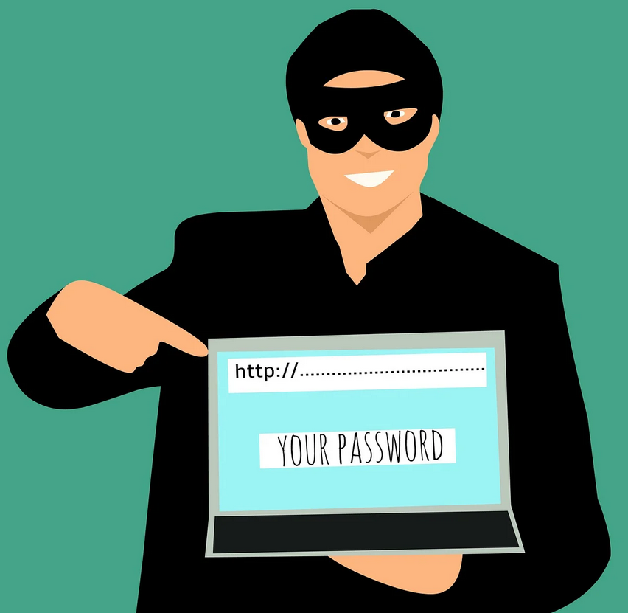
Issues with your Account (Image)
Issues with Your Account
They are trying to get your username and password for the service.
Image Source: https://pixabay.com

Slide 19
CRA Tax Return (1 of 2)
A specific example around tax season.
These emails will usually have one of two flavours:
  You have gotten a high tax return.
  There are issues with your return.
Real example from the inbox:
  “Hello, we regret to inform you that you’re being audited, please click here to see the details”

Slide 20
CRA Tax Return (2 of 2)
The CRA will never include a link in an email.
Legitimate CRA emails will say something to the
effect of…
  “Hello, you have an unread email in your CRA account inbox, please log in to the account to see the details”
It will not contain a link; it will tell you to access the website on your own to view it.

Slide 21
Random eTransfers
The scammer is trying to get your financial information.
The spelling mistake in the example is intentional, while the message looked legitimate, it had spelling errors that can also tip you off.
Someone sent you an eTransfer.
These can look very legitimate, but the sender can tip you off.
Companies will not send you eTransfers.
Real Example from the inbox:
  "Google has sent you a deposit of $1,000, click here to logon to your account and despoit it”

Slide 22
Account Expiring
The scammer is trying to get your account information.
These will say your account for a service is about to expire, and you should click the link to renew it.
Real example from the inbox.
  “Hello, your apple account is set to expire tomorrow due to inactivity, to renew it and avoid losing your information and downloads, please visit (shady link here)”

Slide 23
Virus / Compromised Account (1 of 2)
The scammer is trying to get your personal and account information.
An email informing you that you have a virus on your computer.
An email informing you that your account has been compromised.
Both will get you to click a link or attachment and enter information to fix it.

Slide 24
Virus / Compromised Account (2 of 2)
The scammer is trying to get your personal and account information.
Real examples from the inbox:
  “Your computer has a virus, please click this link to start cleaning your computer now.”
  “Oh no! Someone has compromised your Facebook account, please see the attachment to learn how to fix it”

Slide 25
Smishing
A type of phishing attack that involves sending SMS (text messages) to the victim.
This will often involve a link being sent to you from your service provider or an unknown source that will attempt to get you to reveal personal information (via logon or otherwise).
Often, these will be a message pretending to be from Apple, Google, your phone service provider, or a bank.

Slide 26
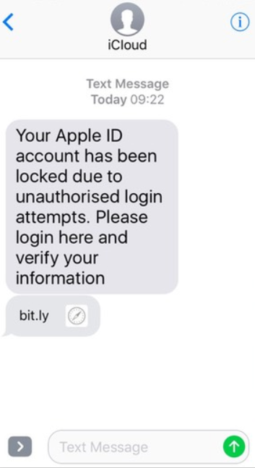
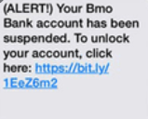
Examples of Smishing

Slide 27
Vishing
Vishing is voice phishing.
This is a very common method of attack, as it takes advantage of the victim’s lack of knowledge or fear of repercussions.
Often, they will try to get you to pay money for them to “fix” the problem.

Slide 28
Examples of Vishing
Calls from the “CRA” claiming that there is a warrant out for your arrest unless you speak to an agent.
  This takes advantage of people’s fear of getting in trouble with the law.
Calls from “Microsoft” claiming that they have discovered viruses on your computer.
  This takes advantage of people who are not as familiar with computers.

Slide 29
The Job Posting
A posting from a company with little to no information or pretending to be a larger company.
Once you apply, they will email you asking you to give them more information.
They will offer you the job without an interview, or with only a phone interview.
They will then ask for your financial information.

Slide 30
Example of Job Posting
“Hi Julie,
Thank you for applying to be our sales consultant, we are happy to offer you the job. We will pay you a rate of $23 per hour 35 hours a week.
Please email me with the attached form to indicate your acceptance.”

Slide 31
Story – CRA Phishing

Slide 32
Story - CRA Phishing (1 of 2)
The first time I did my own taxes I was sort of nervous wondering if I did them correctly.
About two weeks after I submitted it, I got an email saying that there was an error with my submission, and I was to be audited.
If I did not comply and check the message and follow their next steps, the fines would increase.

Slide 33
Story - CRA Phishing (2 of 2)
I had my parents look at the email and my return before clicking the link.
They were able to determine that it was a fake CRA email, as the CRA will not tell you to click a link in an email.
It was a scam to infect my computer with malware and collect sensitive personal information.

Slide 34
Story – What Could Have Happened?
My computer, and potentially my entire network of devices, could have been infected with malware.
My personal and financial information could have been compromised.

Slide 35
Story – Lessons Learned
Think before you click – read the email thoroughly, look at the email sender, hover over the link to see where it directs to but do not click it.
Be aware of scammers pretending to be the CRA or other companies.
  They will not tell you to click a link in your email, they will tell you to separately log on to your account and check your inbox there.

Slide 36
What Should I do if I Clicked a Phishing Link?

Slide 37
I Clicked on a Link, What Should I do?
If you click on a phishing link, there are five steps to do immediately:
  Do not enter any information.
  Disconnect from the internet.
  Backup any important files.
  Run a virus scan.
  Change all your passwords using a separate device.

Slide 38
Why Do I Need to Disconnect?
Disconnecting your device from the Internet after clicking a phishing email will stop the virus from infecting other devices on your network.
It will help stop an attacker from stealing important confidential data from your computer.
If your device is not connected to Wi-Fi, the attacker cannot remotely access or control it.

Slide 39
Why Backup Files?
Backing up your files will allow you to access them once you get rid of the malware.
To do this, use an external hard drive or USB stick.
If you backup your files regularly you will not need to do this unless there are any new files that you need since your last backup.

Slide 40
Why Run a Virus Scan?
A virus scan will help you determine if your computer has been infected and the scope of the infection.
Once the virus scan is complete, you should be able to quarantine or delete the threat.

Slide 41
How to Run a Virus Scan?
It is worth running several different virus scans (using different programs).
It is also worth running a boot virus scan.
If you are not sure how to do this, it may be worth having a professional help you with this.
You may need to complete a system restore or recovery depending on the scope of the infection.

Slide 42
Why Change my Passwords?
Changing your passwords ensures that the hacker cannot access any accounts compromised by the phishing attack.
You should change the passwords on a different device rather than the one compromised.

Slide 43
Conclusion

Slide 44
Protect Yourself from Phishing (1 of 6)
The most important thing when it comes to stopping phishing attacks is to pay attention to what emails, texts, and phone calls you receive.
Do not click on hyperlinks or attachments unless you were expecting one and know where/who it came from.
Think before you click!

Slide 45
Protect Yourself from Phishing (2 of 6)
Pay attention to the sender and double check to make sure it is coming from an email address you recognize or would expect.
Phishing scams will very often claim you won a prize to get you excited, do not be tempted by it.
Companies will not just ask you for your information over text and email.

Slide 46
Protect Yourself from Phishing (3 of 6)
If a friend, colleague, company, or organization contacts you and you were not expecting it, or it seems out of place, consider the following:
  Try to contact them another way, for example if they emailed you, call them.
    Do not use a phone number provided in the email. Call the number posted on their secure, verified website.

Slide 47
Protect Yourself from Phishing (4 of 6)
If a friend, colleague, company, or organization contacts you and you were not expecting it, or it seems out of place, consider the following:
  If you decide to email back to check for validity, start a separate email directly to the correct email of the person you are trying to reach.

Slide 48
Protect Yourself from Phishing (5 of 6)
Look over the content of the email to make sure it is what you would expect from that person/company.
  If it is littered with spelling/grammatical errors, it is probably not legitimate.
  If it is claiming you won a prize you did not enter to win, it is probably not legitimate.
  Emails that have small amounts of content, asking you to click a link, are probably not legitimate.

Slide 49
Protect Yourself from Phishing (6 of 6)
Know the common phone phishing scams (vishing) so you can recognize when it is not real.
Examples include:
  The CRA does not call you to threaten you with prison unless you speak to them.
  Microsoft will not call you about computer viruses.
  Duct cleaning services are not legitimately calling you to get you an estimate on cleaning your ducts.

Slide 50

Canadian Internet Registration Authority (CIRA)
These modules were made possible by the contributions of CIRA and their Community Investment Program.

Slide 51
References (1 of 2)
Mash, Marina. "Dear YouTubers, phishers are after your accounts." Kaspersky, 7 May 2019, www.kaspersky.com/blog/youtube-channel-owners-phishing/26894/. Accessed 25 Nov. 2020.
"Re-Hashed: Phishing Email Examples — The Best & Worst." HashedOut, 21 Oct. 2020, www.thesslstore.com/blog/phishing-email-examples-the-best-worst/. Accessed 25 Nov. 2020.

Slide 52
References (2 of 2)
"What Is Phishing?" Phishing.org, www.phishing.org/what-is-phishing. Accessed 25 Nov. 2020.
Ahmed, Arooj. "A Phishing Scam Is Targeting Instagram Users To Steal Email And Instagram Credentials." Digital Information World, 3 Sept. 2020, www.digitalinformationworld.com/2020/09/a-phishing-scam-is-targeting-instagram-users-to-steal-email-and-instagram-credentials.html. Accessed 25 Nov. 2020.
"What to Do if You Click on a Phishing Link?" The Defence Works, 23 Aug. 2019, thedefenceworks.com/blog/what-to-do-if-you-click-on-a-phishing-link/. Accessed 25 Nov. 2020.

