Slide 1
Social Media Security

Slide 2
What Will You Learn?
Gain a better understanding of how to protect yourself online through your social media settings.
Security and privacy settings and concerns for social media platforms.
What social engineering is and how it relates to social media.
Learn about geotagging.

Slide 3
Social Engineering and Other Threats

Slide 4
Social Engineering
“Social engineering is the act of tricking someone into divulging information or taking action, usually through technology. The idea behind social engineering is to take advantage of a potential victim’s natural tendencies and emotional reactions.”
  --Norton
Rather than trying to hack into your computer or accounts, the hacker will try to get you to give them your information freely.

Slide 5
Examples of Social Engineering
General examples include:
  Fake emails from companies saying there is an issue with your account and asking you to log in and fix it.
  Phone calls reporting a virus on your computer, asking for information about your devices.
  Messages from the CRA telling you that you either received a huge refund or are being audited and you need to provide money or information.

Slide 6
Examples of Social Engineering (cont.)
General examples include:
  Dropping USBs in a parking lot in hopes that someone will pick them up and insert their computers.
  A text message telling you there is an issue with your cell phone account.
  A random link in a Facebook message from someone you don’t know.

Slide 7
What do they have in common?
All the previous examples are non-technical.
The scammer is trying to appeal to your emotions and instinctive reactions to get you to provide personal information or money.
These types of attacks are often not targeted: they often use the same method on a variety of people, as they know someone will fall for it eventually.

Slide 8
Targeted Social Engineering Attempts
There are both personal and organizational targeted social media attempts.
Personal attempts don’t mean that the person knows you or has a personal reason to scam you, just that they are using your personal information for the attempt.
Organizational attempts involve targeting multiple users at an organization to gain access to it.

Slide 9
Targeted Personal Social Engineering
Personal attempts consist of hackers using information about you to scam or impersonate you.
For example, if they know you bank with CIBC, they will try to send a fake CIBC email.
  Using the above example, they could also pretend to be you and get access to your accounts.
Example of Social Engineering with Vishing

Slide 10
How Social Engineering Impacts Social Media (1/2)
Social media networks contain a ton of information about users and have wide user bases.
Everyone who uses a service has information about them, potentially including:
  Email addresses or phone numbers, photographs, ages, birthdays, friends/followers, geographical locations.

Slide 11
How Social Engineering Impacts Social Media (2/2)
People may not be aware of what they are sharing, who they are sharing it with, or how the information could be used against them.
By default, social media platforms have very minimal security and privacy settings enabled.
Most platforms don’t tell you who is looking at your profile, or what they’re accessing on it.

Slide 12
Examples of Social Engineering (1/5)
Quizzes and games trying to elicit personal information.
  “Want to find out your superhero name? The first half corresponds with your birth day and the second half corresponds with your birth month”.
  “Enter your first crush, full name, mother’s name, home city…. Tag 10 of your friends”.

Slide 13
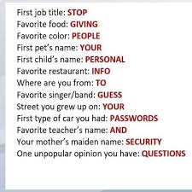
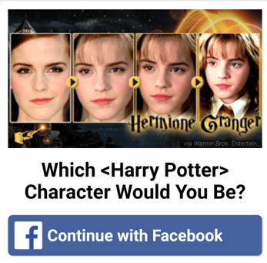
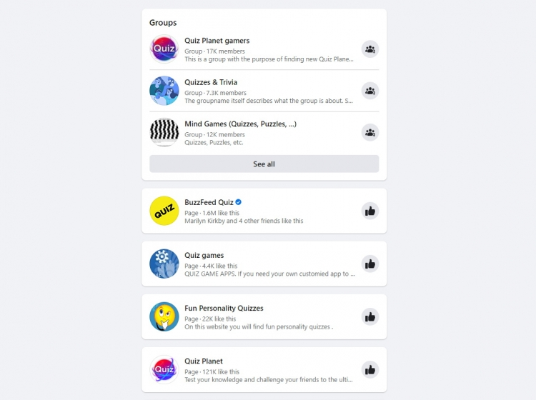
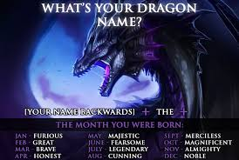
Examples of Social Engineering (2/5)

Slide 14
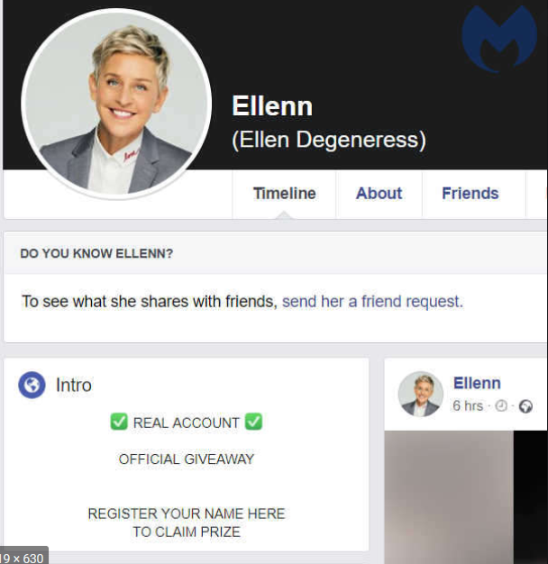
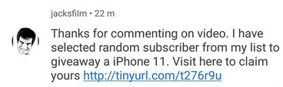
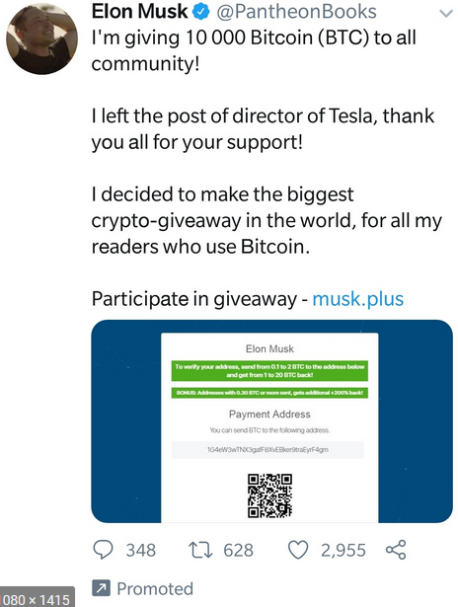
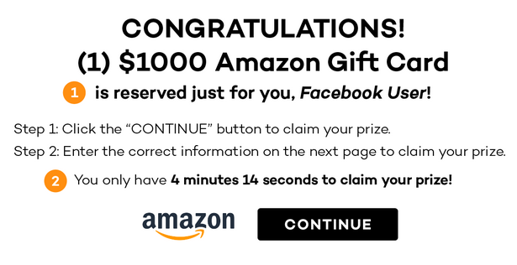
Examples of Social Engineering (3/5)
Fake giveaways of expensive products.
  “Click the link below for a chance to win AirPods”

Slide 15
Examples of Social Engineering (4/5)
Emails saying that your social media account has been compromised and asking you to enter information or click a link to fix it.
Users with little information adding or messaging you.
People pretending to be friends, family or coworkers.
Games and applications asking for a lot of personal information or access to photos.

Slide 16
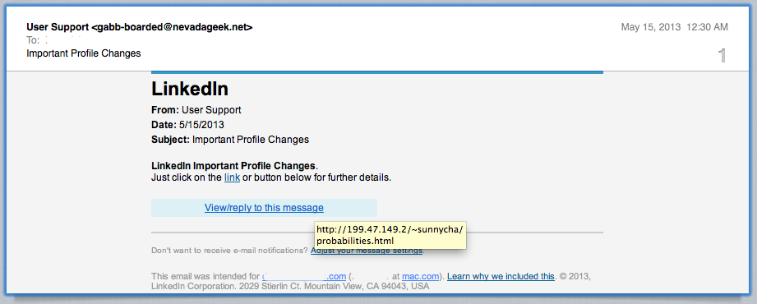
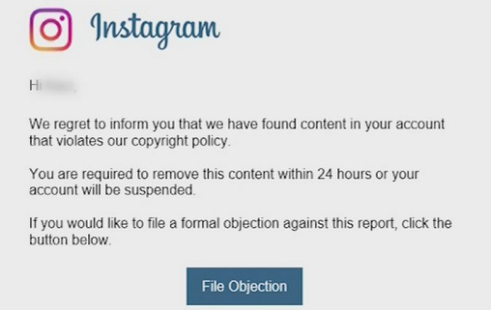
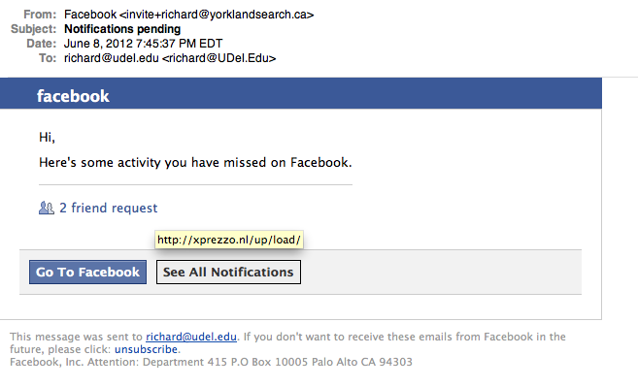
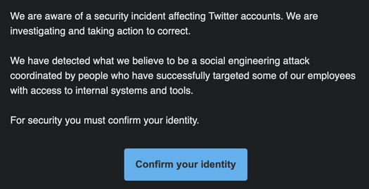
Examples of Social Engineering (5/5)

Slide 17
How to Avoid Social Engineering (1/3)
Do not share personal information.
Even if it seems unimportant like your dog’s name, hometown or favourite movie.
  These are common security questions.
If you get a suspicious message or see a suspicious post from someone you know, do not click it, and verify they sent it via phone or email.

Slide 18
How to Avoid Social Engineering (2/3)
Think before you click links in posts or emails.
  Giveaways that seem too good to be true probably are.
  If you get an email from a platform asking you to enter your details or click a link, do not do it
  Hover over links to see where they redirect to.
Only add people you know on social media.

Slide 19
How to Avoid Social Engineering (3/3)
Be careful with the applications you install on your devices and social media platforms.
Avoid putting financial information on social media
  For example, do not use your credit card to pay for items in a Facebook game.
Don’t post anything online that you wouldn’t be okay with anyone in the world seeing.
Edit your security and privacy settings.

Slide 20
Phishing
Phishing is a type of cyberattack which involves contacting someone through email, phone, websites, or text message in order to spread malware, or obtain personal and/or financial information.
As discussed earlier, the large user base of social media accounts allows hackers to widely target people with phishing scams.
  Most people use at least one platform.

Slide 21
Phishing on Social Media
Common Examples Include:
  “There is an issue with your account, enter your credentials below to resolve issues”.
  “Your account has been compromised, click here to secure your account”.
  “You have a new message, please click below to login”.
  “5 people have added you, login here to respond”.

Slide 22
How to Avoid Phishing
If a message seems suspicious or has a lot of spelling errors, ignore it.
Do not enter your credentials into the email.
Hover over links to see where they direct to.
Do not click links in the email, instead, open your social media app or visit the web page directly through your browser.

Slide 23
Theft
If someone compromises your social media account and you use the same password for financial accounts, they will have an easier time of getting into those accounts.
Third party applications and games which are based around getting you to purchase things using a credit card are common.
  Some of these may be designed to collect your information.

Slide 24
How to Avoid Theft
Use different long, complex passwords for all accounts.
Do not share personal information online.
  Avoid completing quizzes or questionnaires asking for personal information.
Carefully consider the applications you install and what information you share with them.
Do not share your financial information with applications on social media.

Slide 25
Robbery
Sharing information about yourself, such as where you live can put you at risk.
  Geotagging, either intentionally or automatically, can alert individuals to when your home may be unoccupied.
If you share pictures or information about what you own, it may make you a more attractive target to a robber.

Slide 26
Story - Robbery

Slide 27
Story – Robbed After Posting Vacation Photos
At a previous job, a coworker had mentioned being robbed while being on vacation a few years ago.
They had posted pictures of themselves in Cuba for two weeks.
At some point during this time, someone broke in through a window and stole their television and gaming systems.

Slide 28
Story – How did this happen?
The coworker had posted vacation photos of her family, letting the culprit know that no one was home.
The culprit already knew their address, either through previous geotagging, or knowing the victim personally.
If their profile security settings were minimal, random people could find them.

Slide 29
Story – Lessons Learned
Be careful with what you post online.
Ensure your privacy and security settings are up to date.
Disable geotagging on pictures and posts.
If you go on vacation, wait to post pictures until you get home.

Slide 30
Stalking and Cyberbullying
Previous coworkers, friends, romantic partners, and random people and groups can use social media to find out information about you and find your location.
Social media can provide stalkers with a ton of information including your location, common places you go, your network and how to get a hold of you.
Your personal information could also be used to bully, harass or threaten you.

Slide 31
Fake Users
Fake accounts are created on social media sites for many reasons including:
  Spreading malware
  Gathering personal information
  Trying to scam people
  Stalking
Fake accounts may be created by random people, or potentially people you know.

Slide 32
Identifying Fake Users
Fake accounts will often have little to no content or photographs.
A way to identify a fake user is if they are a user with a lot of connections or friends from multiple geographical locations.
They will send generic or short messages.

Slide 33
Fake Users – Impersonators (1 of 2)
There are two kinds of impersonator accounts:
  People in your network
  Celebrities
Impersonator accounts are used to spread malware and steal personal and financial information.
Celebrity impersonator accounts can also be used for reputation damage.

Slide 34
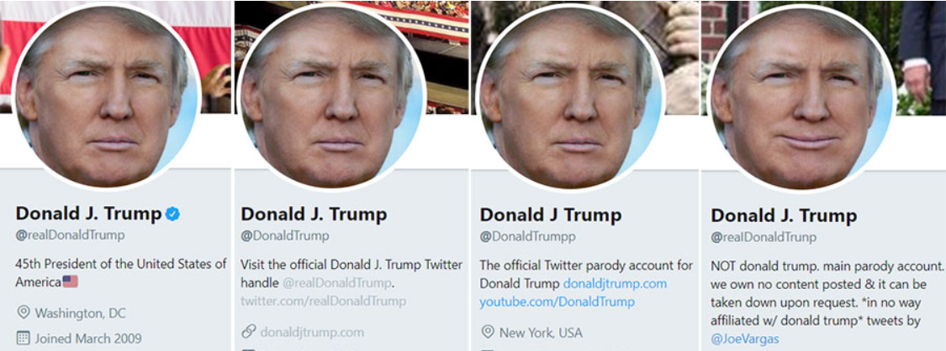
Fake Users – Impersonators (2 of 2)
Which one of the below is real?
  How can you tell?
  What problems could these fake accounts cause?

Slide 35
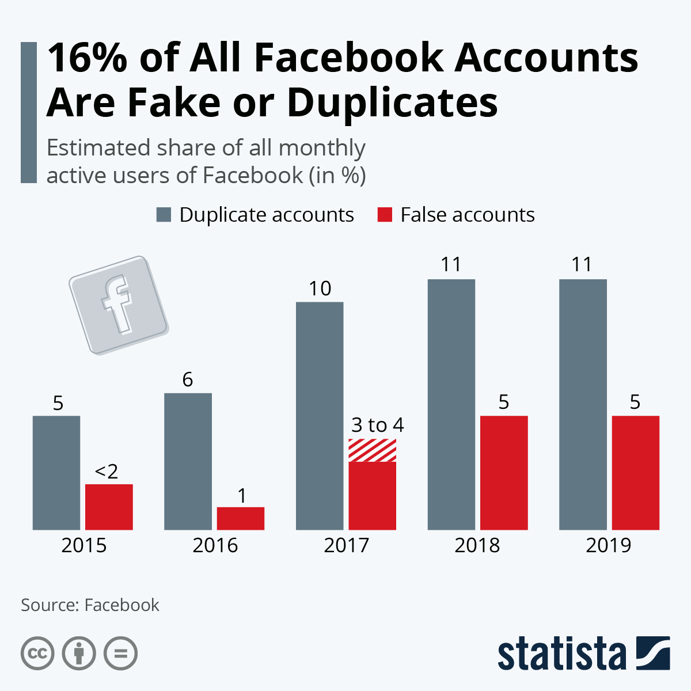
Fake User Statistics
Source:https://www.statista.com/chart/20685/duplicate-and-false-facebook-accounts/

Slide 36
Conclusions

Slide 37
In Conclusion (1 of 3)
Think before you post
  Do not share private information on social media
  Only share posts, information and pictures you are comfortable with the whole word seeing
Think before you click
  If an email, post or message seems suspicious, has spelling or grammatical errors, is too good to be true or has a sense of urgency, don’t click it

Slide 38
In Conclusion (2 of 3)
Enable two-factor authentication on social media platforms.
Edit your privacy and security settings on all social media platforms.
  Be aware of who can see your information, and if it is publicly searchable.
Use different long, complex passwords for all social media accounts and all other accounts.

Slide 39
In Conclusion (3 of 3)
Be careful with which third party applications you use through social media.
Always lock your devices when not in use.
Disable location services.
Manage your networks, don’t add people you do not know.
Be aware of common social media threats and look out for them.

Slide 40

Canadian Internet Registration Authority (CIRA)
These modules were made possible by the contributions of CIRA and their Community Investment Program.

Slide 41
References (1 of 4)
"TikTok Privacy Settings." internetmatters.org, www.internetmatters.org/parental-controls/social-media/tiktok-privacy-and-safety-settings/. Accessed 10 Dec. 2020.
"13 Social Media Security Best Practices." Fraud Watch International, Jan. 2019, fraudwatchinternational.com/social-media/social-media-security-best-practices/. Accessed 4 Dec. 2020.
"Social Media Security Guide." UCLA IT Security, www.it.ucla.edu/security/resources/security-best-practices/social-media-security-guide. Accessed 5 Dec. 2020.

Slide 42
References (2 of 4)
Doffman, Zak. "Is TikTok Spying On You For China?" Forbes, July 2020 www.forbes.com/sites/zakdoffman/2020/07/25/beware-tiktok-really-is-spying-on-you-new-security-report-update-trump-pompeo-china-warning/?sh=17006d454014. Accessed 1 Dec. 2020.
Doffman, Zak. "Warning—Apple Suddenly Catches TikTok Secretly Spying On Millions Of iPhone Users” Forbes, June 2020 https://www.forbes.com/sites/zakdoffman/2020/06/26/warning-apple-suddenly-catches-tiktok-secretly-spying-on-millions-of-iphone-users/?sh=feccc334ef05. Accessed 1 Dec. 2020.

Slide 43
References (3 of 4)
Patterson, Dan. "Facebook data privacy scandal: A cheat sheet." TechRepublic, July 2020, www.techrepublic.com/article/facebook-data-privacy-scandal-a-cheat-sheet/. Accessed 7 Dec. 2020.
"Protect your account, Edit Account Privacy." Pinterest, help.pinterest.com. Accessed 10 Dec. 2020.
Symanovich, Steve. "What is social engineering? Tips to help avoid becoming a victim." Norton, July 2018, us.norton.com/internetsecurity-emerging-threats-what-is-social-engineering.html. Accessed 6 Dec. 2020.

Slide 44
References (4 of 4)
"Privacy Settings." Snapchat, support.snapchat.com/en-US/a/privacy-settings2. Accessed 10 Dec. 2020.
"15 Social Networking Safety Tips." Norton Security Online, www.nortonsecurityonline.com/security-center/15-social-networking-safety-tips.html. Accessed 6 Dec. 2020.
"An update on our security incident." Twitter Inc., July 2020, blog.twitter.com/en_us/topics/company/2020/an-update-on-our-security-incident.html. Accessed 14 Dec. 2020.

