Slide 1

Effective Group Presentations
Creating unity from diversity
Created for the writing centre by Carol shields, 2010
Notes:
Open the topic of group presentations by asking what students may have noticed in good or poor presentations they’ve seen.
Suggest that problems we see in the final presentation are often caused much earlier in the process.
Ask: So, what are your teachers looking for? (Go to slide 2).

Slide 2
Characteristics of Effective Group Presentations
The message, organization, and style are UNIFIED.
The presentation looks and sounds CREDIBLE.
The important ideas in the presentation are CLEAR to the audience.
Each speaker is ENGAGING and holds the attention of the audience..
Notes:
Where possible, tie students’ earlier comments to the principles of Unity, Credibility, Clarity & Audience Engagement.
Let’s explore each of these in more detail; for example, what do we mean when we say things are ‘unified’? (next slide)

Slide 3
The Presentation is Unified
The group appears well-organized – they work as a team.
Ideas flow logically throughout the whole presentation, not just in each speaker’s section.
Any repetition between speakers is planned and meaningful.
Transitions between speakers are smooth.
Visuals have a unified look.
Notes:
When the group works and speaks as a team, we often don’t notice the teamwork because things go very smoothly.
When the teamwork isn’t there, we DO notice. For example, we notice when we have to sit through John saying the same thing Sarah said two minutes ago – good way to anger an audience, especially if presentations run over time because of needless repetition. Or when the conclusions have nothing to do with the content in the body.
Pet peeve as a teacher: Jim says to Frances, “Are you done? What? Me now? (points to crumpled paper) This part?” The transitions are unplanned and Jim has no clue what he’s doing. What a waste of time for all of us in the audience. Jim clearly doesn’t care about the experience he’s giving us (or his teammates!).
Another favourite: three different slide show templates, 6 different fonts, and the same picture twice in the PowerPoint presentation. Don’t do it!
An side-effect of this disorganization is that you seem not to know what you’re doing. You will lose credibility with your listeners (next slide).

Slide 4
The Presentation is Credible
The content is of high quality
  Information comes from credible sources.
  Visuals are clear and sharp, and operate smoothly, without technical problems.
Each group member knows his/her material thoroughly and how it fits into the whole.
  No one reads his/her part from a screen or paper.
  All speakers can answer questions or comment on the overall message.
Each group member looks and sounds professional.
  Clothing, physical presence, and expression are professional and positive.
  No one stumbles over new vocabulary – the pronunciation is correct.
  There are no spelling or grammar errors in visual parts of the presentation.
Notes:
Credibility is about being believable. We usually associate this with quality of information, knowledge of the material, and professionalism.
Sources: Your professor will usually be clear about the types of sources that you’re required to use (e.g. “no Wikipedia”; professional journals only; must include primary research). If the prof doesn’t say, ASK. Generally speaking, ‘any ol’ website’ won’t cut it in post-secondary. More information about finding excellent sources can be found in the Library (and here in the Comm Centre) – the staff are very friendly and helpful. Bring your assignment requirements with you and let them help you. It’s FREE!
Knowledge of Material: I always know when someone doesn’t know their stuff. A) they’re reading it off the paper, and B) they’re stumbling over complex sentences and mispronouncing words. Clearly, someone else has written it, and they’re just reading it for the first time today. Don’t do that. Know your stuff. Know your partners’ stuff. Be ready to deliver your presentation even if Katy has the flu.
Part of credibility is professionalism.
Your mom said to make a good impression – she was right. Attention to the details makes a difference (Even if you’re a little underprepared, you can sometimes make up for it by looking and sounding as professional as possible.)
NEVER make a mockery of the assignment or tell us that your presentation is in any way substandard.
Especially if Canadian English is your second language or dialect, please take the time to check the pronunciation of the vocabulary, especially of key words and technical terms. Even if English is your FIRST language, check your pronunciation, your spelling and your grammar. You are a TEAM. Help each other (gently and respectfully) with these things!

Slide 5
The Presentation is Clear
The presentation is effectively introduced and concluded.
  The audience understands the purpose and the organization/approach that will be used.
  The audience receives a summary of important ideas at the end.
  The conclusion follows logically from the rest of the presentation.
Notes:
Clarity is about getting your ideas across to the audience in a way they understand. The way the introduction, body and conclusion work together should help your key points to come through clearly.
One of the most frequently omitted parts of presentations is the Overview. Give the audience a roadmap for your presentation in the introduction, ESPECIALLY in a group presentation. Your listeners and your professor will appreciate it! For example, you might say, “Our group will share with you some information about Caffeine. Margaret will introduce us to this drug’s origins and to food sources which contain caffeine. Tran will show us some studies of caffeine’s effects, both positive and negative, on humans. Finally, I will suggest, based on other research, how much caffeine we should ingest and how we might reduce caffeine consumption if we are over-using the drug.” Now it’s clear where you’re going and how you’ll get there.
You can’t introduce or summarize anything if you don’t know what it is. The team MUST have a thorough knowledge of the WHOLE presentation and of each speaker’s key points in order to introduce or summarize the content accurately. (I have seen conclusions that completely contradicted what had been said by another speaker. Not good.)

Slide 6
The Presentation is Clear (cont.)
Examples are provided that clearly illustrate concepts for the listener(s).
  Examples are relevant, and the connection between the illustration and the concept is made clear for the listeners.
  The delivery is calm and clear; the audience can easily take in the ideas.
Any visual aids communicate ideas effectively
  They are clearly labelled.
  Speakers communicate with the audience about what information they want the audience to notice in charts, graphs or illustrations.
Notes:
In the body, clarity involves helping the audience to understand each key point.
Without examples or illustrations, many of us won’t fully understand new concepts or general principles.
SLOW DOWN. We take in information less quickly when we listen, compared to when we read, so don’t let your nerves dictate your speed. Speak calmly and leave pauses between your ideas so that the audience can digest them.
Another common error is showing visual elements like charts or images without saying anything about them or even labelling them! A title is very helpful to the audience, and the identification of the source is important. Tell us what we’re looking at and where you got it! And tell us what you want us to see. Here’s an example (next page):

Slide 7
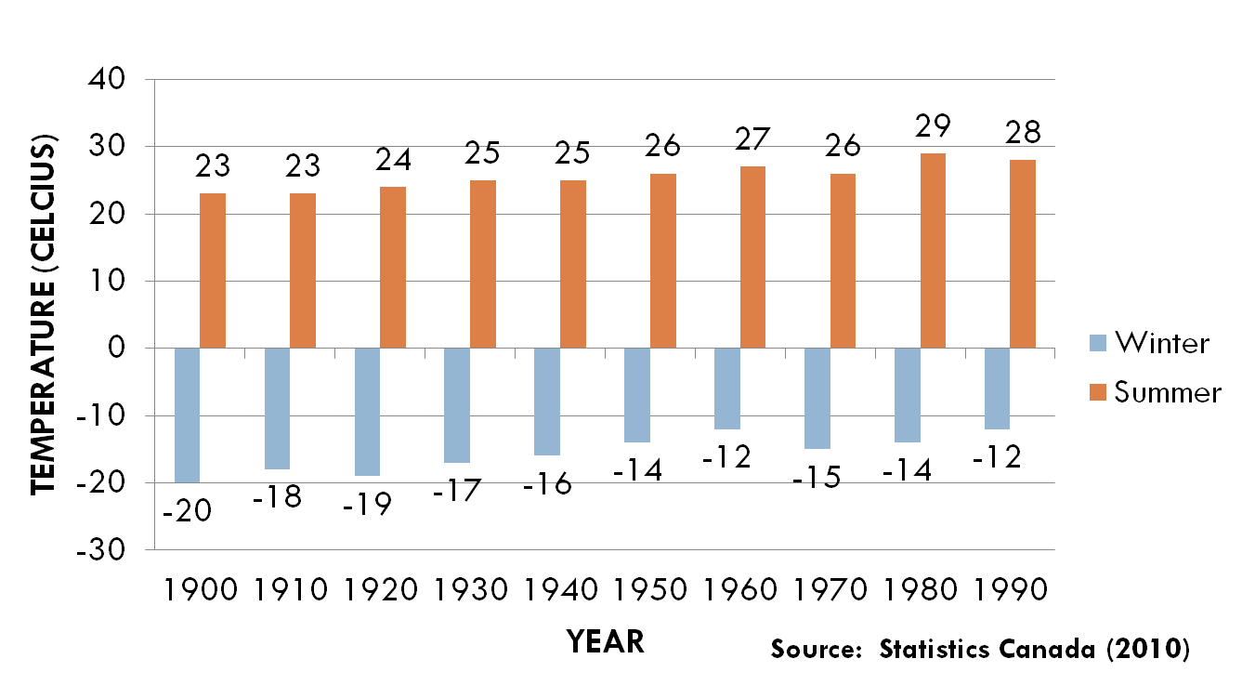
Figure 2: Average Hamilton Temperatures (1900-1999)
Notes:
I tell the audience what they’re seeing, and I name my (very credible) source:
“These bars represent the average temperatures in Hamilton over the last 100 years in the summer and winter, according to Statistics Canada.”
I tell them what I want them to notice:
“Notice that, although temperatures have gone up and down, they have gradually increased overall. At the bottom of the chart, you can see the average for every 10 years. Note that there has been an overall increase, in both summer and winter, of about 6 degrees celcius over the last 100 years – an average of .6 degrees celcius every 10 years.”

Slide 8
The Presentation is Engaging
Each speaker makes effective eye contact with the audience.
Each speaker’s physical presence is positive and enthusiastic.
Each speaker uses information and examples that are relevant or useful to the audience.
Speakers use questions or activities to actively involve the audience.
During each speaker’s part, other team members demonstrate respect and courtesy toward that speaker.
Notes:
To ENGAGE an audience is create a situation where their minds are actively involved in what you’re saying. It’s extremely important to connect with your audience.
Think of professors whose classes you’ve enjoyed: they didn’t read words at you from a book in a boring tone, did they? READING AT is very different from SPEAKING WITH – eye contact matters. Delivering a set of words you seem not to care about is very different from sharing ideas enthusiastically - your attitude matters.
Forgetting your audience’s needs and interests is a common error. Connect your messages to their lives: “The next time you pull up to the drive-through window, notice X…” or “In our classroom, this principle can be applied to the following situation: imagine such and such…” You can also ask them to participate actively in the presentation.
We don’t want to distract the audience’s focus – to disengage them. We want them to focus on the current speaker and his/her message. If it’s not your turn to speak, sit down, be still, and look interested.
A note: If you are angry with a teammate on presentation day (it happens), be professional and put that aside. All presentations are about the AUDIENCE. We don’t want to witness your interpersonal drama. Demonstrate respect for your teammate, for the assignment (i.e. your professor and your education) and for your listeners. You don’t solve anything by ruining your presentation grade.

Slide 9
How to Get it Done
A Unified, Credible, Clear, and Engaging presentation begins with attention to the process:
  Understand the goal of the project. Read instructions carefully.
  Agree on clear tasks, expectations and deadlines.
  COMMUNICATE well and frequently. Solve group problems immediately.
Notes:
The minute you get a group assignment, get your team’s contact information. Email that they USE, cell #s, etc.
Everyone has to have a common understanding of the goal, or you will struggle – everyone in the boat will be rowing in different directions.
Everyone has to have a common understanding of each person’s tasks, of the level of work expected, and of deadlines.
Everyone has to be in the loop all the time. All emails must go to everyone. All new information must be shared with everyone. All meetings must be attended by everyone.
If you do this, it’ll work. If you don’t, you’ll be the people in my office complaining about group work and whining because your group is frustrated and falling apart. You can’t be a lone wolf, a ghost, or a burden on a successful team. You just can’t. Give it up. Get on the train or get out of the group.
Having trouble with a group member? It happens. Talk to that person honestly and clearly IMMEDIATELY. Do NOT wait until the member has missed three meetings and finally shows up with half-completed work scribbled on a crumpled piece of paper. By that time, everyone is angry and emotional. The FIRST time a deadline is missed or a task doesn’t meet expectations, deal with it by focusing objectively on the action or situation, the problem it causes for the group, and what is needed to solve the problem.
First, check to see that you had the same understanding of the task, expectations and deadline: “Juan, you were responsible for bringing research about headphones to today’s meeting, right?” The member may or may not have a reason for not completing the task, or may have misunderstood the deadline; that’s fine. However, there is still an impact on the group. Be clear what the problem is: “I understand your situation and why you couldn’t bring the data today. Still, Susan has the job of organizing the data, and that puts her behind schedule. That’s stressful for her, and it could affect the overall project schedule.” Be clear what you need, and give the person an opportunity to fix the problem. “The team needs Susan to get going with that data. When can you have it for her?” If you give the person a chance to participate in creating the deadline, he can’t say that you imposed it on him – he created and agreed to it. Negotiate the new task: “Susan, does Friday work for you? OK, so we’re agreed that you’ll have that to Susan by Friday, correct?” Finally, be clear about the consequences. “Juan, we know you’re busy this week and that you had a situation that caused you to miss the first deadline. So you’ve suggested a new deadline and we need you to meet it. If you don’t meet it, we’ll really be behind and we’ll need to go to the prof.” If Juan misses the second deadline, you have every right to be upset and Juan shouldn’t be surprised when you say, “OK, it’s time to see the prof. because the project is behind schedule and we need some help.” At that point, the whole group (yes, Juan, too – don’t be cowardly) should meet with the prof. to advise him/her of the situation, and to ask for advice about how to proceed. You may or may not be able to drop Juan as a group member. At the very least, the professor will be aware that you are having problems and that you are actively trying to solve them as a group.

Slide 10
How to Get it Done: Compose
Preparing the content:
  Do good research – get help from the Library or your professor to access the best possible sources.
  Figure out how best to share each piece of data:
    Should this be a chart? A graph? A spoken section?
    How would YOU best understand the idea?
  Create an outline and a draft of any visual presentation (e.g., PowerPoint, overheads, physical samples)
Notes:
http://brain.mohawkcollege.ca
Get together to show each other the data you’ve collected. Sometimes other group members, who are not familiar with your research, can help you to figure out how to share your data. They might say, “I don’t get it. Give me an example,” or “I need to SEE that – how about making a chart?”

Slide 11
How to Get It Done: Edit
Once you have completed your research:
  Coordinate your data – eliminate redundancy and look for gaps in your information.
  Check the assignment – have you covered all requirements or do you need more/different data?
  Look at logical flow and overall consistency of your organization.
Notes:
At the risk of repeating myself – the key word here is COORDINATE. It’s a team. If you have each done individual research or have split up the jobs, this is the time to come together and to create a single, whole, unified presentation.
Be sure you have everything you need and nothing that you don’t. No missing assignment elements. No redundancy. (Redundancy is USELESS repetition, not PURPOSEFUL repetition.) If you have to go back to the library, that’s OK. If some information that you gathered isn’t the right thing or is redundant, oh, well. Be open to changing things around and to adding and deleting data.

Slide 12
How to Get It Done: Polish
PRACTICE! PRACTICE! PRACTICE!
  Time your presentation.
  Check each other for presence and smooth, credible delivery – do you REALLY know your part?
  Note any technological, written, spoken or other problems and fix them. Finalize your script and visuals.
Then PRACTICE AGAIN!
Notes:
Surprise and impress your professor! Meet the time limit given! Be able to pronounce your group members’ first and last names when introducing them! Know your presentation so well that you can actually communicate with your audience! Have NO technical glitches or mispronunciations! Make smooth transitions between speakers! Be a seamless team.
Good luck!

